Slide 1
Qualifications involving more than one degree-awarding body:
Using the Characteristics Statement
Harriet Barnes
Assistant Director, Standards Quality and Enhancement

Slide 2
^{What and why?}
Notes:
Assumption that there is a range of experience and knowledge in the audience – some of you will be very familiar with these types of awards, while for others this will be a new field. So I will set out some context, explain why and what QAA has done so far and then outline the contents of the new publication and suggest how you might want to make use of it.

Slide 3
Qualifications involving more than one degree-awarding body are distinctive because they involve a UK degree-awarding body working with at least one other body empowered to award higher education qualifications in a way that involves some pooling of those awarding powers. Two or more organisations are working together as equals, each with responsibility for the academic standards of the award being made in their name.
This is different from arrangements for working with others where the UK degree-awarding body works with a delivery organisation that does not have degree awarding powers to provide learning opportunities.
Notes:
Or ‘Joint, Double, Multiple, Dual and Concurrent Awards’ – but there are problems with the terminology which I will explain later.
The qualification awarded in this way may be at any level of the Qualifications Frameworks.
The characteristics of graduates of such awards are described in the relevant qualification descriptors and other Characteristics Statements
The Quality Code reserves the use of the term 'partner' for these situations where degree-awarding bodies work together in a way that involves pooling their awarding powers.
It is important to recognize that we are talking only about arrangements where some kind of sharing of degree awarding powers is involved; not ‘standard’ collaborative arrangements, or articulation agreements (or arrangements between two providers with degree awarding powers where only one is exercising those powers)

Slide 4
Drivers
Bologna Process and Erasmus
Joint medical schools
Research collaboration
Growing maturity of delivery organisations internationally

Slide 5
Challenges
The legal authority to award a qualification jointly or otherwise to award a qualification with another degree-awarding body
The potential risk to the security of a degree-awarding body's own academic standards
The recognition by other jurisdictions of qualifications involving more than one degree-awarding body
Providing clarity for students in relation to a variety of arrangements and the potential for inaccurate or misleading information

Slide 6
^{Characteristics statement}

Slide 7
Quality Code context:
Expectation A1
In order to secure threshold academic standards, degree-awarding bodies:
ensure that the requirements of the FHEQ/FQHEIS are met
consider and take account of QAA's guidance on qualification characteristics
where they award UK credit, assign credit values and design programmes that align with the specifications of the relevant national credit framework
consider and take account of relevant Subject Benchmark Statements.
Notes:
The place of Qualification Characteristics Statements within the Quality Code.

Slide 8
Scope – what’s in
The guiding principle is that a qualification involving more than one degree-awarding body is underpinned by a genuinely joint enterprise and partnership between the degree-awarding bodies involved.
Notes:
The Expectation of the Quality Code, Chapter B10 precludes situations where non-UK awarding bodies offer fees for their students to receive a UK degree alongside their own qualification, where the UK degree-awarding body has had negligible input to the design of the programme and little control over its delivery. In these cases, the academic standards and quality of learning opportunities that have led to the UK qualification may not be adequately secured, posing a high risk to the reputation of UK higher education (and contrasts with the oversight involved in franchise and validation arrangements, which enables academic standards and quality to be secured). [this is sort of what the ‘concurrent’ definition was getting at, without going as far as describing it as ‘badging’]
The converse is also possible, where a non-UK degree-awarding body makes an award without the knowledge of the UK degree-awarding body, where a student has completed a programme of study designed to lead to a UK qualification offered through a franchise or validation arrangement. It is contingent on the UK degree-awarding body to maintain awareness of how their programmes and academic credit are used, and to take steps to address any misconceptions that may arise in situations such as this, including making clear the nature of the UK programme and qualification, and ensuring that any marketing materials are not misleading.

Slide 9
Scope – what’s not
professional qualification, professional title or status, or licence to practise achieved alongside the academic qualification of a degree-awarding body
articulation and progression arrangements
an initial joint programme of study followed by separate specialist routes which determine the final qualification
franchise or validation arrangements
Notes:
articulation and progression arrangements, where credit achieved (or learning completed) for an agreed programme of study at one higher education provider is transferred to contribute to the award completed at another provider, the
degree-awarding body - in these arrangements the two learning experiences are paired together but are not conceived as a joint enterprise, and each organisation retains responsibility for its respective component, although the degree-awarding body may have some oversight of the programme of the delivery organisation

Slide 10
Terminology
‘Degree-awarding body' refers both to UK degree-awarding bodies and also to international bodies empowered to award higher education qualifications. These latter may not necessarily be known as 'degree-awarding bodies'.
‘Degree' is used to refer to the final qualification that is awarded by more than one degree-awarding body as an outcome of these arrangements, although in some circumstances the outcome may be a qualification other than a degree.
Notes:
The same principles about how the awarding function is shared apply, in an appropriate and proportional way if the volume of learning involved is smaller.

Slide 11
Categorisation
Co-dependent, mutually contingent qualifications
Integrated but independent qualifications
Notes:
Looking at the models which people told us about through the consultation and events, we established that there are two big buckets for these arrangements – whether you can get one without the other or not. This has consequences for the way the arrangements are managed, because it determines the extent to which there needs to be joint decision making.
This is not dependent on both degree awarding bodies using the concept of learning outcomes – the term is used here as a shorthand for ‘criteria a student has to meet to gain the award’. That might be learning outcomes, but it could also be time served, completion of compulsory elements etc.

Slide 12
Co-dependent, mutually contingent qualifications
Students must fulfil the requirements of all degree-awarding bodies involved; receipt of the final award(s) is dependent on students achieving a single, shared set of criteria
This includes:
Joint and double/multiple degrees (Bologna definition)
Notes:
Bologna: joint is single certificate, two or more crests; double/multiple is single programme, two or more certificates
Also includes models where the UK awarding body may not be involved in delivery, but is involved in design, management and decision making on final award.
And ‘double’ master’s degrees – twice as much learning, but so integrated can’t get one without the other.

Slide 13
Integrated but independent qualifications
  A jointly conceived programme, but a student does not need to satisfy the requirements of all the partners to receive an award; students achieve more than one distinct set of criteria
  This includes:
  Dual degrees (Bologna definition)
Notes:
Sets of criteria may overlap
Awards may be at different levels
Dual degree: Two degrees awarded individually, attesting the successful completion of two separate curricula, with potential overlap and efficiencies in course-taking, and, if more than one institution is involved, each institution is primarily responsible for its own degree. A dual degree is not awarded for a joint programme
Overlap may be initial or in the middle.
Completion of second may be dependent on completion of first.
Also includes cases with national/cultural requirements – in theory may achieve just UK award, but in practice would only actually get both.

Slide 14
^{Using the statement}

Slide 15
Approaches to quality assurance
Academic oversight (Expectation A2.1)
Academic regulations (Expectation A2.1)
Programme approval (Expectation A3.1)
Assessment (Expectation A3.2)
Examination board (Expectation A3.2)
External examining (Expectation A3.4)
Monitoring and review (Expectation A3. 3)
Certification and transcripts (Expectation A2.2)
Notes:
The document gives illustrative examples under each of these headings which aim to be at the extremes of the continuum from wholly joint to integrated but independent.
Eg Academic regulations
The participating degree-awarding bodies jointly determine which academic regulations govern the award of the qualification(s). Bespoke regulations may be agreed and approved by all the partners, ensuring that the academic standards of each of the degree-awarding bodies involved are satisfied. In some cases, these may be exceeded to take account of a particular partner's requirements but under no circumstances are they compromised.
As individual and separate qualifications are awarded, the academic regulations of each of the degree-awarding bodies apply to the sections of the programme they deliver. The academic standards of each of the degree-awarding bodies involved have to be satisfied. In some cases, these may be exceeded to take account of a particular partner's requirements but in no circumstances are they compromised.
These descriptions focus on areas of risk in relation to academic standards, with the aim of providing a document which is helpful to degree awarding bodies involved in this sort of arrangement – so, as an example, to prevent the situation that it isn’t until you hold the first exam board that you realise you haven’t worked out what to do if a student can progress under one set of regulations but not under the other.

Slide 16
Understanding the differences
  How many sets of ‘criteria’?
  Can you get one award without the other?
  How many pieces of paper?
  How many sets of regulations?
  What does the external examiner look at?
Notes:
These were the questions we used to help us understand the landscape; I think they could also be useful in helping think about what sort of award you want to offer.
Different definitions make this more difficult. There is particular confusion between double and dual, which are used interchangeably – you need to be aware of this. Bologna definitions don’t always work outside Europe.
While it was not the intention in the draft document to prescribe definitions that the sector must adopt, it was clear that there is so much variation in how terminology is used that any attempt to tie terms to models of awards will be hugely challenging. On the other hand, we also have to recognise that a number of respondents were clear that a common vocabulary would be a very helpful tool. We hope that we can go some way towards this by describing broad models within the context of a continuum.

Slide 17
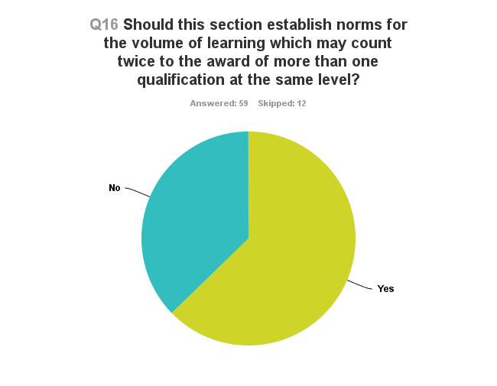
Is it double counting?
Notes:
As the chart above shows many respondents agreed that it was appropriate for the document to establish norms for the volume of learning which may count twice to the award of more than one qualification at the same level.
However, of those that did not agree it was felt that the information provided on certificates and transcripts made this less of an issue and that rules about recognition of prior learning already provided enough guidance – in the sense that thought had already been given to how much learning a student needed to undertake under the degree awarding body for them to be happy awarding their degree.
It was further suggested that QAA imposed limits may not be flexible enough to deal with future arrangements as necessary for universities to maintain a leading presence globally and that guidance should focus on providing a justified international learning experience or providing key principles relating to double counting rather than prescribed norms.
Discussions with the advisory group confirmed that it wouldn’t be appropriate for QAA to set limits, but that the document should seek to highlight the considerations on setting and maintaining academic standards which need to be taken into account in such situations – such as the considerations about RPL. It has also been suggested that any arrangement involving more than one degree awarding body by its very nature involves double counting.
Ultimately, it is up to the degree-awarding body to decide what it considers necessary for a student to gain its degree (which may be informed by other policies already in place).

