Slide 1


Diverse use of the web-based peer assessment tool, Aropä, across the University of Glasgow.
Elaine Huston, Mary McVey, Susan Deeley, Chris Finlay, John Hamer, Lisa Hau, Suzanne McCallum, Helen Purchase and Michelle Welsh.

Slide 2
Peer Assessment as a valid feedback and assessment tool
Challenges:
Student satisfaction with feedback and assessment consistently low in the national student survey
Difficulty in engaging students in the feedback process
Peer feedback addresses:
Timely feedback
Variety of feedback
Active engagement of students in the feedback process
Increases student critical evaluation skills
Notes:
In 2010 Professor David Nicol published a paper as part of the QAAs enhancement theme on graduates of the 21st century which suggested that the ability of graduates to critically reflect on their own work is at the heart of their graduate attribute development.
Within this discourse he used the University of Melbourne, Learning and Teaching Management Plan to look at

Slide 3
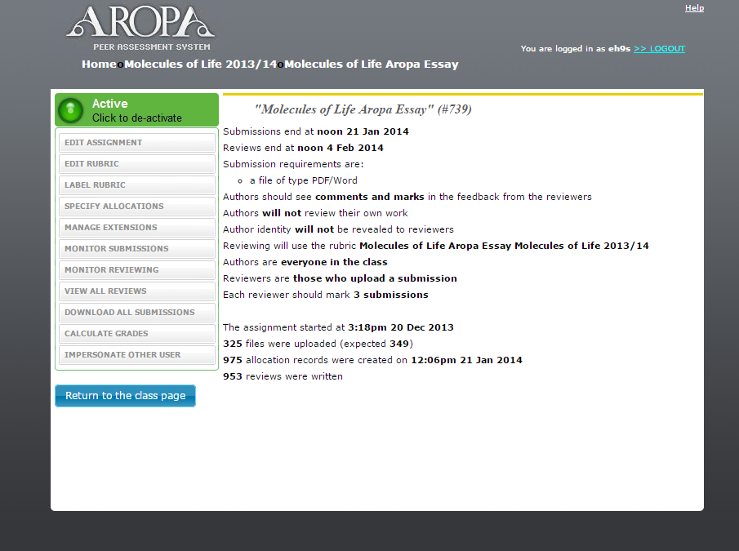
Introduction to Aropä – software for peer review
Software package enabling student peer feedback
Students submit assessment online
Automatic assignment of anonymous peer reviewers
Staff produced rubric for students to follow

Slide 4

Aropä – Diversity of Use
Universities of Auckland and Glasgow, Robert Gordon, Cyberjaya (Malaysia), Washington and Lee (US), Franklin (US), Washington and Lee (US)
In Auckland 9.9% of student body have submitted at least 1 peer review this year so far, in Glasgow 5.4% of students have submitted a review.
Notes:
UoA, UoG and Robert ordon – used for min 3 years, Cyberjaya and Washington since 2013 rest just this year

Slide 5
Aropä – Example of Diversity of Use, UoG
PRE-HONOURS | Student Numbers (2014/15) | Assessment
Level 1 Biology | ~700 | Formative (feed-forward)
Level 2 Life Sciences | ~360 | Summative (10% of 20 credits)
Level 2 Classics | ~70 | Summative (15% of 20 credits)
Level 2 Accounting and Finance | ~150 | Formative
HONOURS
Level 3 Anatomy | ~30 | Summative
Level 3-4 Public Policy |  | Summative

Slide 6
Aropä – Example of Diversity of Use, UoG
Summative
  Assessment of essay submission, feedback essential but not marked, feedback also provided for own essay
  Draft essay submitted, feedback reviews assessed and essay resubmission for grading
  Student –staff partnership in building marking criteria. Student essay graded on this criteria
Formative
  Feed-forward – Draft methods section of lab report submitted for peer review prior to submission for summative assessment
  Tutorial essay submitted for peer review prior to tutorial
  To provide formative feedback on past exam questions

Slide 7
Aropä – Breadth of Application- Reasons for Implementation
Large class sizes making formative
feed-forward staff led initiatives
difficult (LEVEL 1 BIOLOGY)
To better engage students in critical appraisal of peers and own work (LEVEL 2 LIFE SCIENCES)
Improvement of scientific writing skills
(LEVEL 1 BIOLOGY)
Face to face peer assessment, encouraging critical appraisal (LEVEL 2 CLASSICS)
To introduce increased opportunity for formative feedback (LEVEL 2 ACCOUNTING, LEVEL 3 ANATOMY)

Slide 8
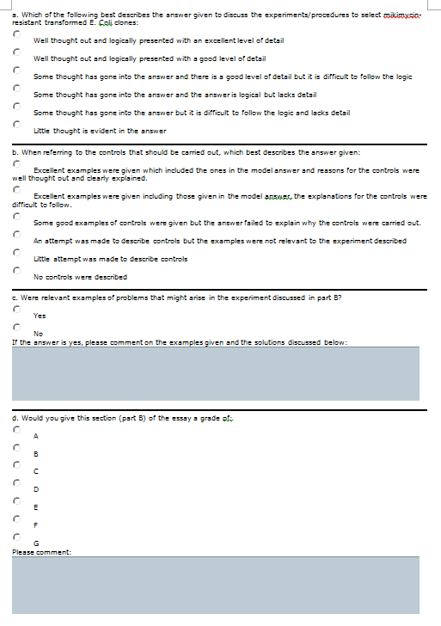
Aropä – Rubric Design
Example a:
Two main approaches:
Focus on main aspects of assessment
b) Focus on grade descriptors
Aim: To guide the student through the marker’s criteria for marking

Slide 9
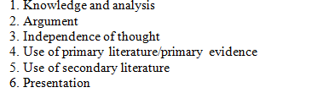
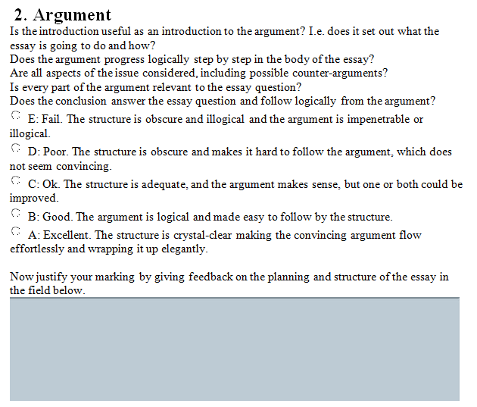
Aropä – Rubric Design
Example b:
Two main approaches:
Focus on main aspects of assessment
b) Focus on grade descriptors
Aim: To guide the student through the marker’s criteria for marking

Slide 10
Aropä – Impact on Staff Time
Initial Set Up
  Student ID number imported, email can also be used
  Rubric created
Ongoing issues
  Not many problems, good support
  Student technical problems minimal
  Classics – GTA training and impact of marking reviews

Slide 11
Aropä – Student Feedback (Level 1 Biology)
Evaluation of Aropä in Level 1 Biology
Aropä was complex to use
I agreed with the feedback I received
The feedback I received was
  Helpful
  Varied
Peer feedback is a good way to learn
I ignored the feedback I received on Aropä

Slide 12
Aropä – Student Feedback (Level 1 Biology)
Evaluation of Aropä in Level 1 Biology
Aropä was complex to use
I agreed with the feedback I received
The feedback I received was
  Helpful
  Varied
Peer feedback is a good way to learn
I ignored the feedback I received on Aropä

Slide 13
Aropä – Student Feedback (Level 1 Biology)
Evaluation of Aropä in Level 1 Biology
Aropä was complex to use
I agreed with the feedback I received
The feedback I received was
  Helpful
  Varied
Peer feedback is a good way to learn
I ignored the feedback I received on Aropä

Slide 14
Aropä – Issues and Problems
Engagement of students in voluntary, formative peer assessed exercises.
Student perception that others might plagiarise their work.
Feedback lacking in empathy
Possible issues with students having English as a second language.
Student focus on grade rather than feedback
Evidence of students acting on feedback?

Slide 15

Designed, developed, maintained & supported by
  Dr John Hamer (john.hamer@glasgow.ac.uk)
  Dr Helen Purchase (helen.purchase@glasgow.ac.uk)
For access to Aropä, simply send an email
to John or Helen

Slide 16
References
Finlay, C., Tierney, A., McVey M and Gray, J. (2012) Online peer review of scientific writing – Aropä. Learning and Teaching Conference, University of Glasgow.
Nicol, D and Macfarlane‐Dick, D. (2006) Formative assessment and
self‐regulated learning: a model and seven principles of good feedback practice, Studies in Higher Education, 31:2, 199-218
Nicol, D (2010), The foundation for Graduate Attributes: developing self-regulation through self and peer assessment, Published by the Quality Assurance Agency for Higher Education
Price, M., Handley, K., Millar, J. and O'Donovan, B. (2010) Feedback : all that effort, but what is the effect?, Assessment & Evaluation in Higher Education, 35:3, 277-289

Slide 17
Suggested Discussion Topic
HOW USEFUL IS PEER FEEDBACK?

