Slide 1
CIT eA-project
(Creating Innovative Technology enhanced Assessment Project)
Russell Taylor
Computing & Interactive Media Lecturer /
Technology Enhanced Learning Specialist
Borders College

Slide 2
Background
Jisc-funded CIT eA-project led by City of Glasgow College
  part of the Colleges’ e-Assessment Group (CEAG),
  CEAG includes the Scottish Qualifications Authority (SQA), the College Development Network, Education Scotland, the Student Participation in Quality Scotland (sparqs), and Jisc RSC Scotland (as was)
Borders College, as part of CEAG was asked to collaborate, having completed an earlier Jisc-funded e-learning project
  Borders Online Transformation project (BOLT) – completed December 2014
This new project focusses on the new Higher National Diploma for Business
Project duration: September 2014 to June 2015

Slide 3
Aims & Objectives
Identify barriers to adoption
Create a series of processes to improve uptake of existing e-assessment options
Drive future development of new e-assessment options
Create a replicable, scalable, sustainable, framework for e-assessment implementation in further education (which may be applicable in other sub-sectors)
  This framework will support institutions to identify and overcome barriers now and in the future.

Slide 4
Aims & Objectives
A toolkit of resources
  which will encourage the use of technology in the assessment process.
Enhancing the learning and assessment experience
Improve learner engagement
Promote greater efficiency through flexible and authentic assessment

Slide 5
History
The BOLT project was an 18-month long project to embed e-learning methods into an FE college
  led to the establishment of a permanent multi-disciplinary e-Learning Team (now Technology Enhanced Learning Unit - TELU) comprising Learning Technologists, Lecturers, Web Designers and a Software Developer
The BOLT project’s aim was to implement a major shift in learning culture towards innovative digital methods
  Built on an earlier ‘Blended Learning’ project
The TELU support lecturing staff in the delivery of new e-learning and e-assessment activities

Slide 6
Learning Systems at Borders
The Moodle VLE system has been in place since 2003 and v2.7 is currently used to deliver course content for the vast majority of courses
  This use is variable (but becoming less so) and not all lecturing staff use the more advanced functions regularly
The Mahara e-Portfolio system is also used extensively and the expertise in this system has grown rapidly amongst both lecturing staff and students
Moodle-linked ‘Turnitin’ assessments had been used in the past for essay-based work but college policy recently changed to mandate its use for all summative written work

Slide 7
Borders College’s Contribution
HND Business – recently introduced
  Replaces the BC delivered / Heriot Watt accredited, BSc Business programme
Provides direct articulation into 3rd year H/W Business degree at Edinburgh’s Riccarton Campus (2+2 model)
4 HND Units selected for Borders components:
  Human Resource Management Practice
  Developing Entrepreneurial Skills
  Combined Unit – Behavioural Skills for Business & Business Culture and Strategy

Slide 8
Assessment Method
Previously….
  Paper-based document production
  Laborious
  Error-prone evaluation
  Error-prone document management (version control)

Slide 9
E-Assessment
A variety of methods used including:
  Online tests using Moodle quizzes – multiple choice and extended response questions
  Turnitin for all discrete written work using Originality Reporting and Gradebook functions
  Mahara for multiple-document portfolio elements, such as:
    HRMP: Staff Handbook
    Developing Entrepreneurial Skills: New Business Start-up Portfolio e.g. Business Plan, Marketing Analysis, Recruitment Strategy, etc.

Slide 10
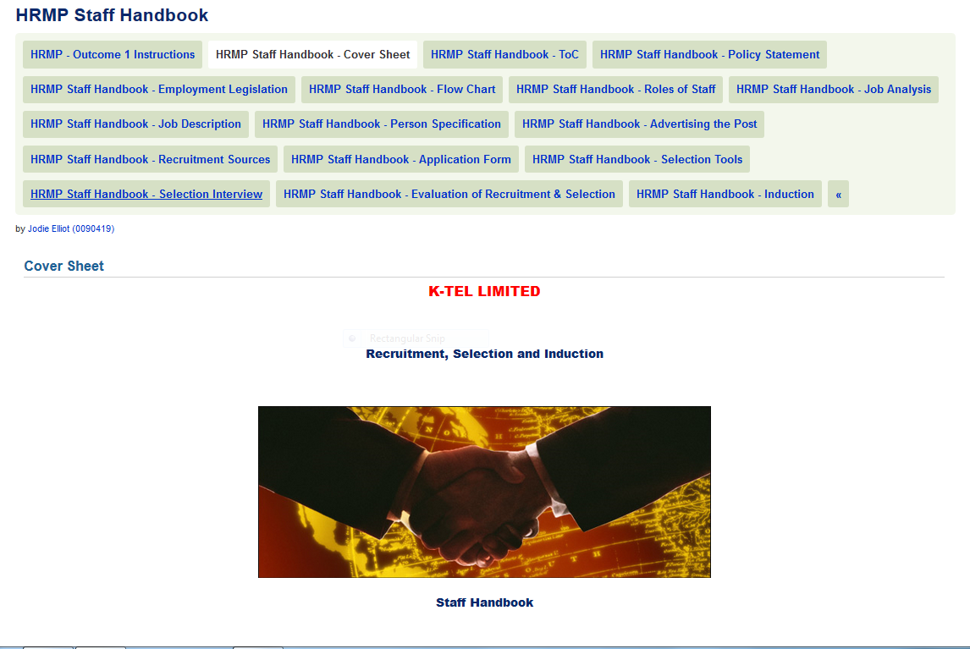

Slide 11
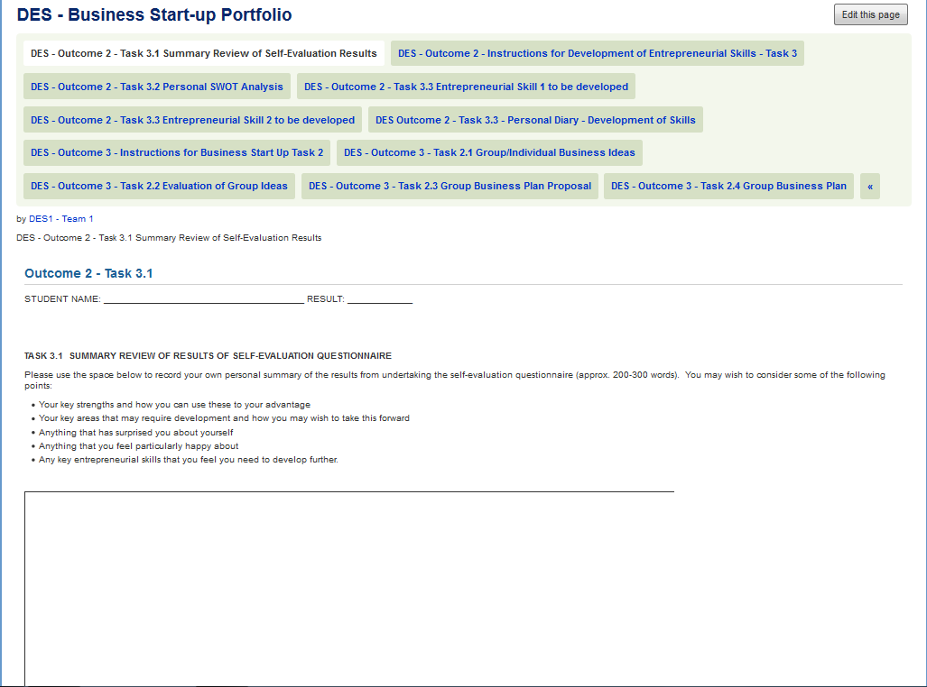

Slide 12
Issues & Feedback
Culture change for lecturers as great as it is for students
Some e-assessment may be more time consuming to mark than paper-based methods
Lack of learning analytics (tracking tools particularly)
  Profound in Mahara
  Less so in Moodle
Students like a variety of assessment methods – including paper!
  Separation of technology for ‘fun’ versus ‘work’

Slide 13
Future Developments
Feed into the CIT eA-project until June 2015
Working with SQA on new e-assessment programme over 2015/16
Evaluate local development of Mahara
  or join consortium led by City of Glasgow College
  Continue to feed into FE’s Machara Group
Feed into Moodle developments through FE’s Moodle User Group
Continue to roll-our e-assessment where appropriate

