Slide 1
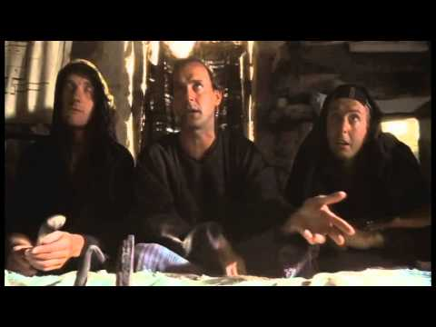
What has TESTA ever done for us?
Lynn Boyle University of Dundee
@Boyledsweetie

Slide 2
TESTA@Dundee
Since 2014 TESTA has been unrolling across the University of Dundee
The TESTA process was adopted fully as part of the Periodic Review Process for all programmes, in 2017
Focus groups with students have been carried out across 23 programmes as part of understanding student perception in assessment and feedback.

Slide 3
TESTA – Focus Groups : Asking the Students
“Tell me about the feedback you receive – what do you think of it?
prompt them about what they think feedback – the various forms feedback may take, how they use feedback, what its limitations are, what the point of feedback is, whether they read it when they receive their marks, whether marks are more important than words; how many of them have received oral feedback on work in tutorials, how useful they find whole class feedback, whether they get this? How long it takes to get feedback and whether this has an impact?
How does your feedback help you do better across modules?
Notes:
The original TESTA research notes give a guide to conducting a focus group with students as part of the TESTA process.

Slide 4
The value of the feedback is diluted under common student perceptions such as lecturer disparity….
It depends on the lecturer upon the day because when they're reading your notes they'll either write something in your logbook or they'll just tell you something but it depends on the lecturer as to how much feedback they give you.
There are inconsistencies because some like different lecturers like different things and you’re trying to remember what all the different lecturers like. For example with a Reference list or Bibliography X likes you to include something you haven’t referenced and they put an mark in where you didn’t reference and others don’t do that.
Notes:
Two typical responses from students in different disciplines but what is this really telling us????

Slide 5
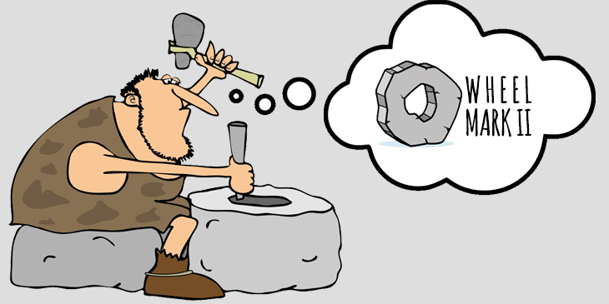
We believe that the majority of tensions we describe result from lack of understanding and lack of communication. The issues with the quantity of feedback result from students’ lack of understanding what feedback is, linked to lack of communication between staff and students about the nature of feedback. Similarly, the issue of quality of feedback is a misunderstanding between what the students expect and what staff think the students need. (Pazio 2016)
Notes:
The discrepancies between staff and students’ perceptions of feedback and assessment practices – analysis of TESTA data from one HE institution
The University of Greenwich is actually telling us what every piece of research has told us before!

Slide 6
Notes:
Academic freedom/ professional judgement/ staff management/ lack of ongoing debate and discussion within the institution/ lack of CPD/ deference to experience?

Slide 7
Notes:
https://youtu.be/55fqjw2J1vI
Sometimes research can look at little like this…….

Slide 8
What has TESTA done for us?
At institutional level it has brought assessment and feedback practices under scrutiny
Student perceptions are being listened to and understood
Individual programmes can act upon information which is programme unique
Sharing good practice can be done through a network of interdisciplinary working
ACTION it has made us take ACTION
Notes:
Bring TESTA to the individual institution and implementing it across the University has highlighted local practice at University, School and Programme Level.

Slide 9
Peer Review
The peer review is based up the work of Lea (2015) and Gibbs (2006) and their view of feedback as a dialogue embedded in the assessment procedure. Gibbs gives conditions for effective feedback based upon a measures of quality. These measures have been adapted for the purpose of this peer review.
Notes:
On the programme I teach, we decided to peer review feedback, different from moderation with clear outcomes we agreed upon using conditions for effective feedback.

Slide 10
I found the process a little embarrassing as I ensured I had sent a piece of feedback which had been selected at random and sent to the team without reviewing it. However this ensured a process that was honest and open! The process was most useful once the team relaxed and we opened the process to a general professional discussion rather than going through each of the peer review questions. I know that I use work load as an excuse for accuracy, but this in reality is really due to speed and haste. In places I was surprised about how vague I was being and despite know the importance of the language of feedback where language did not in fact align with the grade. I enjoyed the discussion around consistency of team feedback but retaining individuality in approach and style.

Slide 11
The key points I will be using as an aide memoire in future feedback are;
Avoid language which does not model advice, however keep some phrases which reflect my feedback style and could be seen as conversational
Be explicit and give a clear example to demonstrate what is being advised for changes in the future, avoid being vague.
Align the feedback with the criteria very carefully to the criteria
Use some model phrases where applicable and paraphrase the rubric for clarity.
Take a coffee break and re read feedback, perhaps even read it out loud to avoid ever writing ‘stud diary’ ever again.

Slide 12
“feedback is provided as part of an assessment process that uses both partially explicated criteria and professional judgement”
(O’Donovan, B., Price, M. and Rust, C. 2008)
Notes:
This remains true but professional judgement must be questioned, revealed and at programme level even perhaps scrutinised?

Slide 13
It is time to take ACTION………

Slide 14
References
Gibbs, G. (2006) How Assessment Frames Student Learning. York. Higher Education Academy
O’Donovan, B., Price, M. and Rust, C. 2008. Developing student understanding of assessment standards: A nested hierarchy of approaches. Teaching in Higher Education, 13(2): 205–16.
Lea, J. (2015) Enhancing Learning and Teaching in Higher Education. Maidenhead. Open University Press
Mann, S.J. 2001. Alternative perspectives on the student experience: Alienation and engagement. Studies in Higher Education, 26(1): 7–20.
NmcC (2009) Monty Python’s Life of Brian – Scene 21 The committee meeting Available at: https://youtu.be/55fqjw2J1vI
Pazio, M. (2016)The discrepancies between staff and students’ perceptions of feedback and assessment practices – analysis of TESTA data from one HE institution Practitioner Research in Higher Education Special Assessment Issue Copyright © 2016 University of Cumbria Vol 10(1) pages 91-108

