Slide 1


Using rubrics in Turnitin: a more consistent approach to assessment and feedback
Jenny Woof
22 March 2018

Slide 2
Biological and Biomedical Sciences BSc Honours
For Biological and Biomedical Sciences BSc Honours degrees, marking of Honours year projects presents a particular challenge
students on these Science degrees all take Honours projects and associated research skills at Level 4 semester 1
the largest numbers of markers of any Life Sciences module - 80 to 100
markers from both School of Life Sciences and School of Medicine

Slide 3
Addressing perceptions of unfair/inconsistent marking
How could we get everyone on board to provide consistent marking and constructive feedback?
Working with Programme Leads Dr Stephen Land and Dr David Booth, reviewed all assessments in this semester and developed new set of marking rubrics for whole of Level 4 semester 1

Slide 4
Development of rubrics
  Took guidance from published sources and external examiner experience of marking criteria used elsewhere
  Tailored the rubrics to specific requirements of each assessment
  Sought detailed feedback and incorporated suggestions from a number of experiences teaching staff
  An iterative process
  Developed a demonstration video, as well as providing detailed written instructions.

Slide 5
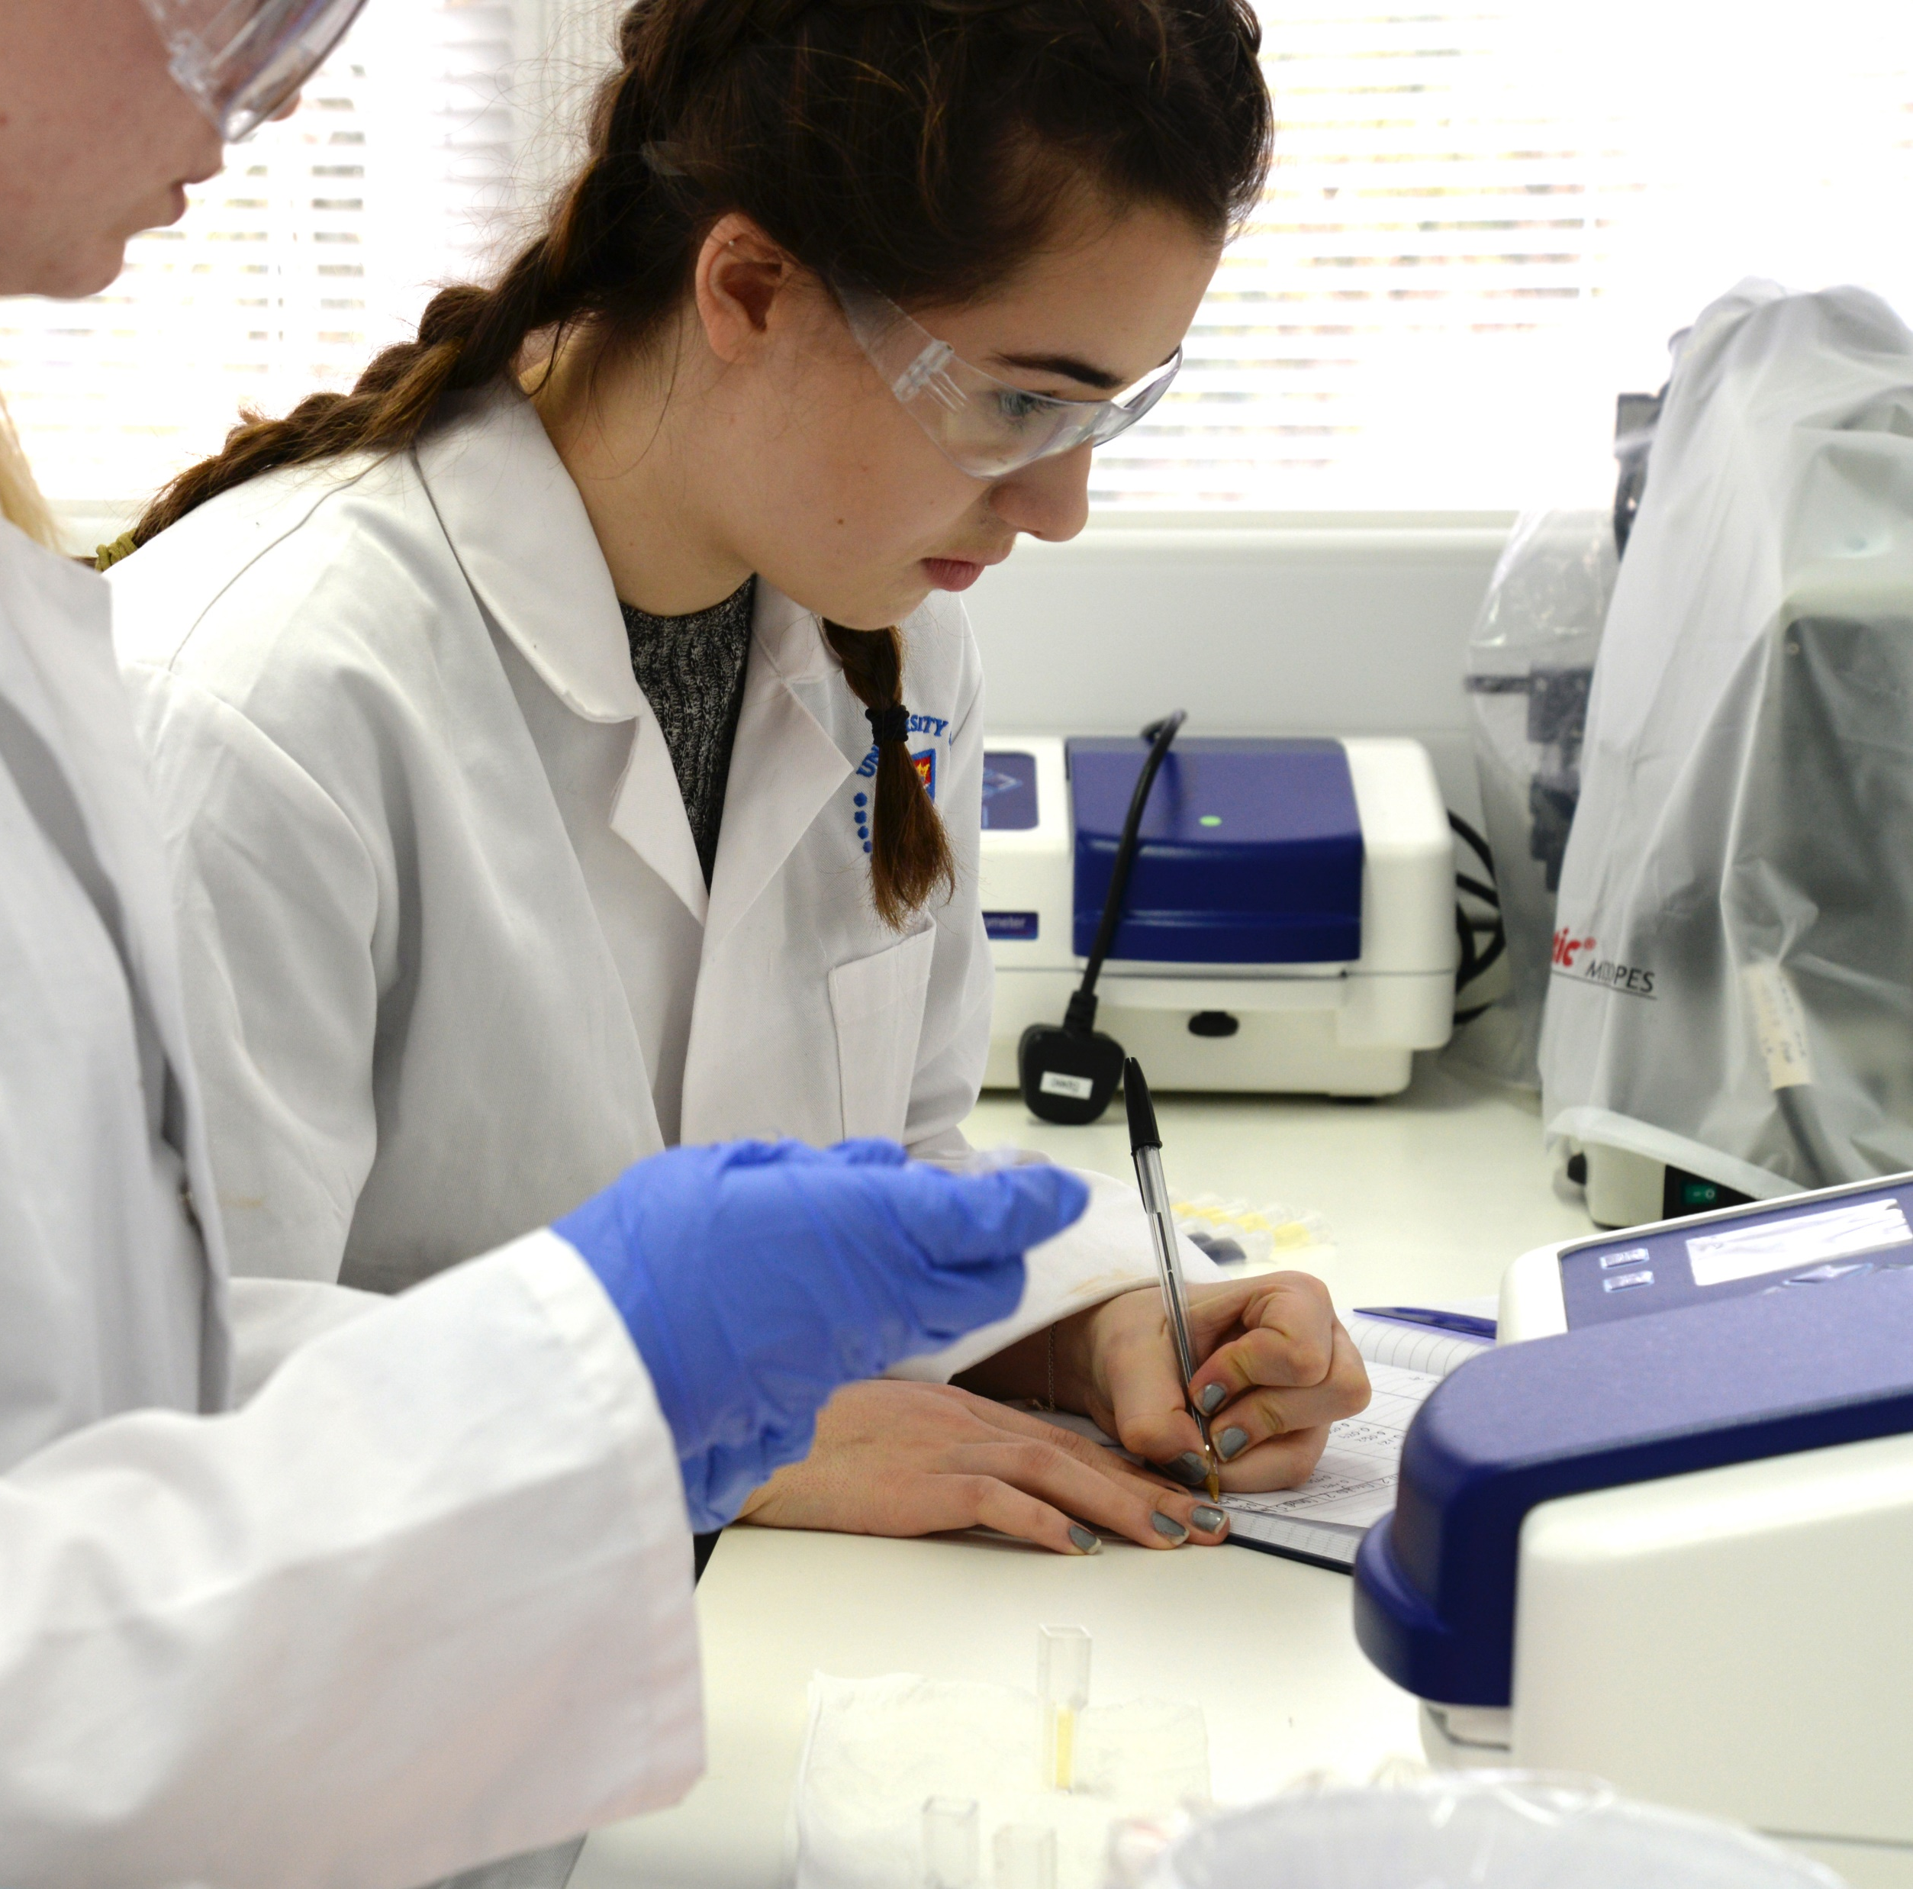
Which assessments did we use the rubrics for?
  Grant/Outreach proposal
  Seminar report
  Project performance
  Project report
  Poster presentation (paper format)
  Oral presentation/viva (paper format)

Slide 6
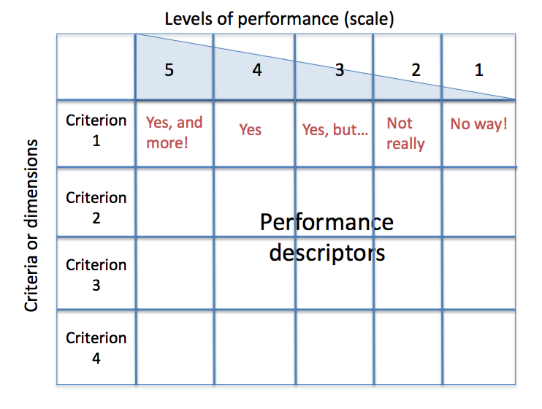
Format

Slide 8
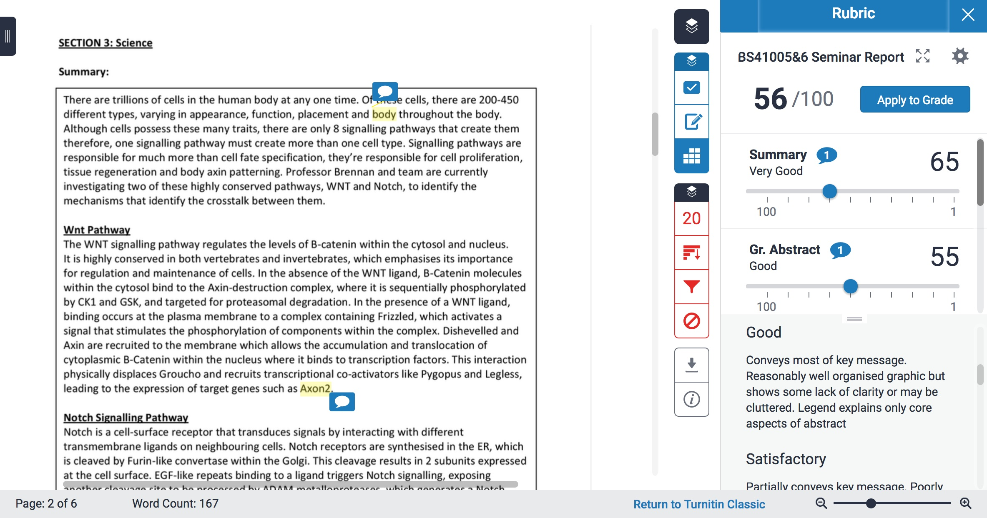

Slide 9
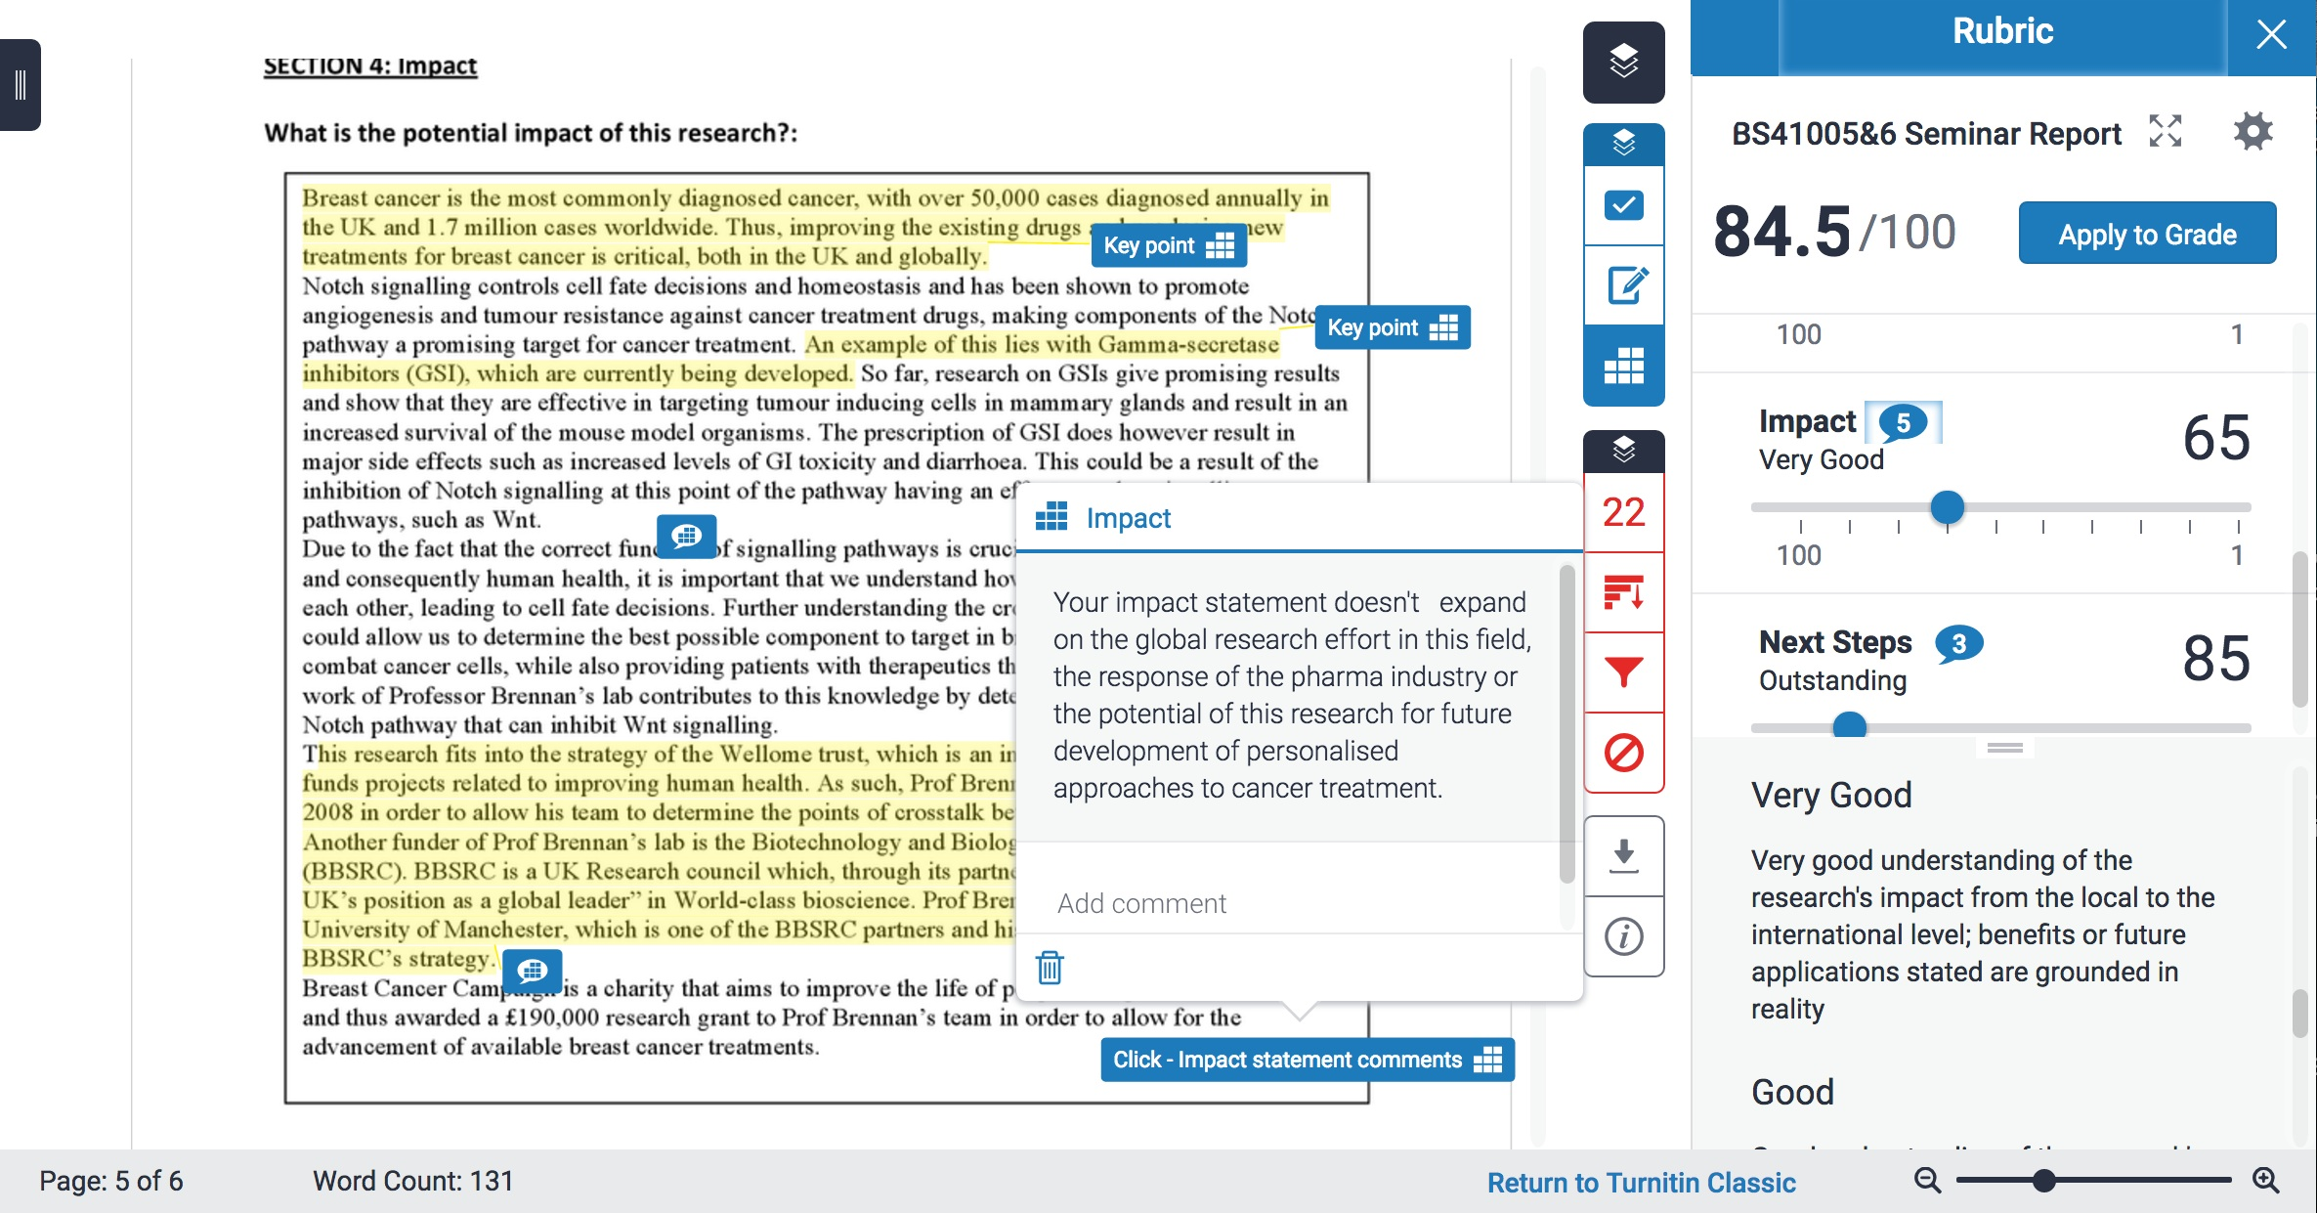

Slide 10
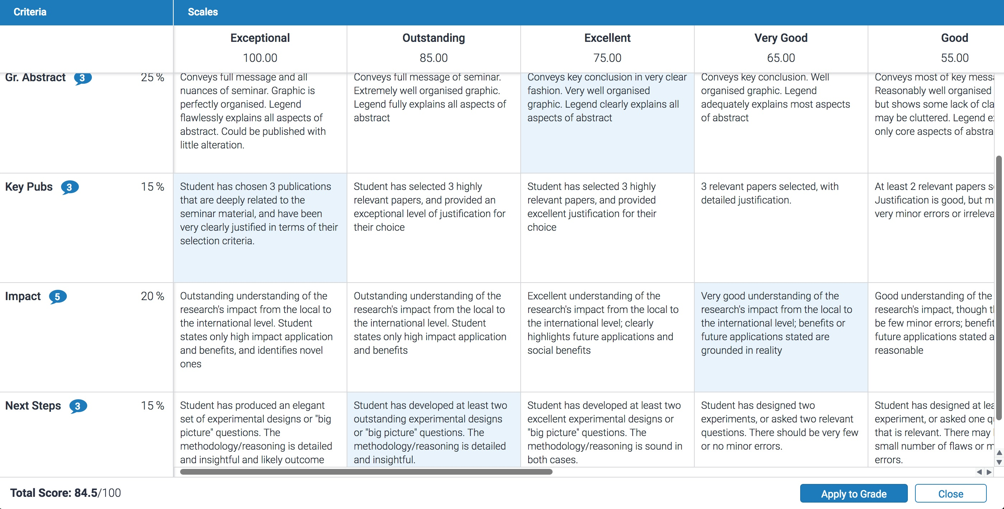

Slide 11
Moderation and feedback monitoring
  Hand in hand with use of rubrics, introduced new system to monitor volume and quality of feedback
  If markers do not provide sufficient or appropriately detailed feedback they are asked to redo it
  Vast majority of markers only need to be asked once, then improve for subsequent assessments
  Information on who will mark and moderate each assessment, timing of release is provided to students

Slide 12
Evidence for impact
  Positive comments from markers
  Students like the rubrics and found them very clear - Feedback from students in staff-student liaison meetings
  Students appear to appreciate the clarity that the rubrics have brought to the requirements of each assessment, and this helps to reduce student anxiety

Slide 13
Assessment and feedback in NSS

Slide 14
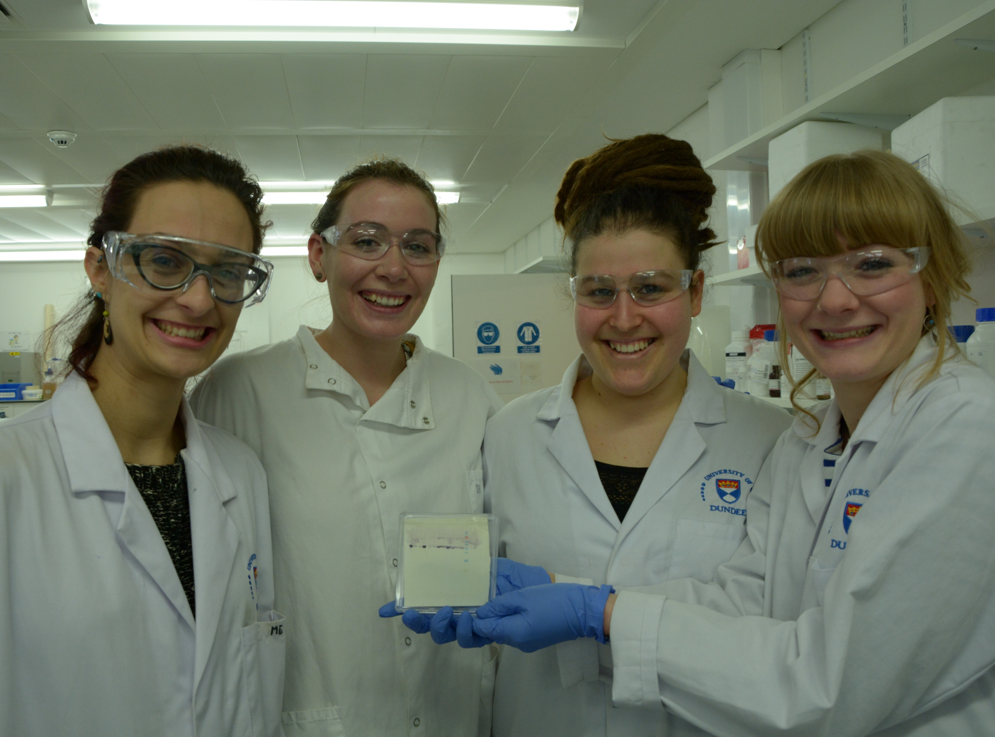
Advantages
  For students:
  Aid full understanding of nature of each assessment and expected standard
  Helps students prepare fully and focus efforts appropriately and feel more comfortable
  In combination with marker’s written commentary, provide detailed feedback for each assessment
  Helps students to appreciate where they have performed well and where to direct future efforts in study and revision

Slide 15
Wider impact
  Streamlining marking process
  Helped raise awareness of teaching objectives and marking standards for all teaching staff involved
  Making good use of features of Turnitin online marking software, improving efficiency and transparency
  Enhanced student perceptions that marking is fair and consistent

Slide 16

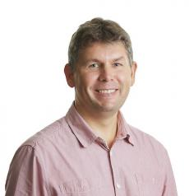
Acknowledgments
Dr David Booth
Dr Stephen Land

