Slide 1
The Graduate School: Before and after
Jonathan Teppett
S E E T H I N G S D I F F E R E N T L Y

Slide 2
PgR Review at Abertay 2005
PhD 4 years Max FT
MPhil 3 Years Max FT
S E E T H I N G S D I F F E R E N T L Y

Slide 3
PgR Reviews 1st Cycle - 2005-2009
x4 School-based reviews
Very small numbers
Majority in one School
Provided a rallying point for PgR issues
S E E T H I N G S D I F F E R E N T L Y

Slide 4
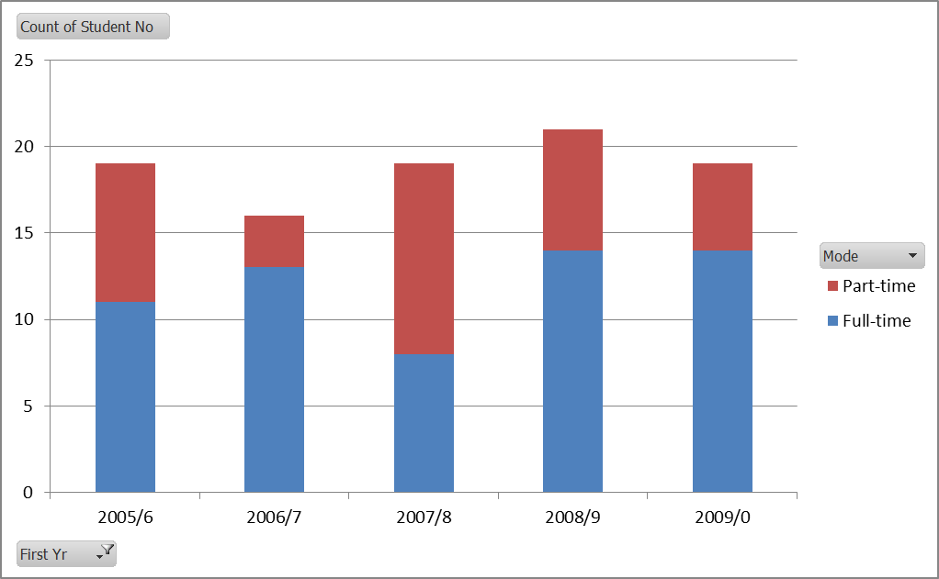
New students 2005–09
S E E T H I N G S D I F F E R E N T L Y
Notes:
2005-09
Less than 20 new starts per year
60 FT starts and 34 PT starts over the period

Slide 5
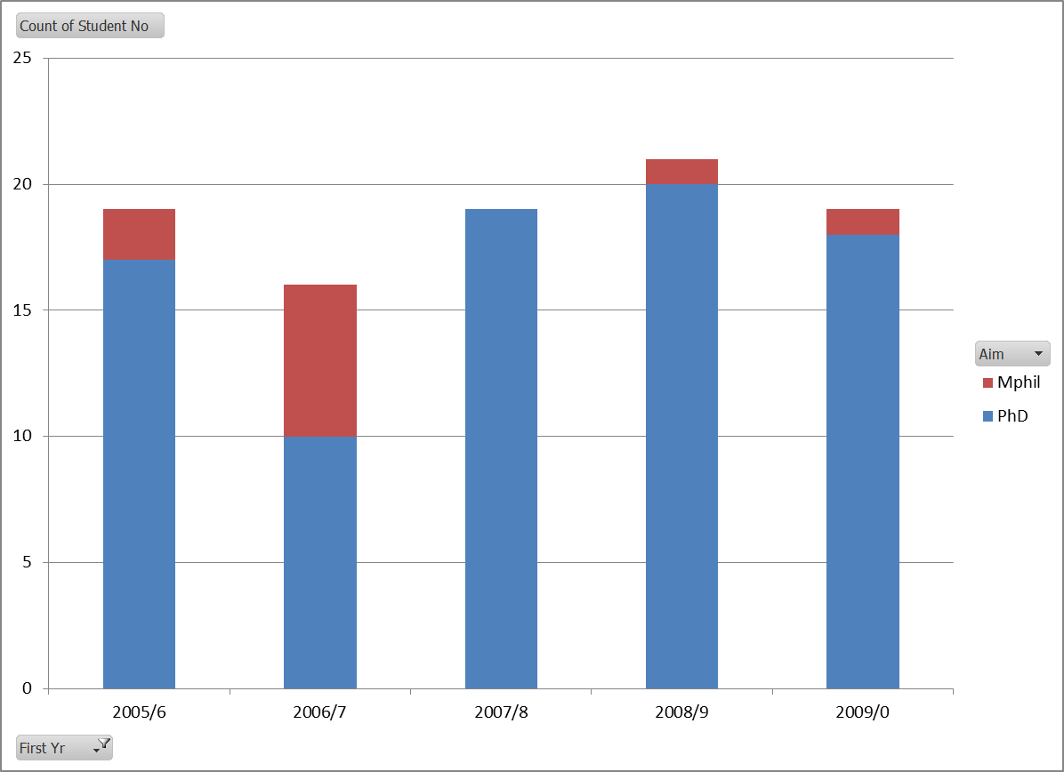
New MPhil/PhD 2005-09
S E E T H I N G S D I F F E R E N T L Y
Notes:
2005-09
Most new starts were PhD
84 PhD (Max 4 years)
10 MPhil (Max 8 years)

Slide 6
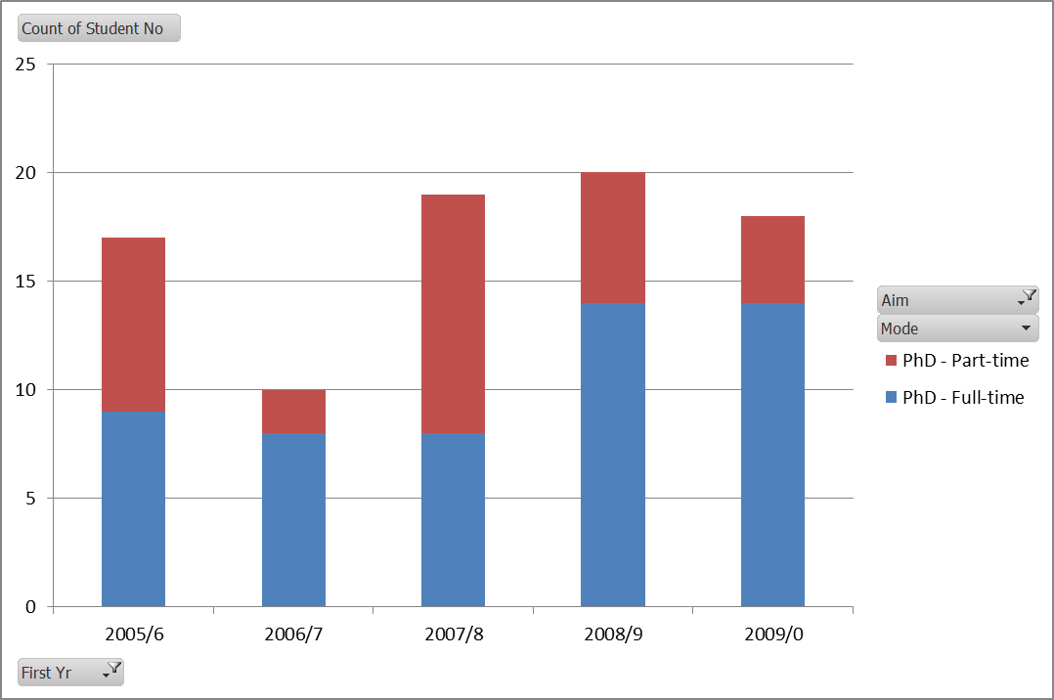
New PhD only 2005-09
S E E T H I N G S D I F F E R E N T L Y
Notes:
2005-09
84 new start PhDs
53 Full-time
31 Par-time

Slide 7
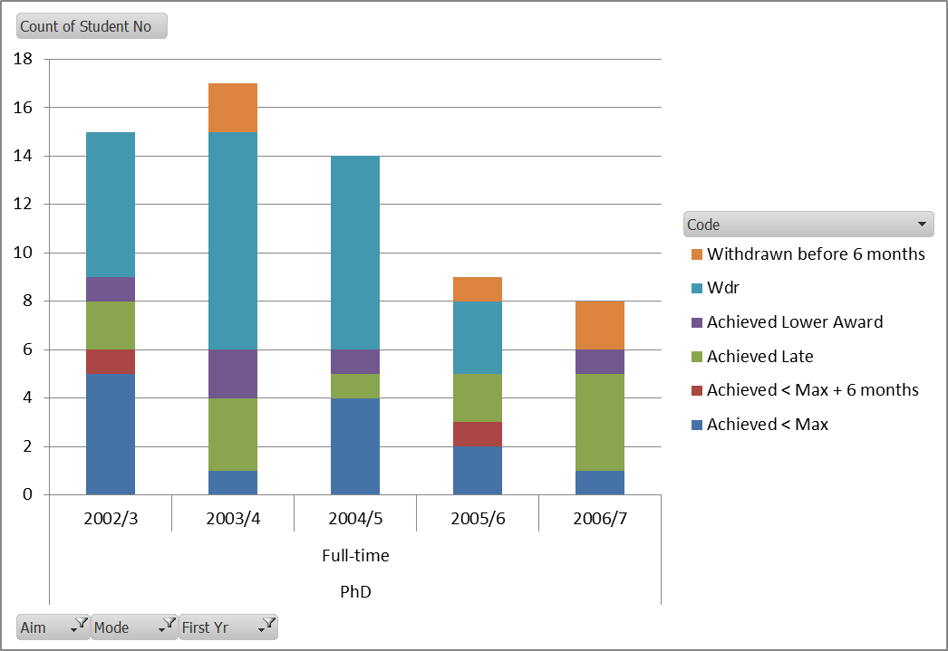
PhD FT 2002-06 Cohorts: exp. End. 2005-9
S E E T H I N G S D I F F E R E N T L Y
Notes:
PhD FT Cohorts 2002-6 ie. With expected end dates 2005-9 based on 4 years Max period
23% (15/63) completed in Max + 6 months
42% (27/63) completed overall
50% withdrew!

Slide 8
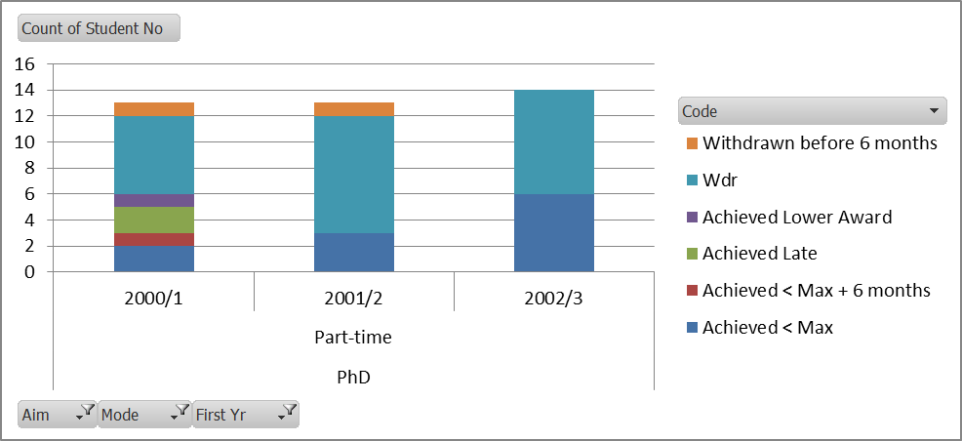
PhD PT 2000-02 Cohorts: exp. End. 2005-9
S E E T H I N G S D I F F E R E N T L Y
Notes:
PhD PT Cohorts 2000-2 ie. With expected end dates 2007-9 based on 8 years Max period
30% (12/40) completed in Max + 6 months
35% (14/40) completed overall
62% withdrew!

Slide 9
PgR Reviews 1st Cycle – Key issues
Key issues: disparate tiny enclaves, need to develop critical mass, research environment, research community, supervisor training, and make more of progression points
S E E T H I N G S D I F F E R E N T L Y

Slide 10
Abertay events
2010 Principal/Vice-Principal suspended
2011 Interim Principal
2012 ELIR
2012 New Principal, Vice-Principals, Directors etc…
Research strategy development
S E E T H I N G S D I F F E R E N T L Y

Slide 11
PgR Process Review
2012 PgR Process Review
Reviewed progress
Took note of all issues – informed Research Strategy development and priorities
Recommended a single University-wide reporting/review process for 2nd Cycle in 3 years
S E E T H I N G S D I F F E R E N T L Y

Slide 12
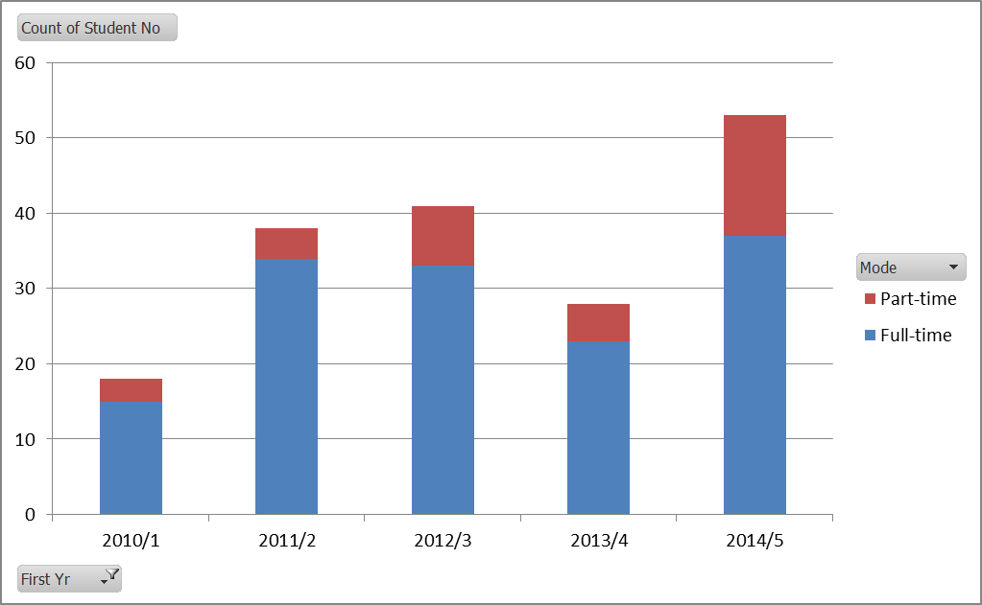
New students 2010–14 FT/PT
S E E T H I N G S D I F F E R E N T L Y
Notes:
2010-14
Rapid growth in numbers
142 FT (60)
36 PT (34)
Nearly double the previous period – increase in FT students but sadly mostly not PhD!

Slide 13
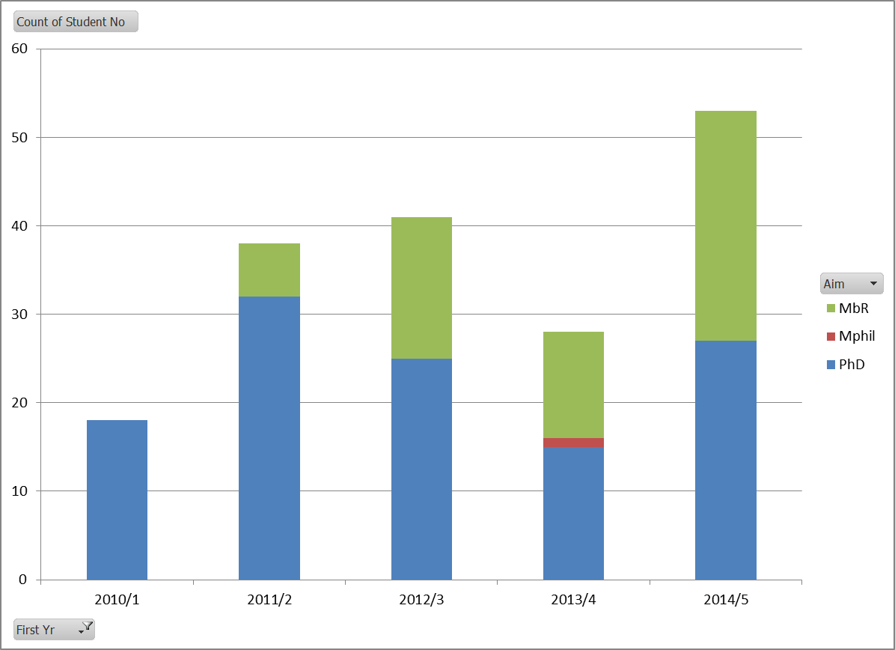
New 2010–14 MbR/MPhil/PhD
S E E T H I N G S D I F F E R E N T L Y
Notes:
2010-14
PhDs 117
Mphil 1
MbR 60
MbR new kid on the block…. Where did it come from? What do we think about it?

Slide 14
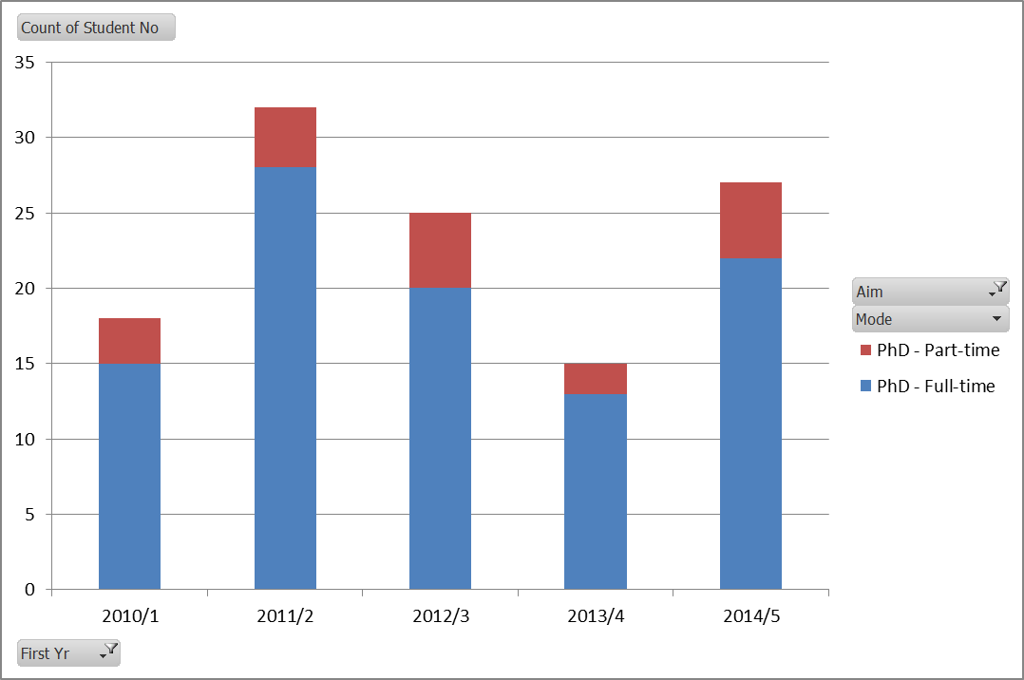
New PhD Only 2010-14
S E E T H I N G S D I F F E R E N T L Y
Notes:
2010-14
117 new start PhD
98 FT (nearly double)
19 PT (significantly down)
2005-09
84 new start PhDs
53 Full-time
31 Par-time

Slide 15
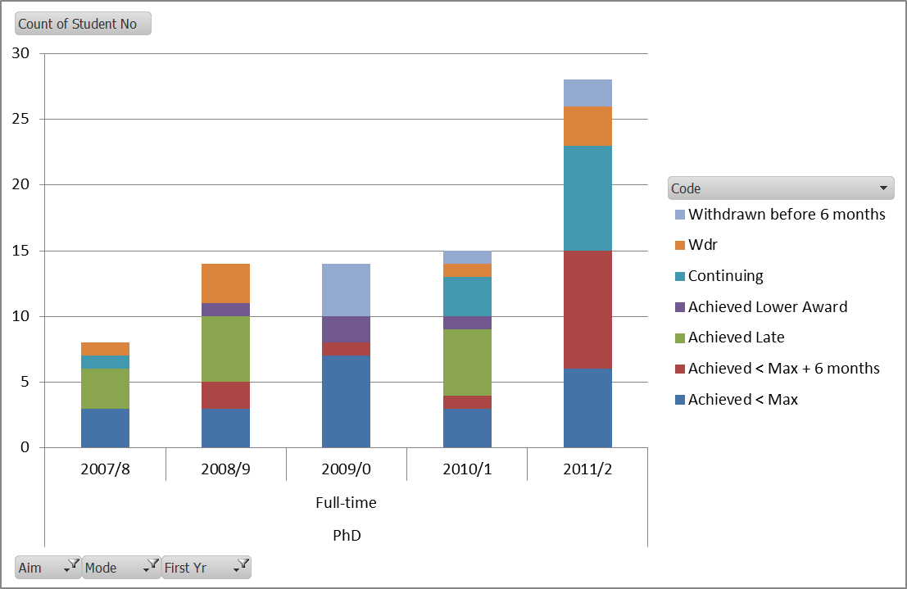
PhD FT 2007-11 Cohorts: exp. End. 20010-14
S E E T H I N G S D I F F E R E N T L Y
Notes:
PhD FT Cohorts 2007-11 ie. With expected end dates 20010-14 based on 4 years Max period
44% (35/79) completed in Max + 6 months
61% (48/79) completed overall
19% (15/79) wdr
2002-6 cohorts
23% (15/63) completed in Max + 6 months
42% (27/63) completed overall
50% withdrew!

Slide 16
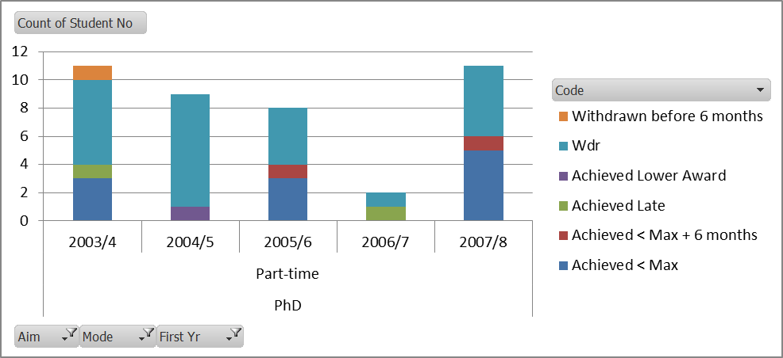
PhD PT 2004-08 Cohorts: exp. End. 2010-14
S E E T H I N G S D I F F E R E N T L Y
Notes:
PhD PT Cohorts 2004-08 exp end 2010-14
31% in max + 6
37% overall
60% wdr
PhD PT Cohorts 2000-2 ie. With expected end dates 2007-9 based on 8 years Max period
30% (12/40) completed in Max + 6 months
35% (14/40) completed overall
62% withdrew!

Slide 17
The Graduate School
2014 Graduate School
2014/15 New Research Governance Framework
2014/15 PgR Regulations / Handbook Review
2014/15 Enhanced supervisor / student training
2014/15 Enhanced Academic Registry role
2015/16 PgR Review x1 Graduate School Review
S E E T H I N G S D I F F E R E N T L Y

Slide 18
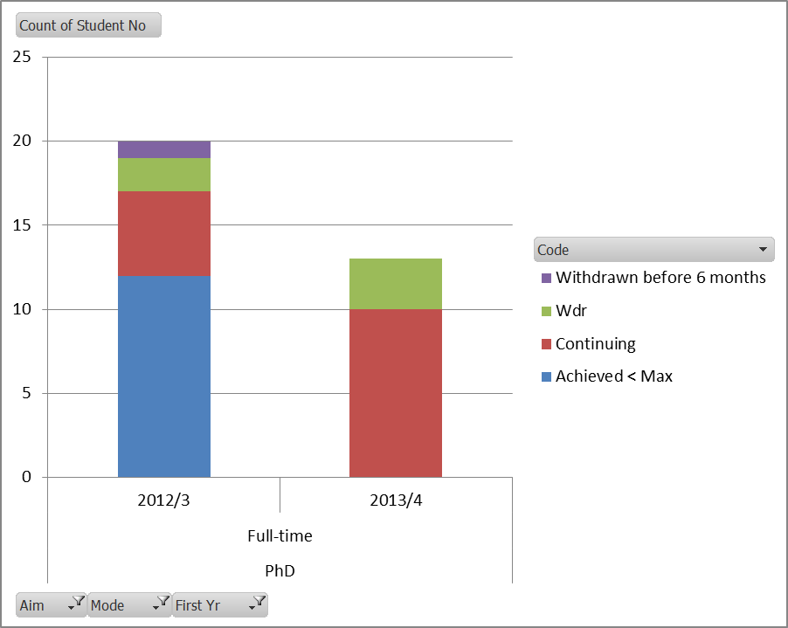
PhD FT 2012-13 Cohorts
S E E T H I N G S D I F F E R E N T L Y
Notes:
2012-13 – max period up 2015-16
60% completed within max period
25% continuing so final figure may increase
15% wdr
2013-14 – max period expires this year 2016-17
77% continuing
23% wdr

Slide 19
Concluding remarks and any questions?
S E E T H I N G S D I F F E R E N T L Y

