Slide 1
The Goldilocks's Challenge: getting institution-led review just right!
Nina Anderson
Head of QuEST
University of the West of Scotland

Slide 2
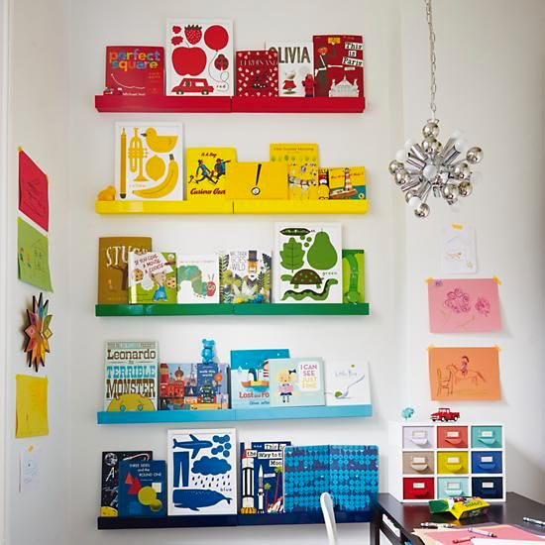
Essentials..

Slide 3
Institution-led Review 101
Consideration of support services
Periodic review of all provision – one a cycle of not more than 6 years
Ensure programmes are aggregated to provide coherence
Include all credit bearing provision (PG/CPD/Collaborative/Research Students/Online)
Some form of I-lR activity taking place each year
Evidence of embedding of UK Code for HE
Engagement with relevant benchmarks
Explore ways to reduce burden by engaging with PSRBs – reflect on outcomes of PSRBs at I-lRs
Promote scrutiny & discussion of the institution’s approach to SCQF
Each review team should include at least 1 external
Review team must take account the range and volume of provision being reviewed
Institutions to develop and deploy mechanisms to directly involve student in I-lR, and take account of the increasing diversity of the student body.
Institutional processes for student feedback and effectiveness of annual monitoring will be explicitly considered as par of I-lR
I-lR to provide robust, comprehensive and credible evidence that academic standards and quality of provision are being maintained.

Slide 4
FREEDOM & FLEXIBILITY….
We can determine how to schedule I-lRs
We can decide how to aggregate provision for review

Slide 5
Size and Composition of the review panel #1external

Slide 6
We have control of how we facilitate periodic review of the strategic and operation role of support services in relation to student experience

Slide 7
History of Institution-led Review at UWS
Grouped primarily around subject benchmark statements
Restructuring internal from Schools to Faculties… and back to Schools
At a more local level from Subject Development Groups to a more programmatic “programme primacy” approach and use of Programme Boards
Annual discussions with Assistant Deans about grouping and scheduling
Increased confidence in our QA/QE
Dare to be Different

Slide 8
Too Small Too focused?
limit the number of individual programme reviews (PSRBs
involvement/niche programme/multi site delivery).

Slide 9
Too Broad Too Big?
Lack coherence... but for some Schools larger groupings could be a option.
Logistics – we need to know the detail!

Slide 10
Just Right...?....for UWS...now!
Acknowledge and recognise the individual School structures;
Useful outcomes and enable teams to action outcomes based on School governance and reporting;
Reduce repetition and duplication where possible (PSRBs/NPPs/AM);
Spread then workload...no no group the workload!!;
6 year cycle retained;
QuEST team happy.....!.

Slide 11
School reactions!
Welcomed – Strong engagement in discussions
Some cautiousness but some creativity!
School specific approaches appreciated
Importance of recognising programme reporting lines
No major changes to the scheduling but changes to the aggregation.

Slide 12
Continuous process
Need to monitor and review
Learn from challenging events... and successful ones!
Partnership with Schools
Feedback from review teams and panels
ELIR 4....

Slide 13
Thank you for listening. Any questions or observations?

