Slide 1


Linking assurance and enhancement
The use of enhancement workshops in ILR

Slide 2
Past
In theory......
Choice of enhancement topics
School-led
Useful dialogue; Exchange of ideas; Exploration of development opportunities
Notes:
The School was asked to identify no more than three enhancement topics. They were encouraged to choose topics which presented challenges, so that these could be discussed during the session.
It was suggested that the expertise of the externals participating on the Review Team could be used. For example, one external was the Head of a section that managed IDL delivery, and the enhancement topic chosen was for developing IDL programmes.
The intention was that:
the session would be led by the School and that there would be open discussions, debates, exploration of issues etc.
There would be a useful dialogue, exchange of ideas and exploration of opportunities for taking things forward.

Slide 3
In practice……
Effectiveness and success – varied
Show and tell
Leadership / ownership
Quality Assurance
Notes:
Some sessions were more effective than others.
The majority resulted in the School talking through topics from their enhancement plan and activities undertaken – it was usually a show and tell or what had been done, rather than presenting challenges for discussion.
At times there was some confusion as to the leadership of the session, and it regularly resulted in the Chair of the Review Team taking the lead.
On occasions sessions would evolve into more expanded discussions around QA issues that had been explored during the earlier review meetings. Review Teams sometimes took the opportunity to ask further questions.

Slide 4
The issues......
Structure
Guidance
Preparation
Purpose
Notes:
Staff in Quality & External Partnerships (Q&EP) got together to discuss the effectiveness of the workshops and came to the conclusion that the lack of success was mainly due to:
There was no clear structure to the session, so discussions could go off in any direction.
Guidance – apart from a brief discussion around what was expected during review preparation meetings, no further guidance or support was provided for the School in delivering these sessions.
A lack of preparation down to the fact that there was no guidance provided and production of the reflective document took priority meant that there was very little preparation done for the session.
What was the purpose of the session? Without guidance, structure, direction, there was no real purpose.

Slide 5

Changes….
The plan......
Workshop style
Learning and Teaching Strategy
Perceived benefits
Assurance with enhancement link
A mechanism for taking forward a L&T objective
Review Team’s expertise
Wider dissemination - practices/issues
Notes:
Following discussions, it was agreed that it was important for a session to:
have a clear purpose
be useful to the Schools
be linked to enhancement
be led solely by the School (strengthening the ownership of the session)
A workshop style format was agreed, with a topic chosen from the School’s Learning and Teaching Enhancement Plans.
Benefits were assumed to be:
There would be a more explicit link between assurance and enhancement (as part of the process)
The workshop would provide a mechanism for the School to take forward a learning and teaching objective.
There would be an opportunity to make use of the Review Team’s expertise
A mechanism for dissemination – sharing issues/practices etc
The proposal to introduce a workshop style session was approved by the University’s Quality and Standards Committee

Slide 6

Enhancement Workshop
Guidance from Quality and External Partnerships
School-led
School Enhancement Plan
One page workshop brief
Briefing paper
Notes:
6-9 months prior to the review date, Q&EP Team meets with Director of Academic Quality (DAQ) /Director of Learning & Teaching (DLT) and Head of Dept to discuss the review process. Schools are then contacted 2 months prior to the review date by the Quality Enhancement Officer (QEO), who provides guidance specifically on the workshop session.
Key features of the session are covered, including structure, format, participants and possible themes (previous sessions are used as guidance) and to clarify roles
Session is School-led – this is a key feature and means relevance and ownership.
Departments will have a number of topics to choose from, based on the School’s Enhancement Plan (linking with University’s L+T Strategy) and are encouraged to consider areas of expertise of the Review Team when selecting the topic.
Template for the workshop brief has been introduced this year, to set out more clearly what is required and to ensure the session is planned and thought through well in advance. The workshop brief is submitted 4 weeks prior to the review (submission date changed this year to provide more time to address any areas of concern, e.g. student participation).
The School is provided with a briefing paper setting out timelines and guidance for reference.

Slide 7
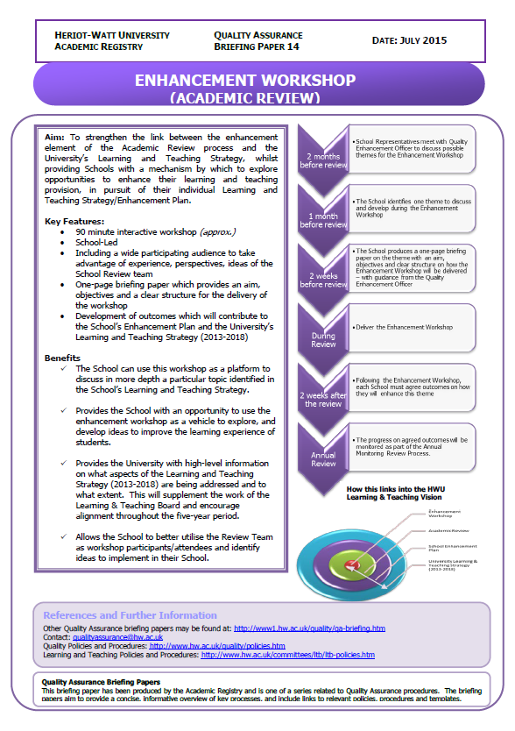
QA Briefing Paper
Notes:
A summary of the process including timelines.

Slide 8
A successful workshop requires:
Preparation
Student participation
Good facilitator/s
Achievable outcomes
Notes:
As with any workshop, there needs to be a well thought-out structure with aims and objectives clearly stated – link with School enhancement plan so that there is a clear purpose.
Meetings with the QEO and the timelines set out in the QA Briefing paper have helped to reinforce the need for preparation and planning.
Student participation and good facilitation of the sessions is key.
Outcomes need to be achievable.

Slide 9
What happens next?
Annual Monitoring
Linking up enhancement initiatives
Feedback on operation:
Schools
Review Teams
Notes:
Annual monitoring process involves consideration of the implementation of the University’s Learning and Teaching Strategy, and progress made with learning and teaching objectives.
Intention is also, that annual discussion meetings will provide an opportunity to report back on how useful the workshops have been for taking forward L&T objectives. As the meetings from the most recent cycle took place shortly after the first round of workshops, there was little opportunity to do this properly.
Linking up enhancement initiatives – the QEO attends all workshops. This gives the opportunity to share ideas and practice across the University. We are starting to look at how we report back on initiatives in a structured way, e.g. through SLEC.
Feedback on operation
Feedback from Schools so far has been very positive, with the sessions providing an opportunity for students and staff to work together to identify and discuss issues and propose solutions (student experience/GAs)
Review Teams were less certain about the purpose of the workshop and could not see how the session benefited them in their role as reviewers. (Although one reviewer verbally reported that the session had helped clear up some issues that had been raised during the review meetings). There was also a common view that the extra time would be better allocated to the review meetings (which were quite tight).

Slide 10
Q & A

