Slide 1
Ipsative Feedback, e-Portfolios and LEAF
(Leading Enhancements in Assessment and Feedback)
Dr Dave Morrison
Research Assistant
University of Glasgow
Learning and Teaching Centre

Slide 2
The LEAF Project (Leading Enhancements in Assessment and Feedback)
To improve efficiency and effectiveness of assessment and feedback by looking at full programmes and comparing across subjects and universities
Running simultaneously at four universities (Glasgow, Edinburgh, Nottingham, Birmingham)
Original subjects were History, Biosciences, and Economics
Currently Biosciences, Business Management, and Engineering

Slide 3
Non novus sub sol (e.g. NSS)
Findings
Students find feedback inconsistent, late, and unhelpful
Students want feedback on exams
Students are not taught how to use feedback
Staff pressed to give detailed feedback within timeframes
Not true in History
Most staff are actively working to improve feedback
Seldom collectively
No one agrees about or fully understands marking criteria

Slide 4
Ipsative and Longitudinal Feedback
A Solution?
Full-programme / student career approach
Ipsative Feedback
Feedback ‘based on a comparison with the learner’s previous performance and linked to long-term progress’ (Hughes 2011: 353)
Longitudinal
Charting patterns/changes over time against criteria

Slide 5
Benefits
Makes use of natural human talent for pattern recognition
Other types of feedback do not
Late feedback can still have value
Exams can be formative
Inconsistent feedback may show patterns over time
Marking criteria may become clear over time
Focuses on improvement
Develops self-management
Does not make bad feedback better
Makes students better able to pan for gold

Slide 6
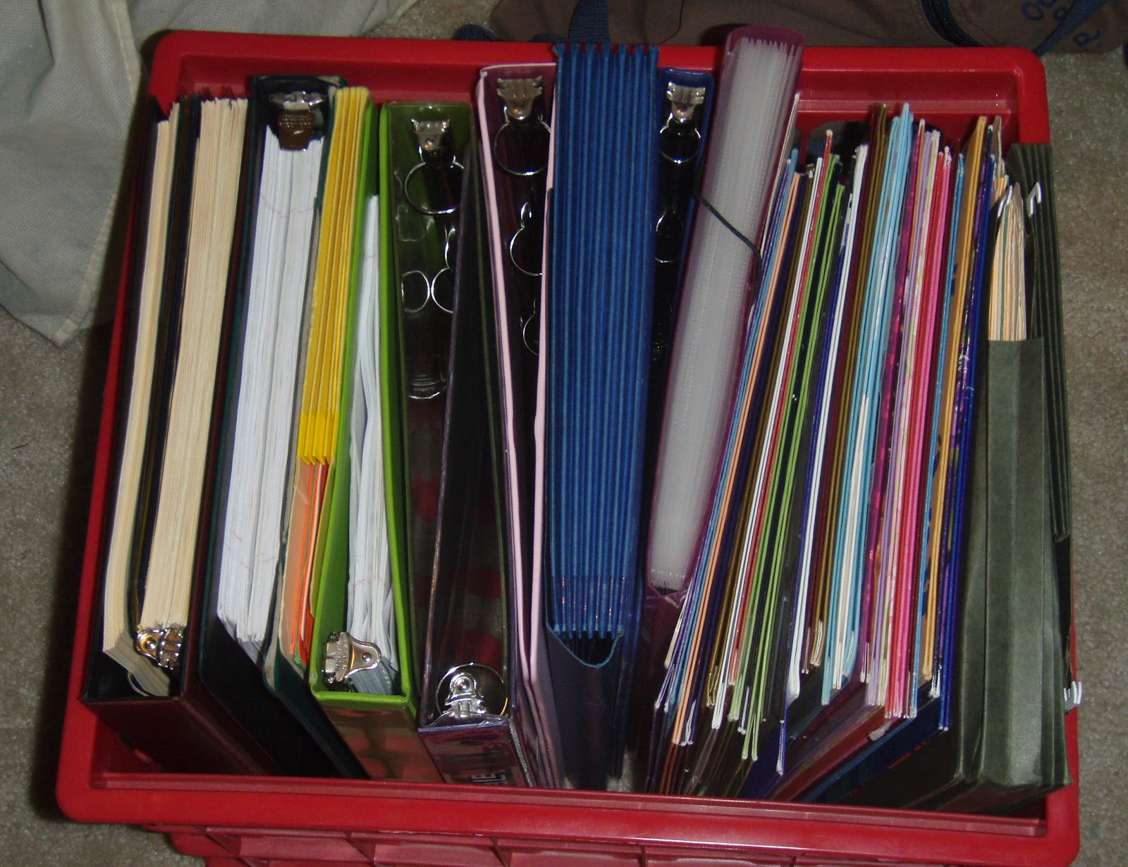
Feedback Portfolios
Hardcopy
Relies on students to create, sort, and store
Not traditionally reliable
Not available to advisors directly
Does nothing to improve feedback quality

Slide 7
E-Portfolio
Feedback Portfolios
Students can’t lose or fail to create it
Available to advisors
Potential for automated sorting and analysis
e.g. word clouds
Could provide record of feedback by subject and marker
Directly assisting in improving feedback quality

Slide 8
Implementation
?
Stores data by module, not by student
Feedback lost when module resets
Pull module data out to another database?
Store feedback before it gets to Moodle?
In house front-end (e.g. “TeleForm”)
Simultaneous to Moodle and Mahara?
Does it need to go to Moodle or Mahara?
?

Slide 9
Scoping
Access to Moodle database
Do we have as much as we need? Will we continue to?
Learning Technologies Unit (LTU) vs. IT Services
Timetable
LTU estimates 1 year with buyout to develop
This does not include implementation or staff and student training
Sustainability
Moodle or Mahara updates could crash backend links
An in house front-end could leave with the developer
Security
In house system too open?

Slide 10
Training/Marketing
Having a portfolio doesn’t make it work
Student training required (use and value)
Thru mini-MOOC or video lectures?
Getting verbal feedback into the system?
Getting staff to use it
High resistance in some subjects
Easy to sell the value, not the feasibility
Not able to (effectively) mark on scripts
Difficulty with feedback on equations
Dislike/distrust of standardised formats
Concerns about autonomy
Hard to compare scripts (when needed)
Not helpful for exam feedback
Must be at computer to mark

Slide 11
There’s work ahead, but there is light...
Conclusions
Students in LEAF already keeping portfolios (hardcopy)
Engagement and feedback on benefits is very positive so far
Students in LEAF requesting standard forms and readable feedback across subjects
Parallel student e-portfolio project (subject-based: Psychology)
Parallel staff e-feedback projects gaining traction in some subjects (Math & Stats, Business School)

Slide 12
Further Reading
Knight, P.T. (2000) The value of a programme-wide approach to assessment, Assessment & Evaluation in Higher Education, 25(3), 237-251
Nicol, D. (2010) From monologue to dialogue: improving written feedback in mass higher education, Assessment and Evaluation in Higher Education, 35(5), 501-517
Hughes, G. (2011) Aiming for Personal Best: a Case for Introducing Ipsative Assessment in Higher Education Studies in Higher Education, 36(3), 353-367
Jessop, T., El Hakim, Y., & Gibbs, G. (2014) The Whole Is Greater than the Sum of Its Parts: A Large-Scale Study of Students’ Learning in Response to Different Programme Assessment Patterns, Assessment & Evaluation in Higher Education 39(1), 73–88
Deneen, C., & Boud, D. (2014) Patterns of Resistance in Managing Assessment Change, Assessment & Evaluation in Higher Education, 39(5), 577–91

