Slide 1
Enhancing the student experience: implementation of the UHI assessment, feedback and feedforward policy QAA Focus On: Feedback from Assessment, 2018
Andy Brown, Head of Academic Development and
Dr Mei-Li Roberts, Programme Leader: BA (Hons) Child and Youth Studies

Slide 2
Outline
Background (Andy Brown)
Policy and guidance
Staff and student resources
Technology
Implementing the policy: BA (Hons) Child and Youth Studies Programme (Dr Mei-Li Roberts)

Slide 3
Policy and guidance

Slide 4
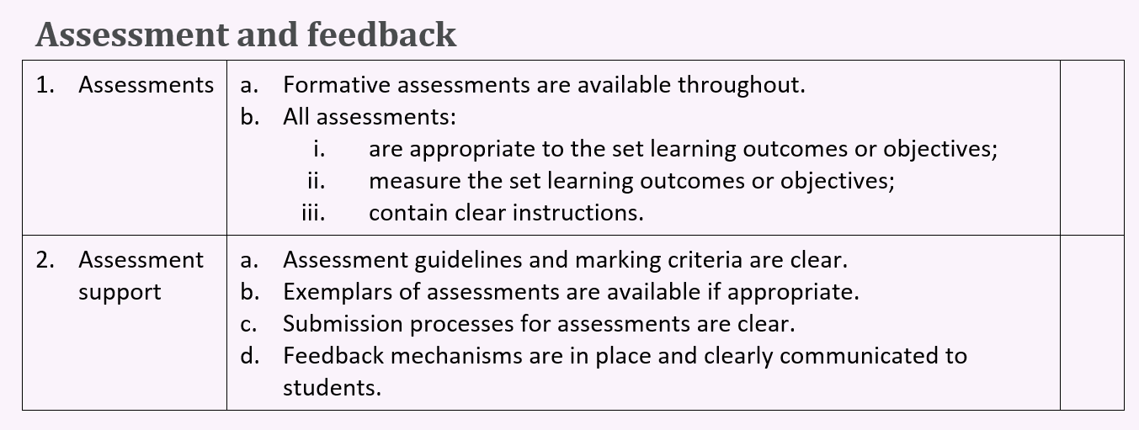
Blended Learning Standards: 2011
https://mahara.uhi.ac.uk/view/view.php?id=606

Slide 5
Blended Learning Standards: 2011
https://mahara.uhi.ac.uk/view/view.php?id=606

Slide 6
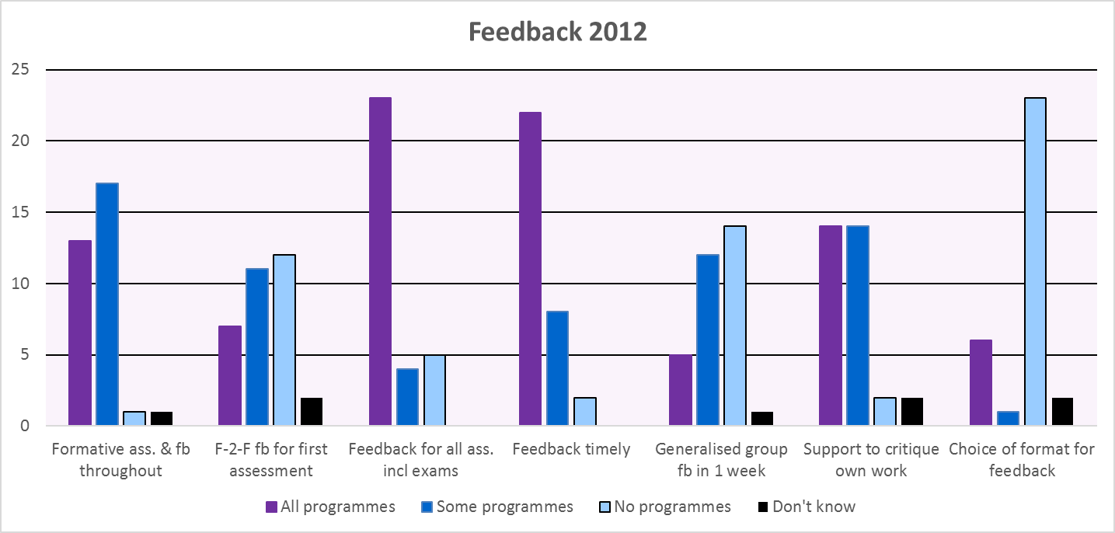
Assessment and feedback survey

Slide 7
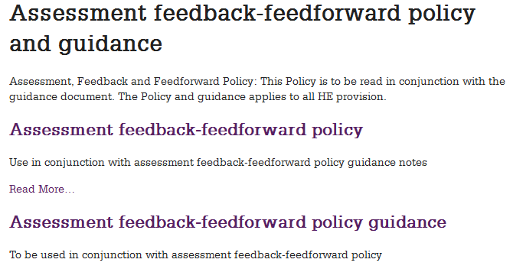
Policy 2014
http://www.uhi.ac.uk/en/about-uhi/governance/policies-and-regulations/policies/assessment-feedback-feedforward-policy-and-guidance

Slide 8
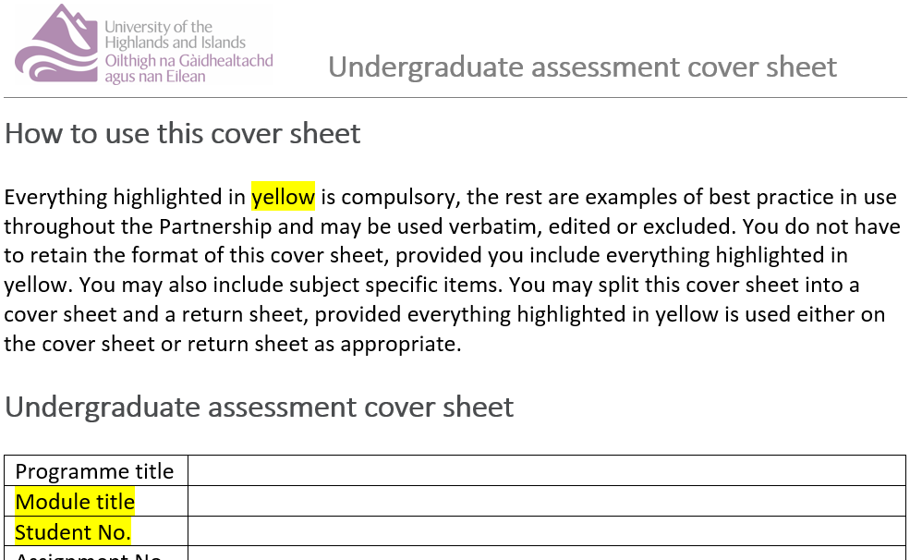
Standard SQA / UG / PG cover/return sheets

Slide 9
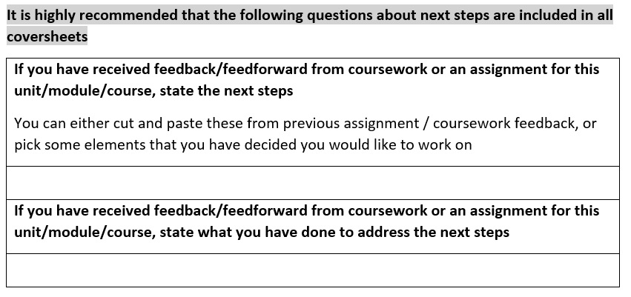
Standard SQA / UG / PG cover/return sheets

Slide 10
Learning, Teaching and Enhancement Strategy (LTES) 2017-2021
12 Learning and Teaching Enhancement Values
Assessment and feedback for learning:
rich and varied assessment
relevant learning opportunities
formative assessment and feedback allowing reflection and refinement of work
supporting students to make decisions in how they progress.
https://www.uhi.ac.uk/en/learning-and-teaching-academy/learning-and-teaching-enhancement-strategy/

Slide 11
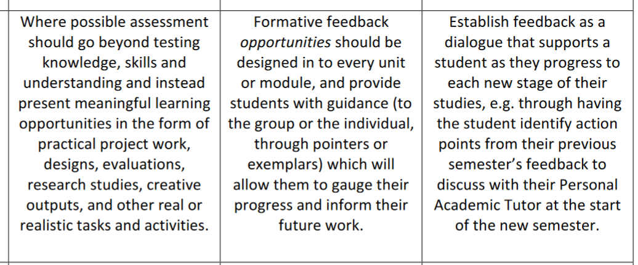
LTES guidance
https://www.uhi.ac.uk/en/t4-media/one-web/university/learning-and-teaching-academy/files/other-docs/Learning-and-Teaching-Enhancement-Strategy-2017-2021.pdf

Slide 12
Staff resources

Slide 13
EDU resources for staff
http://staffresources.uhi.ac.uk/support_portal/

Slide 14
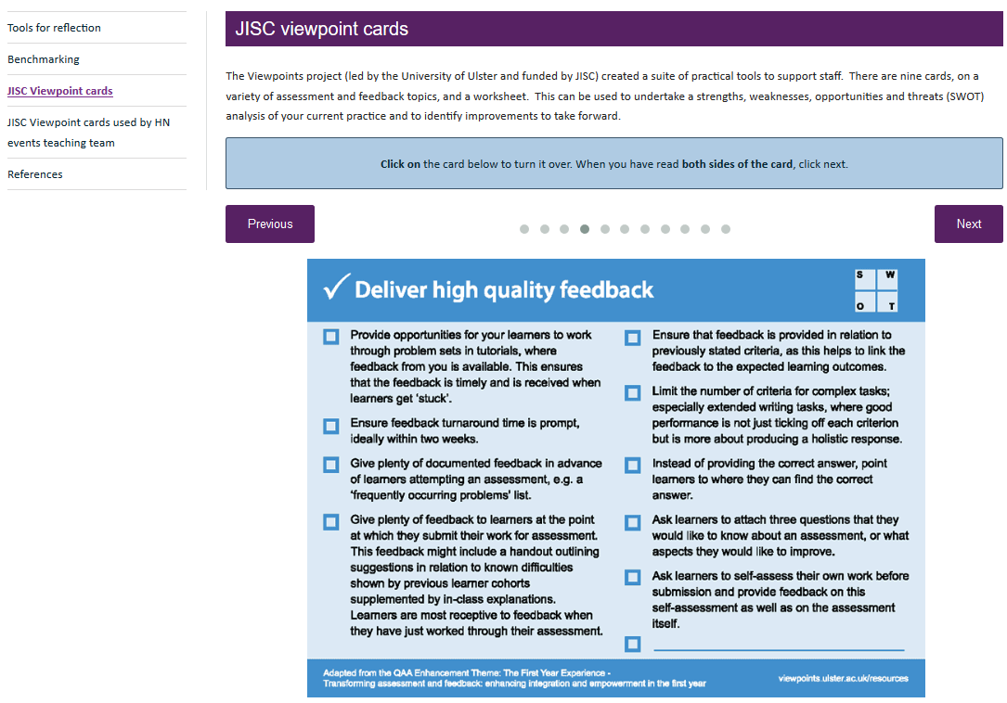
http://staffresources.uhi.ac.uk/support_portal/

Slide 15
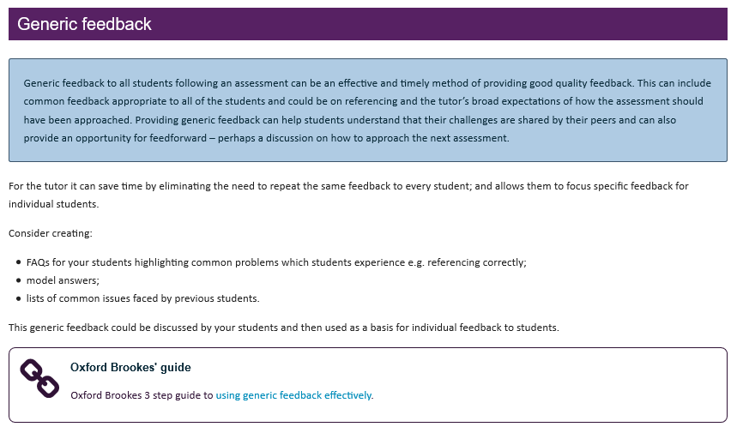
http://staffresources.uhi.ac.uk/support_portal/resources/assessment-feedback/design_feedback/generic_feedback.html

Slide 16
http://staffresources.uhi.ac.uk/support_portal/resources/assessment-feedback/design_feedback/audio_feedback.html

Slide 17
Student resources

Slide 18
Student online induction
http://induction.uhi.ac.uk/

Slide 19
http://induction.uhi.ac.uk/

Slide 20
http://induction.uhi.ac.uk/Assessment/assessment_feedback/index.html

Slide 21
Technology
Blackboard Collaborate, TurningPoint and Skype for Business (quizzes, voting, polling)
Blackboard blogs and wikis
Mahara ePortfolio
Turnitin GradeMark
MSWord comment tool.

Slide 22
BA (Hons) Child and Youth Studies
Delivered fully online across 9 academic partners (AP)
Personal Academic Tutor support at each AP
300+ students enrolled
Mainly female, mature student cohort
Most in employment (part-time or full-time)
Academic rather than practitioner award.

Slide 23
Graduate Attributes
Graduate attributes embedded in every module and across programme
BUT students not necessarily aware of graduate attributes when applying for further study/employment
Faculty event highlighted that this needed to be made explicit to students.

Slide 24
Subject Network event discussion
How to make graduate attributes explicit?
Embed personal development plan as a reflective assessment in a core module at each level?
But reflective assessments already embedded in the modules
Need to reflect on graduate attributes rather than module content
Also agreed this should enhance the student experience.

Slide 25
Graduate Attributes: reflection assessment
Mandatory assessment for all modules
0% weighting
Not marked.

Slide 26
Graduate Attributes: reflection assessment
Students submit their Graduate Attributes reflection on the Assessment Coversheet
They reflect on the process they undertook to complete the assessment
This includes how this met the identified Graduate Attributes in the module descriptor
If no reflection is submitted they do not pass the module.

Slide 27
Module descriptor example
Graduate Attributes | Learning Outcomes | Assessment
Knowledge and Academic Skills | LO1, LO2, LO3 | Assessment 1, Assessment 2
Community Awareness | LO1, LO2, LO3 | Assessment 1, Assessment 2
Interpersonal Skills | LO1, LO2, LO3 | Assessment 1, Assessment 2
Communication | LO1, LO2, LO3 | Assessment 1, Assessment 2
Self Management | LO1, LO2, LO3 | Assessment 1, Assessment 2

Slide 28
Graduate Attributes: reflection assessment coversheet
The assessment is embedded on the coversheet – the first box is mandatory:
Reflect on the process you undertook to complete this assessment including how this met the identified graduate attributes in the module descriptor.
Note at least 2 areas of development identified in previous assessment feedback and outline how you have addressed these in this submission.
Outline any areas you would like feedback on.

Slide 29
Further assessment guidance
For clarity, failure to complete the Graduate Attributes reflection section of the coversheet will result in a FAIL for the Graduate Attributes Reflection assessment and therefore the MODULE.
However, completion of this section does not mean you will automatically pass the other assessments in the module (i.e. the assessments the coversheet is attached to).
Completion of this section only means you have passed the Graduate Attributes Reflection assessment. Your other assessments are assessed and marked as usual and you still need to achieve an overall pass mark to pass the module, in addition to submitting your Graduate Attributes Reflection assessment.

Slide 30
Further assessment guidance (cont)
The Graduate Attributes Reflection assessment has a 0% weighting, this means that it is not marked but MUST be completed.
Your reflection can be as brief or as detailed as you wish, however you should bear in mind that the purpose of the Graduate Attributes Reflection is to:
Make explicit the graduate attributes that you are gaining in completion of your modules and degree.
Create a portfolio of reflection so you have specific examples that you can draw on to demonstrate how you have gained/met these attributes when applying for employment or further study. You may wish to save your reflections for future use.
Develop your reflective thinking, learning and practice, which is an important element of both academic study and professional practice when working with children and young people.

Slide 31
Further assessment guidance (cont)
It may also be useful to discuss your reflections with your PAT to identify areas for development as part of your personal development planning.
The UHI Graduate Attributes can be found here to assist in writing your reflection:
https://www.uhi.ac.uk/en/students/careers/get-experience/graduate-attributes/

Slide 32
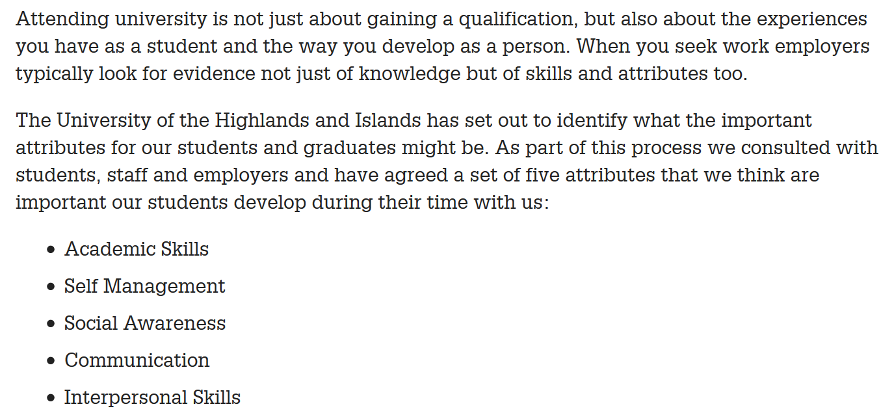
Graduate Attributes
https://www.uhi.ac.uk/en/students/careers/get-experience/graduate-attributes/

