Slide 1
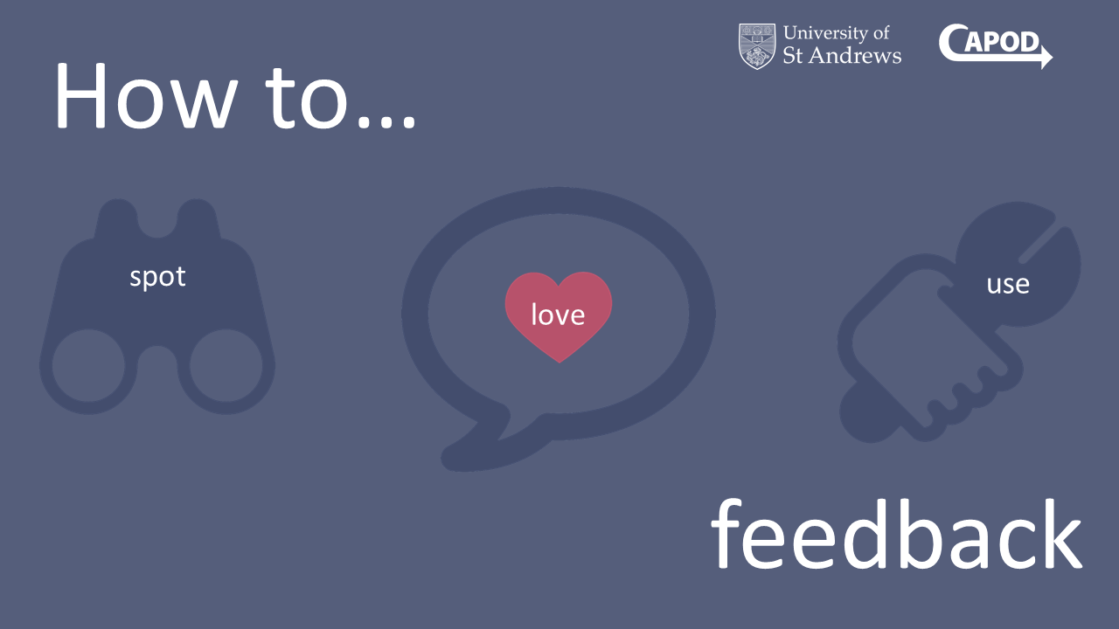
Notes:
Welcome to our session!
I’m Ros Campbell, Academic Policy Officer at the University of St Andrews and <Zach introduces himself>
We’re here today to share our online course that aims to improve student engagement and satisfaction with feedback

Slide 2
Session outline
Presentation: 15 minutes
Q&A: 5 minutes
Discussion with your neighbour: 5 minutes
Feed back discussion points to room: 5 minutes
Notes:
In the next half hour, we plan to:
Give you a brief overview of the course, and share initial feedback from the students who have completed the latest version of the course
We’ll then take some questions before we consider a couple of discussion points in pairs and feed back some key points to the room

Slide 3
Evolution of the course
Edinburgh Napier & Making feedback work for you
Mindset theory
F2f workshop and online course embedded in modules
Optional online course
v3 launched February 2018
Notes:
Edinburgh Napier delivered a session called ‘Making feedback work for you’ to our Directors of Teaching a few years ago
The session included Carol Dwek’s Mindset theory, and how mindset affects how receptive and motivated students are to acknowledging and acting on feedback
It was so well received that we drew upon the content and embedded it in selected modules within a range of schools via a tutorial and a Moodle course
In order to roll out the initiative across the University, a decision was taken to focus on the Moodle course
The latest version of the course was launched in February
It’s pitched at first year undergraduates but is available to all students.

Slide 4
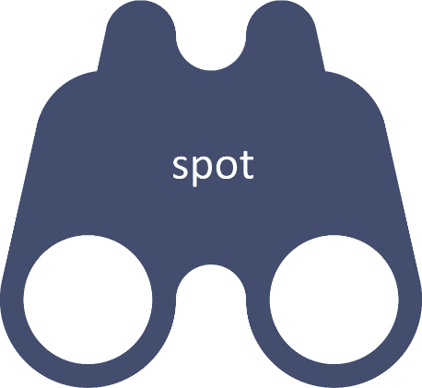
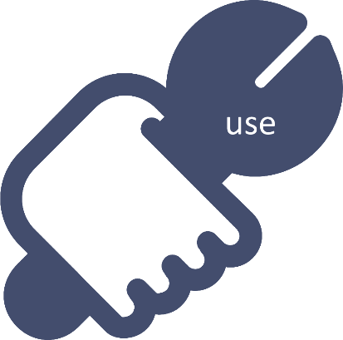
Course content/structure
Content streamlined and delivered through videos
Takes up to one hour to complete
3 sections:
Short survey
Notes:
In response to student feedback, the content was streamlined and is now delivered through four short videos and two activities.
A student created the videos using whiteboard animation software Videoscribe.
We decided to experiment with a more informal and engaging style.
The 1-hour course is organised into 3 sections:
How to spot feedback explains the sources and types available at University
Once students spot feedback, they need to be receptive to it. Section 2 explains how to fall in love feedback via a growth mindset
The final section explains how students can use feedback to get the best out of themselves and their degree
Students are then taken to an optional survey.
The plan is to refresh and enhance the course annually in response to staff and student feedback.

Slide 5
Demo
Notes:
I’ll now share a clip from each section of the course.
After the demo: I’ll now hand over to Zach, who will share some of our initial findings

Slide 6
Student engagement
Course launched 7 February 2018
2,285 (24%) students have accessed the course to date
529 students have revisited the course
Full analysis/review at end of AY 2017-18

Slide 7
Student feedback
Optional questionnaire upon completion of course
20 responses to date
All students:
agreed the course was beneficial
felt better informed about how to make the most of feedback

Slide 8
Most useful parts of the course
It has helped me understand how to receive feedback in the future and how to apply it to future tasks in order to improve
I know most of the course content but it is really helpful to realise and reflect on the ways I use feedback
I get stuck in a rut and bogged down with my workload. This course makes my workload seem more logical and straightforward
The mindset section was useful, as I have a fixed mindset at times. It gave me great tips on how to have a growth mindset

Slide 9
Will you do anything differently as a result of completing the course?
Yes: 16
No: 4
I will try harder to look at the bigger picture and use feedback constructively rather than focusing on the mark itself and how I feel about it
I looked over old feedback and it was like looking at it with fresh eyes
Notes:
Zach: Can you highlight that the 4 who said no either didn’t respond or said that they were already familiar with the content

Slide 10
Will you do anything differently as a result of completing the course?
I will try to be less upset by bad marks and use that energy to look for ways to make my marks better
I will persist in the face of developmental feedback and see it as a positive rather than a negative
Ensure I bring forward my deadlines so I’m not working at the last minute. Use more discipline in reviewing material. These points arise from “self feedback”
Notes:
Zach: Can you explain the ‘self-feedback’ point:
The course explains different sources of feedback and points out that students themselves are a fantastic source of feedback
They may not realise it, but students provide themselves with lots of useful reflections and advice when they read a draft of their work with a critical eye and self-appraise an assessment to identify its strengths and weaknesses
The ideas they generate about what they would do differently if they tackled a similar piece of work again also counts as feedback.

Slide 11
Areas for development
From a student perspective
Expand activities to add discipline specific elements
Provide more information on dealing with feedback outside of the University, e.g. in the workplace
Include focused and relevant activities for PG students
From our perspective
Increase engagement with the student population
Include advice on how students can provide good quality feedback, e.g. via MEQs
Conduct full analysis at the end of the academic year
Notes:
Re. adding discipline-specific elements: this probably isn’t practical but we could incorporate Faculty-specific elements, i.e. Arts, Sciences, Social Sciences
The course is pitched at first year undergraduates but PGs new to the Scottish system may also find the content helpful. Again some PG-specific elements could be incorporated into the course
Schools received feedback from students via MEQs and would benefit from more specific feedback. If something is considered and described by students as ‘good’ – what makes it good, being more specific would help Lecturers/Tutors

Slide 12
Questions

Slide 13
Discussion with your neighbour
What are the most effective ways to engage students in online courses when they are not compulsory or embedded in modules?
How can we create a culture in which feedback is perceived by students as a shared responsibility rather than something that is given externally and assimilated in a passive manner?
Notes:
We’d like you to choose one of the questions and spend five minutes discussing this with your neighbour.
We’ll then use the final 5 minutes to share some of thinking.
<Read out questions>

Slide 14
Thanks for joining us
Rosalind Campbell
Academic Policy Officer
rc42@st-andrews.ac.uk
Zach Davis
Director of Education
doed@st-andrews.ac.uk
Notes:
Thanks so much for joining us!
We hope you’ve found the session useful.
Please do get in touch with us if you want to learn more about the course.

