Slide 1



Firrhill High School
Has HE got all the answers?
Making Feedback Sparkle in Primary and Secondary Schools
Alison Saxon, Depute Headteacher, West Linton Primary School
Carol King, Geography Teacher, Firrhill High School, Edinburgh
Maggie King, Head of Academic Quality, Heriot-Watt University
Learning and teaching
QAAS Focus On Session, 22 March 2018

Slide 2
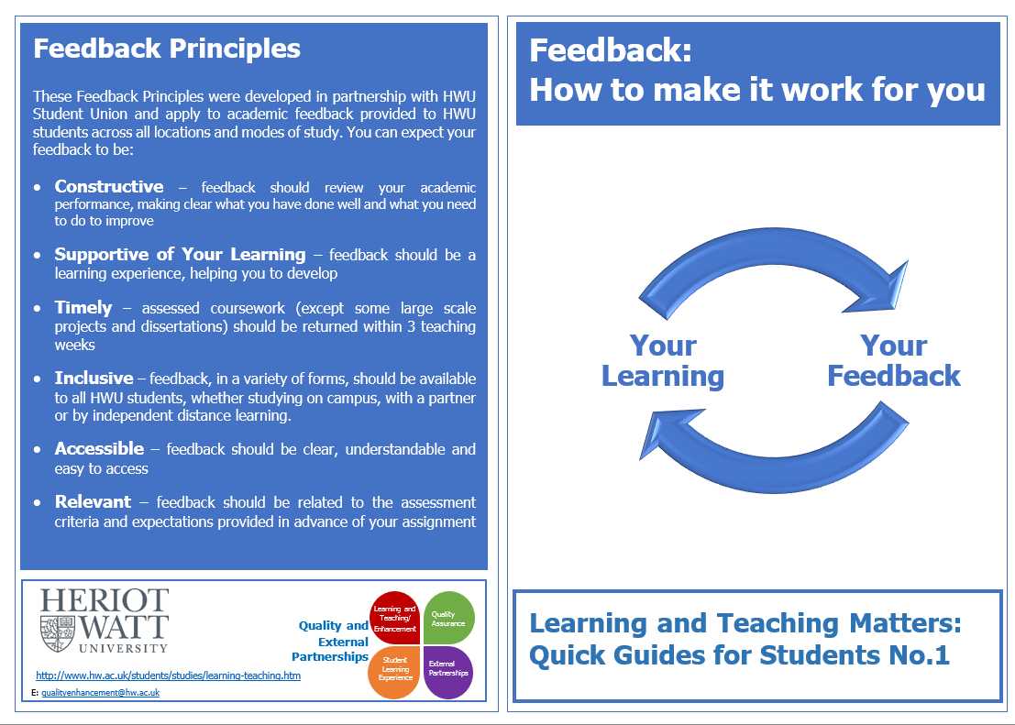

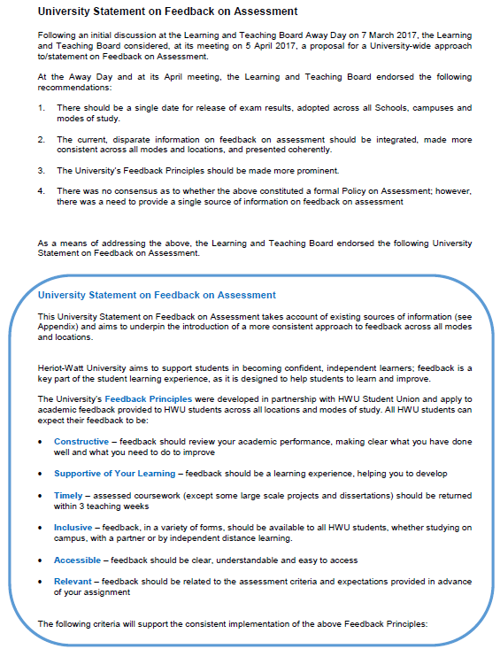
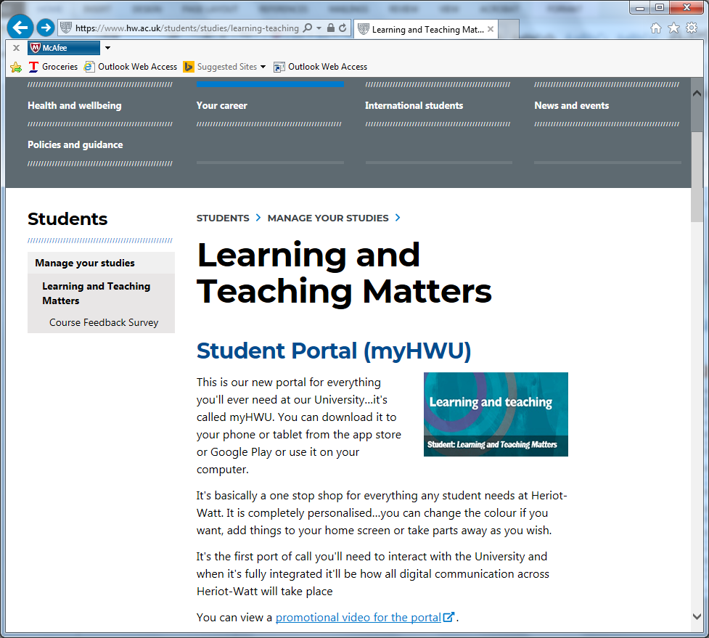


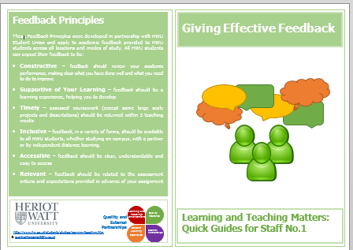
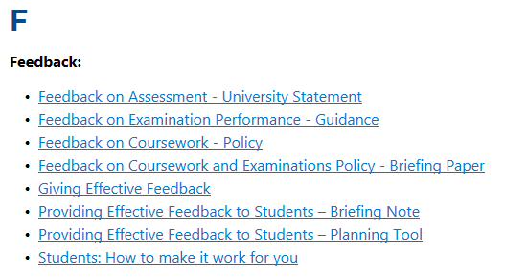
Tackling the “Feedback Issue”
2016
2017

Slide 3
Doubts …
Meanwhile, in a galaxy far, far away a primary and secondary school not so far away …
What use is made of feedback?
And by whom?
Who is the feedback for?
Right time?
Right format?
Everyone knows how to provide Useful Feedback for Learning?
Students get the opportunity to demonstrate how they have learned from feedback?
Everyone knows how to use Useful Feedback for Learning?

Slide 4

Feedback: Practical Strategies
for all of our students
Carol King
Firrhill High School

Slide 5


Feedback Strategies
Learning Intentions
I understand the meaning of the term ‘feedback’.
I am aware of practical strategies to give my students feedback.
Success Criteria
I’ll try one new strategy/adapt an existing strategy this term.

Slide 6
Less teaching + more feedback = better learning
Improving the Quality of Feedback
Exploring new feedback practices to support student learning
By engaging students in a good feedback process, we teach them to be critical thinkers and independent learners.
(Di Michele Lalor,2012:75)

Slide 7
What is Feedback?
Feedback aims to reduce the gap between where the student ‘is’ and where he/she is ‘meant to be’.
It must be actionable, a recipe for future action.
Three questions should drive feedback:
  What am I trying to achieve?
  How much progress have I made so far?
  What should I do next?

Slide 8
Weakness in my own feedback (own practice, interview with students, questionnaire, post-it student evaluations)
Lengthy and illegible comments that students don’t read!
Whole class feedback – huge amount of teaching time giving whole class feedback (least effective).
Giving students the answer (scribbled comment in margin, rather than supporting pupil to make improvement).
Writing same comment - add more detail, expand response.
The dreaded red pen!
Not giving students the opportunity to make use of feedback in class.
Giving marks and comments (research suggests students only look at marks).
Recognising that marks can lead to complacency or despair.
Acknowledging that ‘Good Effort’ doesn’t constitute feedback!

Slide 9

Feedback strategies
Takeaway menu
No marks feedback
Plickers
Using feedback
Feedback shouldn’t highlight what students can’t do
Demonstrate the impact of feedback – intelligence, talent and ability can change

Slide 10

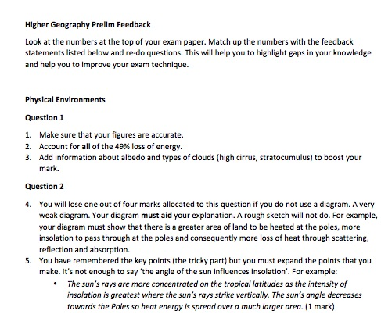
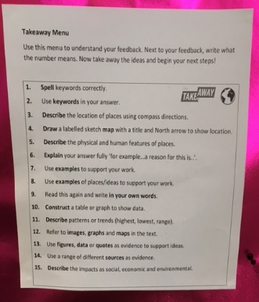
Takeaway menu
Write numbers at top of work
Give students the opportunity to use feedback statements
You have shown a thorough understanding of X and Y, now takeaway 1 and 4. Students are then given time to use the feedback.

Slide 11
No Marks
Where’s the mark?
Have you got a mark?
Marks/grading doesn’t answer the third feedback question (what should I do next?).
Students surprised but acknowledged that they were ‘forced’ to read the feedback.
Improved quality of responses for a number of students.
Able to support students who needed help.
Provided a challenge for pupils who had completed task thoroughly (‘medal’ and a ‘mission’).

Slide 12
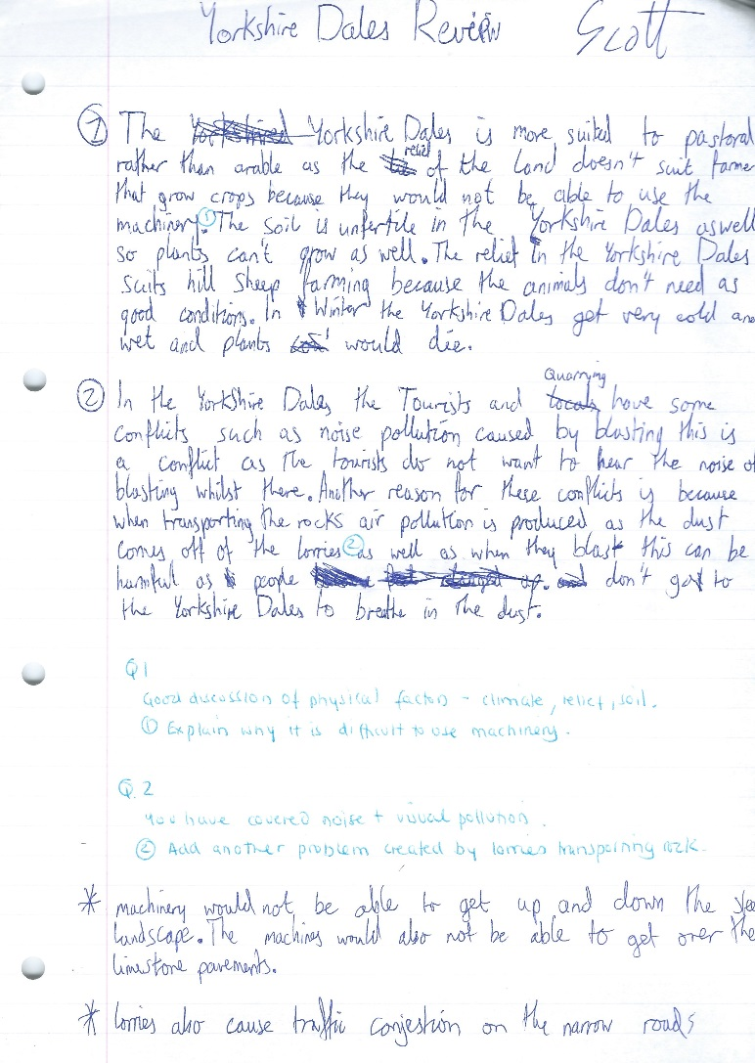
No Marks

Slide 13
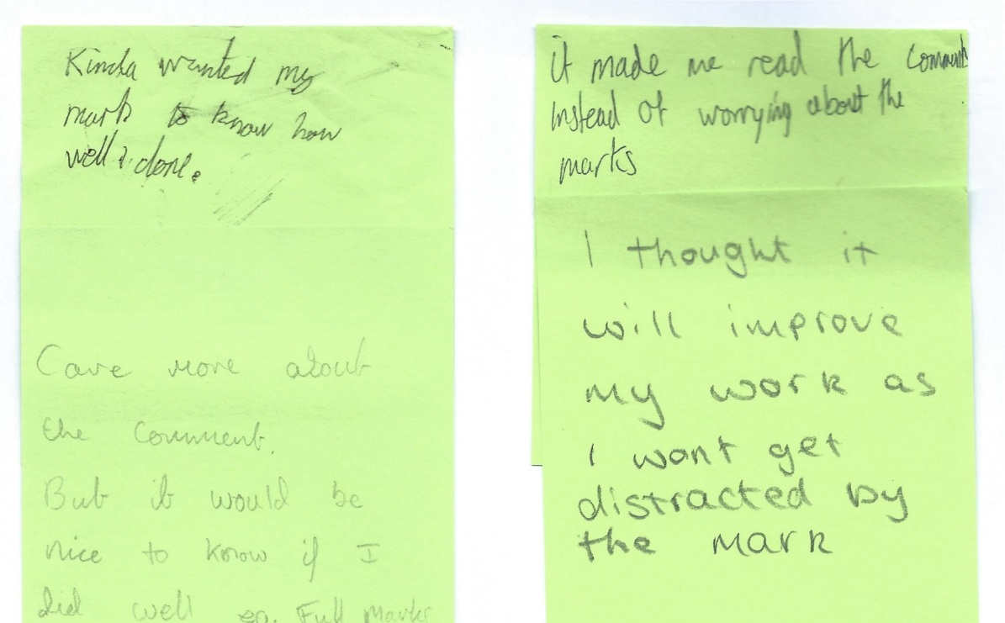
No Marks

Slide 14
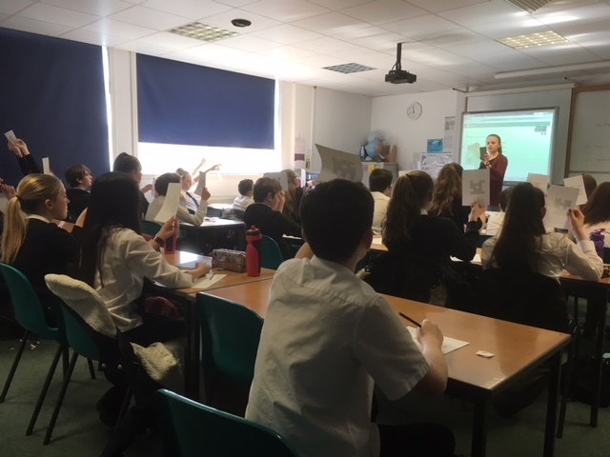

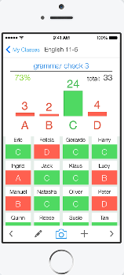

Plickers
Don‘t forget feedback from students!
Paper clicker
No need for handsets and it‘s free!

Slide 15
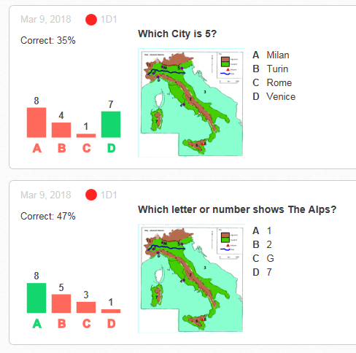
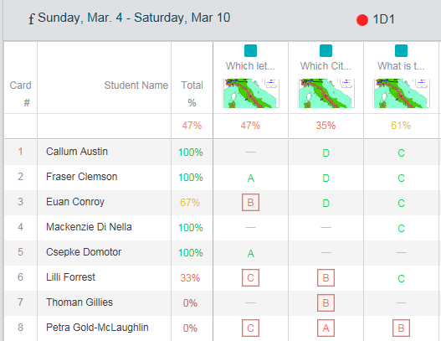
Plickers
Real-time reports
Identify city 5 from the map.
Consolidation, re-teaching a concept/idea or move on?

Slide 16
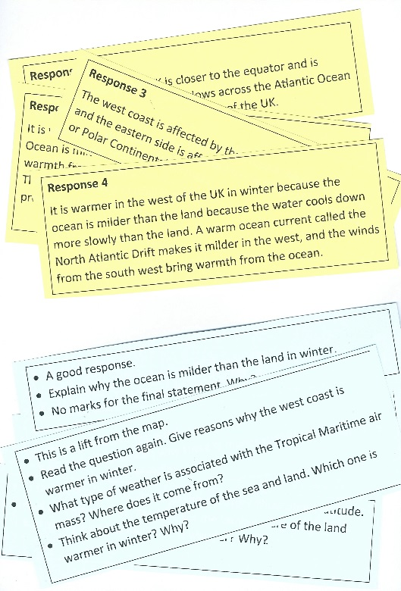
Encouraging students to make use of feedback
Group Task
Task: Match feedback to exam response
Make pupils read the comments!!

Slide 17

Dish the DIRT…give students the opportunity to make use of feedback
Dedicated Improvement and Reflective Time.
Feedback can’t be left hanging; it can’t work if pupils don’t have an immediate opportunity to use it.

Slide 18
Other ideas..
Instead of instructions, present questions about the work to which the students must respond.
Instead of correcting work, tell the student how many mistakes there are that need fixing and encourage them to identify and fix them independently.
Write your feedback on post-its instead of directly on work. Get students to work in groups to decide which piece of feedback was intended for which of their pieces of work.
Spot the mistakes (don’t just show exemplary material).
Don’t just assume learners understand…get feedback from your students.

Slide 19
Top Tips for Feedback
Make it timely.
Use active language.
Keep it positive. Learning is a journey.
Focus on one or more strengths of the work and provide at least one suggestion for a next step.
Give students time in class to make use of feedback. It’s not wasted time!
A medal and a Mission. Don’t forget a challenge for the more able-student. Everyone has something to learn.
Save marks/grades for the end of a unit.

Slide 20
Before you go…

Slide 21
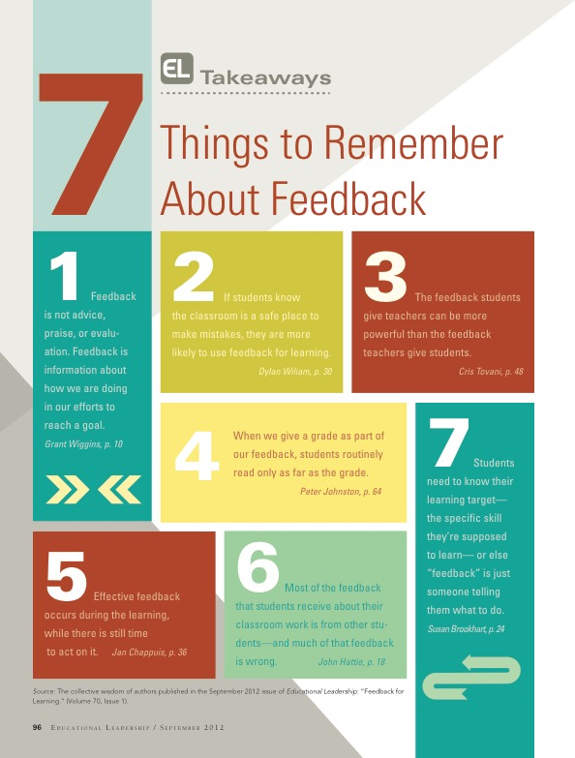
Before you go…

Slide 22

West Linton Primary School
“The most powerful single modification that enhances achievement is feedback. The simplest prescription for improving education must be ‘dollops of feedback’.”
Professor John Hattie
(Influences on Student Learning)
Alison Saxon, Depute Headteacher
West Linton Primary School

Slide 23

What do our ‘dollops’ look like in a typical lesson?
Firstly we need to get the learning environment right…
Culture and ethos
Relationships
High Expectations
Growth Mindset
Learning Powers

Slide 24
Make the learning visible…
Pupil involvement
Learning Intentions
Success Criteria
Co-create the learning based on prior knowledge so feedback is relevant and personal – differentiation.

Slide 25
During the lesson…
Visual resources – WAGOLLS
Modelling – direct input
Remind pupils of learning intentions and success criteria
Opportunities to talk, share and collaborate
Climate of trust which allows mistakes to be ‘exposed’ and shared.

Slide 26
During the lesson contd,…
Learning walks
Continual formative assessment – verbal feedback
Swap and check
Stop and share
Use wait time, lollipop sticks and no hands rule to involve all and encourage a ‘no opt out’ environment.

Slide 27
Feedback which works for us..…
Self and peer assessment
Oral feedback
Written feedback
Learning conversations – with each other, with teachers, with parents/carers
Tickled pink and green for growth
Personal Learning Plans

Slide 28
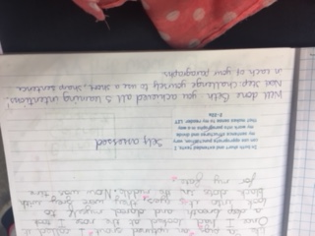
Self Assessment
Curriculum for Excellence Experience and Outcome – basis for learning Intention
Self Assessed
“You have achieved all five learning intentions. Next step – challenge yourself to use short, sharp sentences in your paragraphs.”
Written feedback from teacher

Slide 29
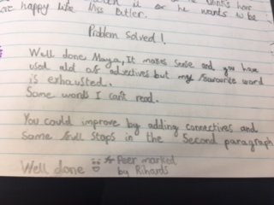
Peer Assessment
It makes sense and you have used a lot of adjectives but my favourite word is ‘exhausted’.
Some words I can’t read. You could improve by adding connectives and some full stops in the second paragraph.
Well done. Peer assessed by Rihards

Slide 30
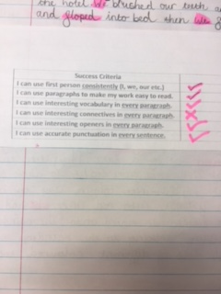
Success Criteria
Tickled pink
Green for growth
Success Criteria
I can use first person consistently (I, we, our, etc.)
I can use paragraphs to make my work easy to read.
I can use interesting vocabulary in every paragraph.
I can use interesting openers in every paragraph
I can use accurate punctuation in every sentence.

Slide 31
Oral Feedback
“ When our teachers tell us something during our learning it means we can check that we are doing the right thing and don’t do the whole lesson as a big mistake. Like ‘oh look you’ve forgotten to do paragraphs’.” P5 pupil
Never underestimate the power of timely oral feedback. And never make assumptions that your feedback has been understood.

Slide 32
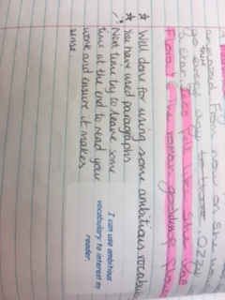
Written feedback
Two Stars and a Wish
Star - Well done for using some ambitious vocabulary
Star - You have used paragraphs
Wish - Next time try to leave some time at the end to read your work and ensure it makes sense.
Learning Intention
I can use ambitious vocabulary to interest my reader

Slide 33
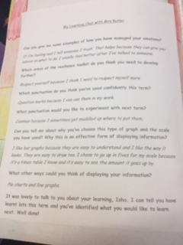
Learning Conversations
Asking for examples of learning that has taken place
Being able to make links in the learning
Asking which areas need to be developed
“I chose to go up in fives for my scale because it’s a times table I know and it’s easy to see the amount it goes up by.”
Discussing appropriate strategies and ways of displaying information.

Slide 34
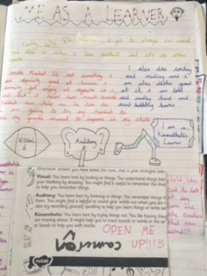
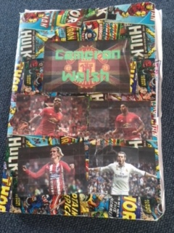
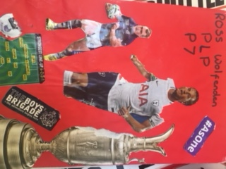
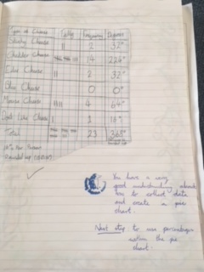
Personal Learning Plans

Slide 35
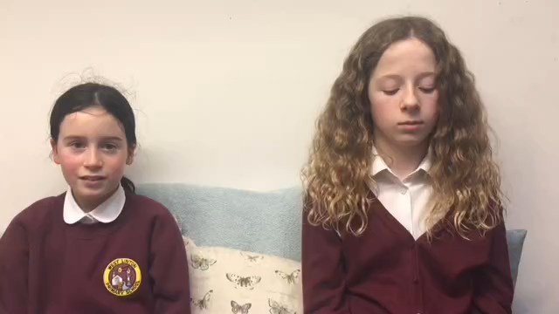
And finally, here’s what our pupils say…

Slide 36
Firrhill High School
Thank you …
Learning and teaching

