Slide 1

Harnessing Institutional NSS and course level data to inform changes in approaches to feedback
Susan Rhind, Neil Lent, Kirsty Hughes, Jill MacKay

Slide 2



Introductions and Context
Senior Vice Principal
(Responsibility for student experience, learning and teaching across the University)
Deputy secretary
(student experience)
AP Assessment and Feedback (SMR)
Lecturer (University Learning and Teaching)
(NL)
Research fellows (VME): JM and KH

Slide 3


Multiple sources… same messages
Course enhancement questionnaires (CEQ)
NSS
Students association Teaching Awards data analysis
LEAF
Principals teaching Award Scheme (PTAS) projects
Notes:
We have increasingly noticed that the different approaches and modes of data collection we use are coming up with the same messages.

Slide 4
Feedback and assessment - Edinburgh
 | Correlation with Overall Satisfaction
Assessment and Feedback Criteria | 0.63
8. The criteria used in marking have been clear in advance | 0.64
9. Marking and assessment has been fair. | 0.46
10. Feedback on my work has been timely. | 0.47
11. I have received helpful comments on my work. | 0.58
Data from NSS 2017, source: UoE
Notes:
Although we are harsh on ourselves – all our schools cluster on the top right.
We see our

Slide 5

Clear criteria in Edinburgh …
Overall, in 2017, 62% of the student body agreed that criteria used in marking was clear in advance
What does that mean . . .
Large scale exploration of 2016 free-text response.
We thematically analysed all 2900 odd student comments on a school-by-school basis
“I have often received feedback too late to change things for my exam. The third (final) piece of coursework was handed in before I received feedback from the first one. How can I tackle coursework without feedback? You know the numbers of students you have so why is the marking load a surprise?”
“Staff encourage you to critically analyse work and then they do the same on your feedback to help you progress”
“My presentation marks were unfair and depended on my peers. My mark did not tally with my feedback (e.g. my feedback said ‘good’ and didn’t explain my result)”
Data from NSS 2016, statements paraphrased

Slide 6
Consistent Messages from NSS About Assessment & Feedback
Feedback not arriving when expected
Feedback not being available prior to the next piece of assessment
Feedback no longer being relevant to the next piece of assessment
Feedback not being recognised as feedback by students
Inconsistency in staff marking of assignments
‘single-mindedly relying on the explicit expression of assessment standards and criteria cannot, on its own, adequately help students to understand assessors’ perceptions and expectations of assessment.’ O’Donovan, B., M. Price, and C. Rust. 2004

Slide 7
Course Enhancement Questionnaire: what is it?
1. The course was well organised
2. The learning aims of the course were clear
3. Feedback so far has been helpful and informative
4. This course has been intellectually challenging
5. The course has developed my skills and abilities
6. Overall I am satisfied with the quality of the course
7. What did you find most valuable about the course?
8. What improvements, if any, would you make to the course?

Slide 8
Holistic Approaches
Table 1: Comparison of qualitative results across EUSA Teaching Award (2014-15) data and NSS 2016 responses.
EUSA Teaching Award Theme | NSS Analysis theme
Concerted, Visible Effort | Staff have research focus
Charisma, personality and engaging teaching | Learning and teaching; assessment and feedback
Breaking down student-teacher barriers and fostering student engagement | Community and alienation
Consistency, predictability and stability of support | Organisation; facilities; student concerns and self-development
Notes:
Having looked at the broader themes from NSS which does not dig down to course level, we can build up a greater picture of specific course level issues or innovations but looking at the course evaluation data and other datasets such as the student union’s teaching award nominations which show the very best of what is happening at Edinburgh.

Slide 9

From Diagnosis to Action
3 levels of feedback quality
Individual
Course
Programme

Slide 10

From Diagnosis to Action: Local
LLC – School of Literature, Language and Culture course for students on assessment and feedback literary including a feedback portfolio
Vet school – assessment literacy training; students marking work, standard setting exam questions, giving feedback
Global academy ELDER* – Programme level approach to course design and assessment.

Slide 11
From Diagnosis to Action: University
Institutional level
Focus on Course and Programme Design
Assessment literacy
‘‘…. assessment (as) a central aspect of curriculum design and development that is integral to teaching and learning, rather than an afterthought”. (Medland, 2016)
“Assessment should be placed at the centre of subject and programme design” (Boud, 2010)
Programme and course design
Assessment and Feedback

Slide 12
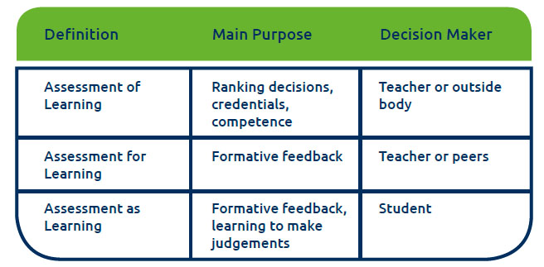

Thank you!
http://bit.ly/2Bi5Swd

