Slide 1
Focus On: Feedback from Assessment
Debra Macfarlane, Quality Enhancement Manager,
QAA Scotland
http://enhancementthemes.ac.uk/focus-on
#FocusOnFeedback
Notes:
Welcome.
Thanks for coming. Promises to be a great day.
No planned fire alarms.
Toilets.
Lunch.

Slide 2
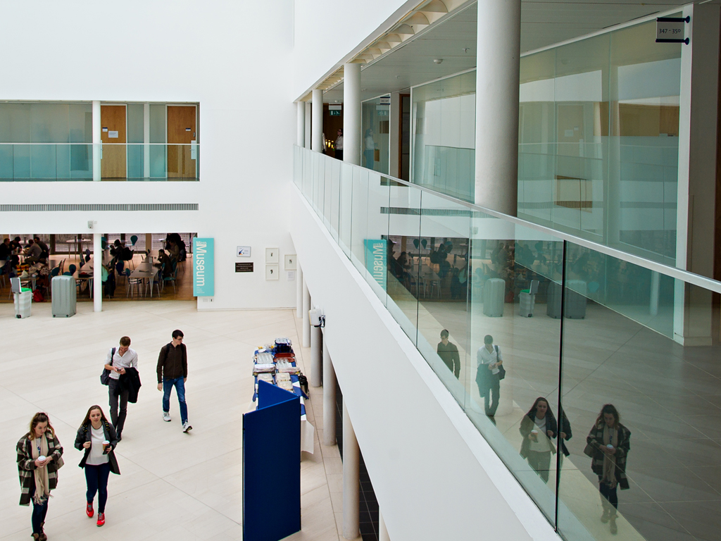
Focus On: What is it?
#FocusOnFeedback

Slide 3

Enhancement in the Scottish University sector
Deliberate steps to bring about improvement in the effectiveness of the learning experiences of students
  Aims to enhance the student learning experience and encourage student engagement and participation in learning and in quality processes
  Emphasis is the quality of the student experience of learning rather than on QA systems and processes themselves
#FocusOnFeedback
Notes:
I know that some of you are familiar with FO. For those that aren’t:
Can’t explain FO without starting with enhancement.
A bit more about what enhancement is, it is:
Deliberate steps to bring about improvement in the effectiveness of the learning experiences of students
Aims to enhance the student learning experience and encourage student engagement and participation in learning and in quality processes
Emphasis is the quality of the student experience of learning rather than on QA systems and processes themselves

Slide 4

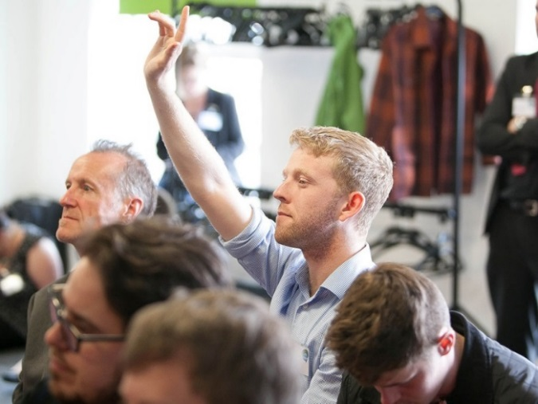
The Enhancement-led Institutional Review (ELIR) process
Peer review of all Scottish HEIs on a four-year cycle
Student reviewers since 2003
International reviewers since 2008
First cycle: 2003-2007
Second cycle: 2008-2012
Third cycle: 2012-2017
ELIR 4: 2017-2022
Judgement and outcomes – commendations and recommendations
#FocusOnFeedback
Notes:
Has anyone been involved in Enhancement-led Institution Review?
Discuss ELIR process
Process - Reflective Analysis/AIS/Visits/Judgement/Reports:
The institution undergoing ELIR submits a self-evaluation document called a Reflective Analysis (RA). The ELIR team uses this document and initial meetings with staff and students to develop themes for exploration during the review visits. These themes relate to broad areas of institutional activity:
​
(Contextual information about the institution and the student population, Enhancing the student learning experience, Strategy and practice for enhancing learning and teaching, Academic standards and quality processes and Collaborative Practice)
At the end of the review, the ELIR team produces an Outcome report (covering the overarching judgment, the commendations and the recommendations) and a more detailed Technical report.
The ELIR 4 cycle began with reviews this year at QMU and RCS and these are happening now.

Slide 5
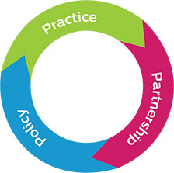
Focus On projects
Focus On projects cover topics that occur frequently in ELIR outcomes as commendations or recommendations
  All HEIs in the sector work collectively to promote policy and practice on the topic.
  One topic is chosen each academic year and all Scottish HEIs work collectively to promote policy and practice around this topic.
  Staff and students identify priority areas and a programme of activity is designed to ensure a positive impact on practice in the sector.
Notes:
Run by QAA
Can be topics arising from reccs or commendations
Topic chosen by SHEEC
Scoping exercise to determine priorities
Previous topics:
Assessment and feedback
Collaborative Activity
Institution-led review
The postgraduate research student experience

Slide 6

Focus On 2017-18
Why feedback from assessment?
Feedback from assessment was an area for development in 9 ELIRs in during the last review cycle.
timeliness of feedback
helping students to use feedback to understand grades
consistency of feedback across different subject areas
overall quality of feedback
#FocusOnFeedback
Notes:
The information above is taken from points arising in ELIR Outcome reports. Further information on the Feedback from Assessment is included in the longer ELIR Technical reports. Information from theTechnical reports is shared with the sector in Thematic reports and we updated the report on Assessment and feedback in July 2017.

Slide 7
Focus On 2017-18
Feedback from assessment: what do students think?
What do students think? What’s helpful and what isn’t?
Do we need to think about students’ engagement with feedback differently?
Following up: how far have we come and where are we now?
How has the sector has progressed since 2014-15? What institution-wide approaches have been successful?
How can/have developments in technology help/ed us?
#FocusOnPGR
Notes:
Feedback from assessment: what do students think?
We want to work with a wide range of students at all stages of study in a variety of institution types and look at what the evidence might be telling us. Part of today aims to consider student views of feedback from assessment and whether we need to rethink our approaches based on the evidence we have.
Following up: how far have we come and where are we now?
If you are a tutor – what have you done differently in providing feedback since 2015? Is it working?
If you are a student – how are you working with feedback? Has your feedback been useful? Are you making the most of it? What do you need that you don’t get?
If you are a policy maker – what has changed since 2015? Have you adopted new policies and procedures? Are they working? Are they operational (turnaround times) or transformational in terms of the quality of feedback?

Slide 8
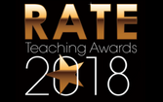






Focus On 2017-18 outputs
Teaching Awards Analysis project
What can we learn about what students value in feedback?
Outcomes and dissemination July 2018
#FocusOnFeedback
Notes:
Looking at text on feedback from TAs both where institutions have a distinct feedback category and more widely where feedback is mentioned.
We are still looking for more institutions to participate in this project with us, and we will be in touch again later this month to give you a further opportunity to take part.

Slide 9


Focus On 2017-18 outputs
Short films
How far have we come in the last 5 years and what needs to change? (The Future for Feedback)
What do students think works, what do staff think and is there a difference?
Assessment Feedback: How can we use technology?
Webinar series & Twitterchats
April-June (topics coming out of today’s discussions)
#FocusOnFeedback
Notes:
Short films
You may have noticed our cameras. You will have the opportunity during the day to contribute to our films if you want to. We are filming today and next week to produce the films outlined.
Webinar series & Twitterchats
During the day, we want to know what topics you would like to see us address further through webinars and other means.

Slide 10
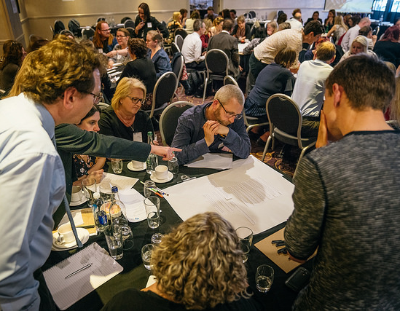
Focus On Today
Inspirational keynotes
Opportunities to work in institutional teams and with others
Sharing practice sessions – motivating, informal, practical
#FocusOnFeedback
Notes:
I’d like to thank all the contributors to today’s event in advance. Focus On projects only work because of your willingness to share your experiences, but the highs and the lows and help other people learn from them and I appreciate your effort in making today so good.

Slide 11
Focus On: Feedback from Assessment
http://enhancementthemes.ac.uk/focus-on
#FocusOnFeedback
Notes:
Introduce Paul Orsmond
Paul is a Senior Lecturer in biology at Staffordshire University and he also teaches in the medical school at Birmingham University. He has researched and written extensively on the impact of feedback on assessment on the student learning experience. He is particularly interested in the communities of learning that students develop and the social interaction that they undertake outside the overt curriculum, all whilst carrying out self- and peer-assessment practices in order to make sense of their learning experiences. His work on staff development has been widely recognised and he has worked with different Centres for Excellence as well as being part of the ASKe (Assessment Standards Knowledge Exchange) work at a national level on assessment and feedback.
Today he is asking the question, ‘ Feedback – it’s all about human interactions isn’t it?’. I hope you will enjoy the session and (check when PO wants questions).

Slide 12
Feedback in higher education: it’s about human interactions - isn’t it?
Paul Orsmond

Slide 13
Feedback – ‘is an integral part of the student learning experience and describes your performance on an assessment, whether an essay, exam or other learning activity. It predominately comes from staff but can come from your peers and even yourself.……however, feedback is only useful if you read, reflect and act on it’.
(The University of Stirling Student Union)

Slide 14
The Oxford English Dictionary defines ‘integral’ as ‘necessary to make the whole complete’.

Slide 15
Tutor Feedback Practice Over the Years
1:1 feedback – a tutor - to a student.
A baton of knowledge.
Isolated process.
Tutor feedback practice conserved over time – like essential genes.

Slide 16
Acquisition Metaphor
Concepts are to be understood as basic units of knowledge that can be accumulated, gradually refined, and combined to form ever richer cognitive structures’ (Sfard, 1998,5)

Slide 17
Some Things Have Changed
Assessments have changed.
GCU helicopter model looks at the bigger picture feedback is not isolated.
Some documentation makes us think about learning differently.

Slide 18
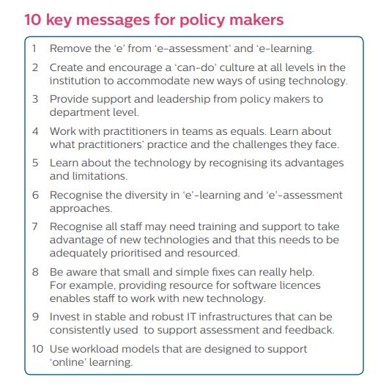
QAA Scotland’s
Focus On: Assessment and Feedback in March 2015

Slide 19
‘Focus On: Assessment and Feedback - policy, practice and partnership’
QAA event March 2015
Key message number 4 makes a request in asking policy makers to ‘work with practitioners’……‘learn about what practitioners do’.

Slide 20
This key message is not ‘talk to us’ about what we do.
It isn’t even ‘observe’ what we do.
It is ‘work with practitioners’ to ‘learn about what practitioners do’.

Slide 21
Join Our Community
Come into our community of practice.
Our knowing will be evident in our doing.
Policy makers and practitioners as ‘learners’ where the feedback in a shared context is an integral part of their learning experience.

Slide 22
Attributes of a Community of Practice
Mutual engagement which bonds the practitioner community of practice together.
Joint enterprise, a sharing of an understanding of a common purpose.
Shared repertoire, community resources.

Slide 23
Participatory Metaphor
‘Permanence of having gives way to the constant flux of doing’….ongoing activities are never considered separately from the context within which they take place.’ (Sfard, 1998, 6)

Slide 24
Who are the Learners in HE
Policy makers, practitioners (tutors), students.
Wegner and Nückles, (2015) when considering the participatory metaphor understand universities as communities of practice.
Landscapes of learning. (Wenger et al., 2015)

Slide 25
An Interesting Question
If we spoke of practitioners and policy makers as learners with feedback integral to the learning experience, would it make us think differently about tutor feedback to students?

Slide 26
Students as Practitioners
Imagine students as practitioners, saying to tutors, work with us practitioners’ to learn about what student practitioners do.
What would tutors learn?

Slide 27
Student Quote 1
‘I mean we’ve only been together two years, but we’ve sort of learnt how each one operates ...They may criticise [you], but somebody else might have a greater understanding [of the subject] and you know that they’ve got a greater understanding and so you know that you’ve got to sort of balance [their view and yours].

Slide 28
Student Relational Social Learning
Reflective comfortable statement.
Historical shared context (2 years) in this relational social learning in the lived-in world (Lave and Wenger, 1991) allows for learning how each one operates. This is about identity.

Slide 29
Identity Change and Feedback
Identity change influences how feedback through the negotiation of meaning, listening to, and accepting the views of others, brings about further learning and subsequent identity change.

Slide 30
Feedback and Employability Skills
Negotiating skills – finding meaning.
Making evaluative judgements.
Listening to the views of others.
Accepting other opinions.
Let us explore student relational social learning more…

Slide 31
Student e-mail on receiving a coursework mark
‘I’ve been speaking to my friends and we think my mark should be higher as I’ve included things they haven’t, and they got a higher mark than me’

Slide 32
Peer Assessment
‘An arrangement for peers to consider the level, value, worth and quality or successfulness of products or outcomes of learning of others of a similar status’. (Topping, 1998, 250)

Slide 33
The Student Learning Practice is Clear
I’ve been speaking to friends. Learning recognised in the doing.
The student knows ‘who to talk to’ and ‘how to talk’.
Historical context again.
Let us explore a little more…

Slide 34
Student Quote 2
‘Once I had a problem [regarding feedback] with my dissertation supervisor. I thought I’d done things wrong … but I spoke to other people who were also his project students … and had the same problem … It wasn’t a case that we were doing something wrong … it was more the feedback he was giving wasn’t relevant to what we were trying to say’.

Slide 35
Student Quote 3
I’ve spoken to friends … and the chances are they’ve been marked by a different tutor … not being able to talk to the tutor [who marked their friend’s work] … so talking to friends you … gives you broader perspectives of what [tutors] are after.

Slide 36
Learning in a Community
Belonging in their community.
‘We’ community identity. Just like the QAA document – student practitioners have a collected identity they wish to share through their practice.
Meaning through experiences.

Slide 37
Student Quote 4 – Ipsative Feedback
‘If you take a piece of coursework that [I] did in the ﬁrst year and compare it to a piece, like an essay, that [I’ve] written this year, you’d see a total change in [my] style of writing and that is not something that’s been instilled in me by anyone else, that is something that I’ve acquired’.

Slide 38
Students Learning Practices
Sustainable learning practices.
Lifelong learning practices.
Practitioner practices.
Many tutors may be unaware that this learning occurs. Many students may not see this as learning because of the power of acquisition metaphor.

Slide 39
Thus far……….
Tutor marks and/or feedback have prompted lots of human interactions, admittingly none involving the tutor. We might say, truly student-centred feedback discussions. Feedback is integral to the learning experience – part of ‘we think’ within our community. It is not jut the individual who learns.

Slide 40
Does HE need to recognise that feedback is integral to student learning occurring in higher education outside of the formal curriculum?

Slide 41
How Students Change
Ask a student at the end of year 2 how they have changed compared to start of year.
A sense of being, of becoming, knowing the practitioner within. Student identity change and development are important in learning.

Slide 42
Learning Outside the Curriculum
‘Invisible learning’ in higher education.
Students are addressing existing HE agenda.
Tutors are learners in higher education. When tutors and students meet it is the meeting of two communities – learning occurs at the boundary.

Slide 43
Tutors and Students Working Together
Swaffield (2011) tells us that the word assessment comes from the Latin verb assidere – which means ‘to sit beside’.
Earl (2003) refers to this as ‘assessment as learning’.

Slide 44
Learning at the Boundaries
Helps students locate themselves and engage with tutor perspective – develop a shared context. Has implications for assignments.
For students to be brought into the specialist tutor community.

Slide 45
Wenger, Wenger and de Laat (2011)
Immediate value in becoming a practitioner.
Potential value new ideas acquired/ways of being.
Applied value enrich community discussions.
Multiple insights.
Realised value interact with wider community.

Slide 46
Learning as a Series of Encounters
‘It’s how students will interpret what you [tutor] think is a cast iron objective statement…we’ve learned that students can see them [assessment criteria] quite differently to us…it’s very often some feedback that we get from students… It’s ah!... You know, they said they didn’t understand that, well why didn’t they understand that? What have we [module tutors] got to do to put that right? What I find useful about peer assessment is twofold. I start to think a bit more how I set the assessment criteria and I can imagine that the criteria I set will probably change. You kind of think of [assessment criteria] in theory and apply them in practice and you can get a nasty shock sometimes’.

Slide 47
Criteria as Boundary Objects
Sadler (2013) – ‘Know-to’ – potential value of feedback.
Torrance (2012) – ‘why’ of criteria and exploring the feedback gap – applied value of feedback.
Sadler (1989) ‘tacit’ and ‘guild’ knowledge – realised value.

Slide 48
‘Tutors and students are not seen as having different roles but having different degrees of expertise’ (Wegner and Nückles, 2015, 633)
Tutors and students as learners – partnerships in learning.

Slide 49
Active Partnerships of Learning
Barron and Corbin (2012) improve student learning and institutional success.
Bovill and Felten (2016) belief existing culture in HE may not suit such development of partnerships.
Partnership as boundary learning can change the culture.

Slide 50
Changing Cultures
Within communities, learning is understood in terms of identity change. As the identity of higher education practitioners’ changes, because of their human interactions, the culture of higher education will inevitably change.

Slide 51
Feedback is about Human Interactions
Students in HE engage in rich learning practices which appear to be unrecognised. This learning should not remain invisible.
We are all learners – welcome to my community.
Recognising that learning occurs at community boundaries benefits students and tutors.

Slide 53
Focus On: Feedback from Assessment
How far have we come and what still needs to change?
Ailsa Crum, Head of Quality and Enhancement
#FocusOnFeedback

Slide 54

Feedback from Assessment
#FocusOnFeedback

Slide 55

Feedback from Assessment
Have the challenges changed since 2015? (Q3)
Have you made the progress you intended? (Q6)
How far has the Scottish sector progressed? (Q7)
Looking back, do you find anything surprising?
What key changes would you make in the next 2 years to improve practice in this area?
#FocusOnFeedback

Slide 56
Focus On: Feedback from Assessment
What’s worked and what hasn’t? (2013-17)
Evaluating institutional approaches to improving feedback in the Scottish sector
http://enhancementthemes.ac.uk/focus-on
#FocusOnFeedback
Notes:
Sharing practice sessions.
All rooms on this floor. Out of the main room to the end of the corridor and turn left.
You can choose one of the three options on the programme and sessions are first come first served.
Each session option includes 2 case study presentations lasting 30 minutes each. Please don’t change room between sessions. There isn’t time.
If your first choice session is full, please choose another session. They are all fantastic – you won’t be disappointed.

Slide 57
Focus On: Feedback from Assessment
http://enhancementthemes.ac.uk/focus-on
#FocusOnFeedback
Notes:
Welcome Naomi
Naomi is a cognitive psychologist specialising in learning behaviour and engagement with education.
Naomi’s research focuses on the processing and implementation of feedback, educational transitions, and educational identities.
Naomi has extensive experience of academic leadership, having held the positions of Director of Undergraduate Studies and Director of Learning and Teaching in the School of Psychology at the University of Surrey, and Associate Dean (Learning and Teaching) in the Faculty of Health and Medical Sciences at the University of Surrey.
She also runs CPD events and workshops at Universities, Schools and Colleges across the UK, to support educators and students to enhance the impact of assessment and feedback on learning and development. Naomi is a Senior Fellow of the Higher Education Academy, and a National Teaching Fellow.

Slide 58



Student engagement with feedback
Dr Naomi Winstone
Senior Lecturer in Higher Education, National Teaching Fellow
QAA Scotland
22nd March 2018
From transmission to transformation: Maximising the impact of assessment feedback through staff-student partnerships
Dr Naomi Winstone
Senior Lecturer in Higher Education, HEA National Teaching Fellow
Director, Surrey Assessment & Learning Lab
@DocWinstone
Notes:
https://www.youtube.com/watch?v=2m3K2IbSJhE
https://www.youtube.com/watch?v=QuLaQoQP9oo

Slide 59
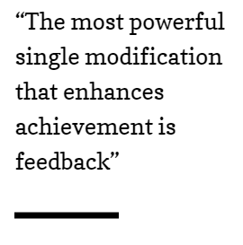
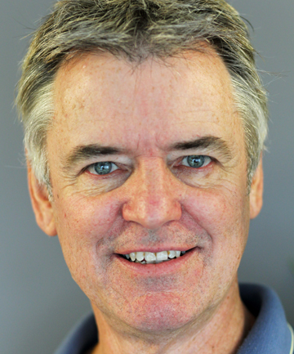
Feedback is power…
John Hattie, 1992, The Power of Feedback
Notes:
The only thing that matters is what students do with it. No matter how well the feedback is designed, if students do not use the feedback to move their own learning forward, it’s a waste of time.

Slide 60
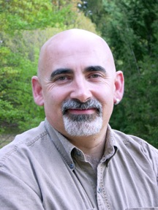
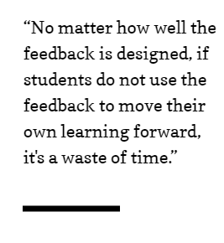
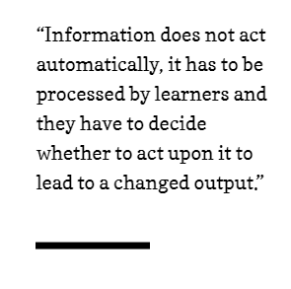
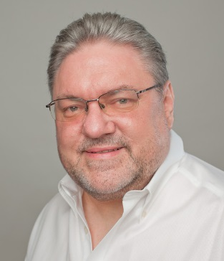
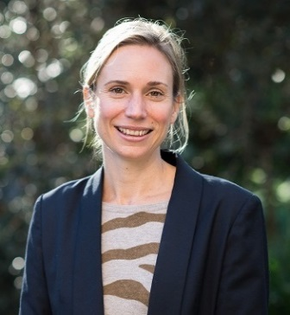
Feedback is power… BUT
Dylan Wiliam, 2014, Is the feedback you’re giving students helping or hindering?
David Boud and Elizabeth Molloy, 2013, Rethinking models of feedback for learning: The challenge of design.
Notes:
Effectiveness about what educator or student does?

Slide 61

Notes:
Grade justification
timing

Slide 62
A partnership approach
“We're paying for education so it's not our, sort of responsibility to engage with feedback because we're paying for it”
-- Undergraduate Economics student
Winstone, Medland, Bourne, Rees & Niculescu (in prep)

Slide 63
A partnership approach
“I assume [students] are educated enough to deal constructively with the feedback they receive – otherwise they should not be at my university anyway”
Carless & Winstone (forthcoming, 2019)

Slide 64
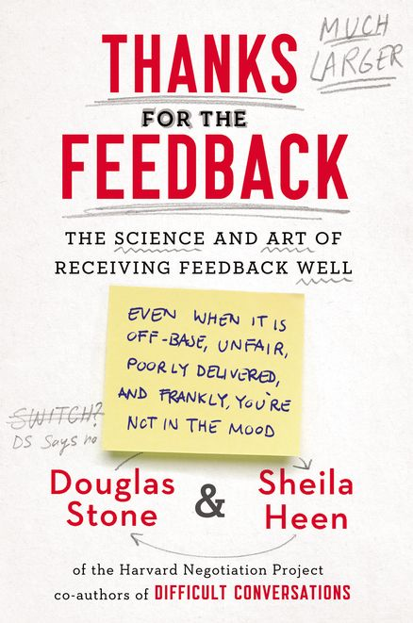
“Interesting. When we give feedback, we notice that the receiver isn’t good at receiving it. When we receive feedback, we notice that the giver isn’t good at giving it.”
Stone and Heen (2014,
p. 3)

Slide 65

We’re all human

Slide 66

Do you have TAA Deficiency?
We’re all human
(Howell & Shepperd, 2013)

Slide 67
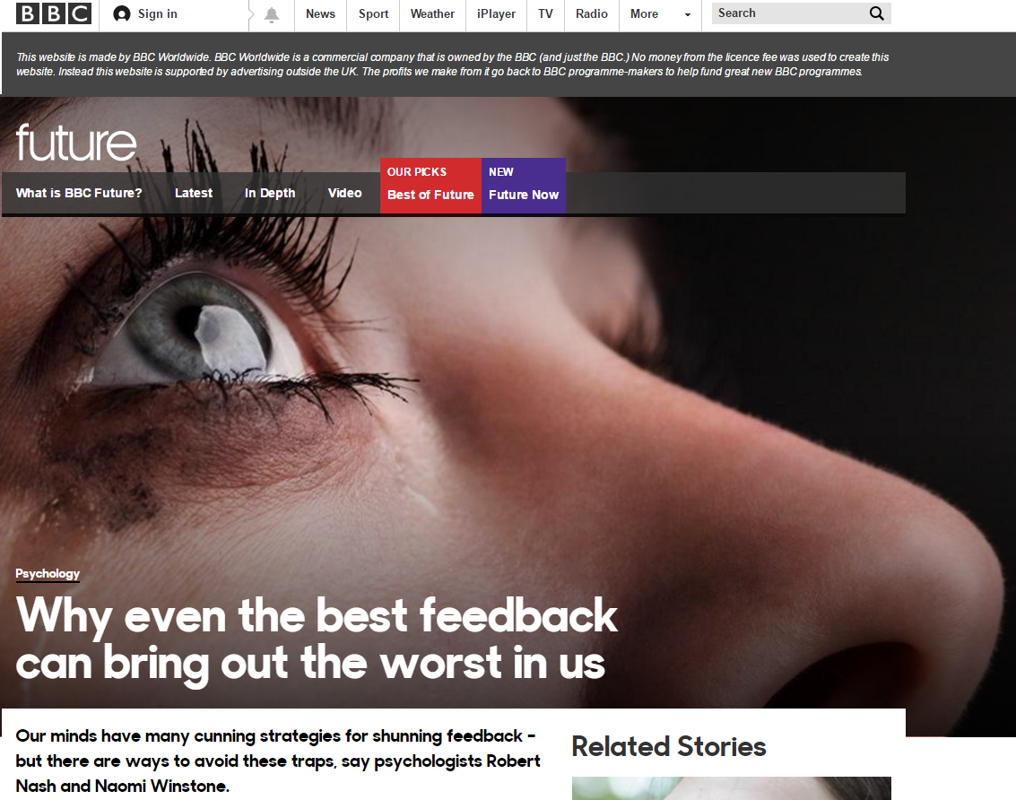
We’re all human

Slide 68
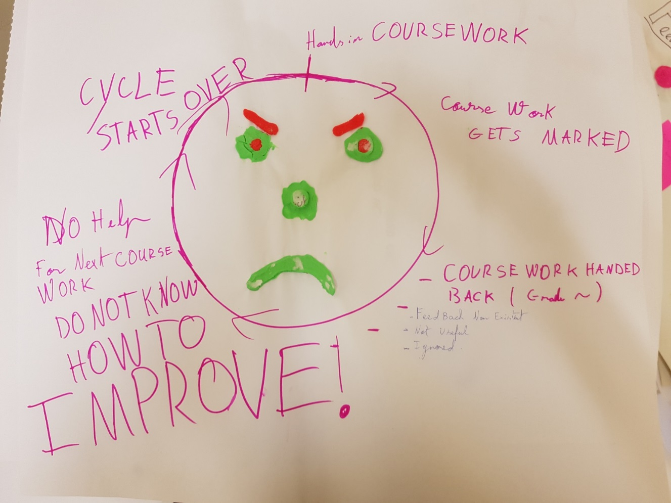
We’re all human
Winstone, Rees, Niculescu & Medland (in prep)

Slide 69
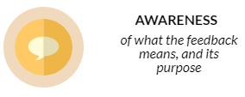
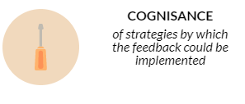

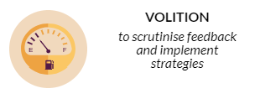
Why it can be difficult to use feedback
Winstone, N.E., Nash, R.A., Rowntree, J., & Parker, M. (2017). “It’d be useful, but I wouldn’t use it”. Barriers to University students’ feedback seeking and recipience. Studies in Higher Education, 42(11), 2026-2041.
Notes:
Grade justification vs learning
Opportunity- when does feedback come?

Slide 70
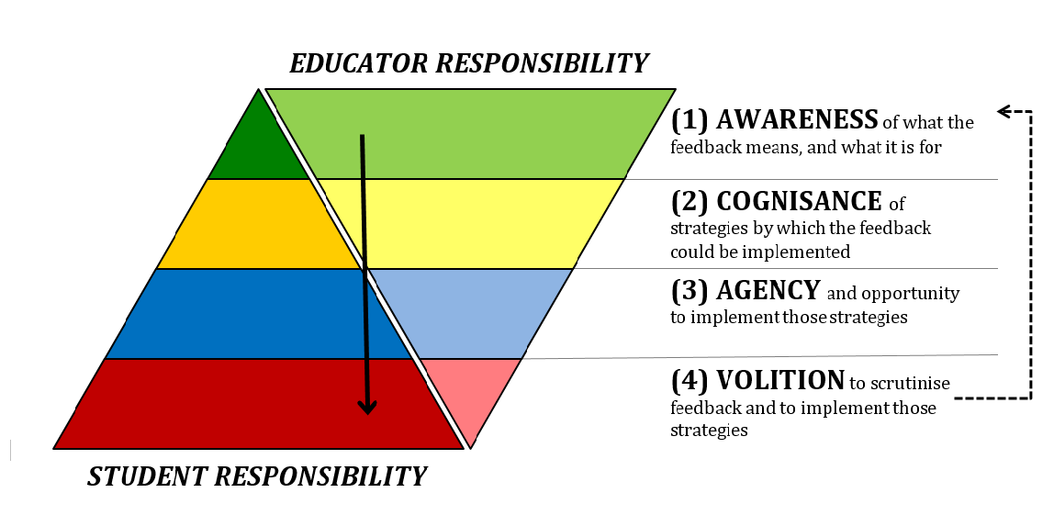
Responsibility sharing
Nash, R.A., & Winstone, N.E. (2017). Responsibility sharing in the giving and receiving of assessment feedback. Frontiers in Psychology, 8, 1519.

Slide 71


Dialogue and shared purpose
“Students potentially have access to a limitless pool of feedback opportunities during their time at university, but this is a resource to be drawn down and implemented through a process ultimately driven by the student themselves, not something to be merely “received”.
(Winstone & Pitt, 2017)
Winstone, N. E., & Pitt, E. (2017). Feedback is a two-way street, so why does the NSS only look one way? Times Higher Education, 2332 , 30.

Slide 72
Building Feedback Literacy
“students should be trained in how to interpret feedback, how to make connections between the feedback and the characteristics of the work they produce, and how they can improve their work in the future”
(O’Donovan, Rust & Price, 2016, p. 940)
O’Donovan, B., Rust, C., & Price, M. (2016). A scholarly approach to solving the feedback dilemma in practice. Assessment & Evaluation in Higher Education, 41(6), 938-949.

Slide 73
Building feedback literacy
S
A
E
Self-appraisal
G
Assessment literacy
Goal-setting and self-regulation
Engagement and motivation
Winstone, N., Nash., R., Parker, M., & Rowntree, J. (2017). Supporting learners’ engagement with feedback: A systematic review and a taxonomy of recipience processes. Educational Psychologist, 52, 17-37.

Slide 74

Feedback guide
Feedback workshop
Feedback portfolio
http://tinyurl.com/hea-deft
Winstone & Nash (2016). The Developing Engagement with Feedback Toolkit (DEFT). York, UK: Higher Education Academy.

Slide 75



FEATS
https://tinyurl.com/FEATSportfolio

Slide 76
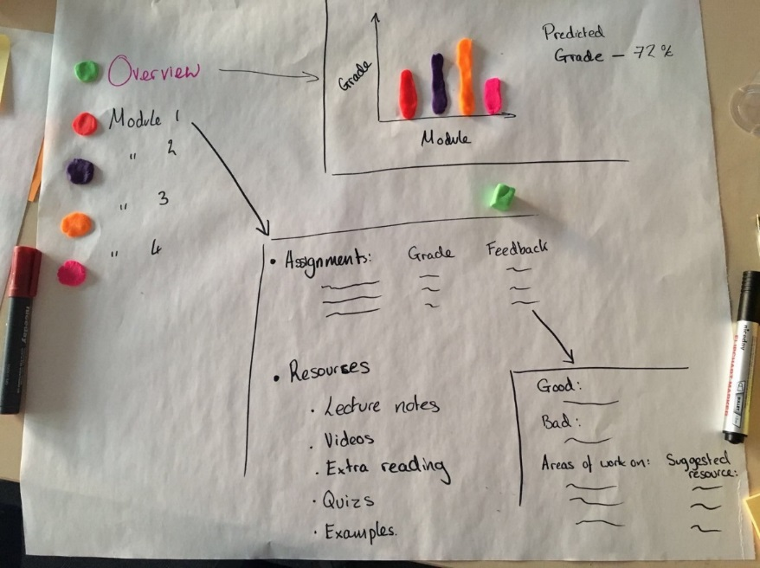
Student co-design
Reflection on current experiences
Individual designs
Group designs

Slide 77
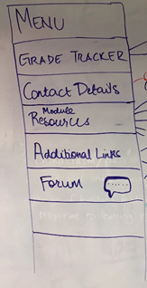
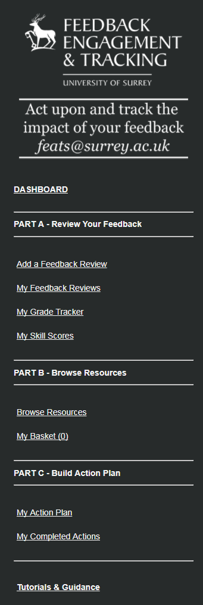
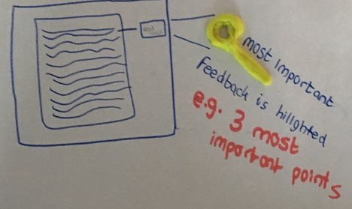
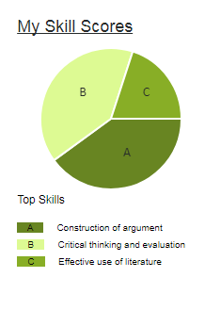
Student co-design

Slide 78
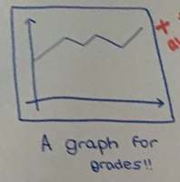
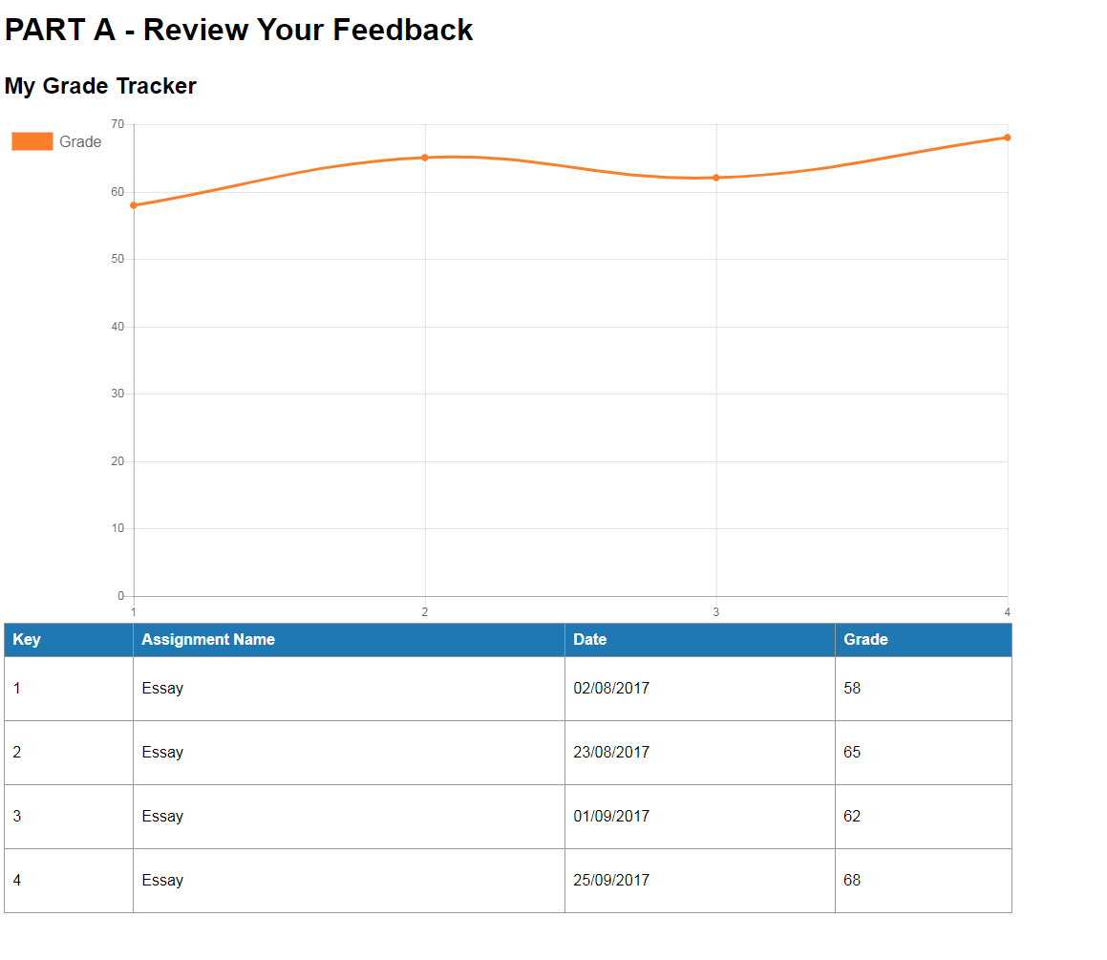
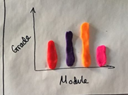
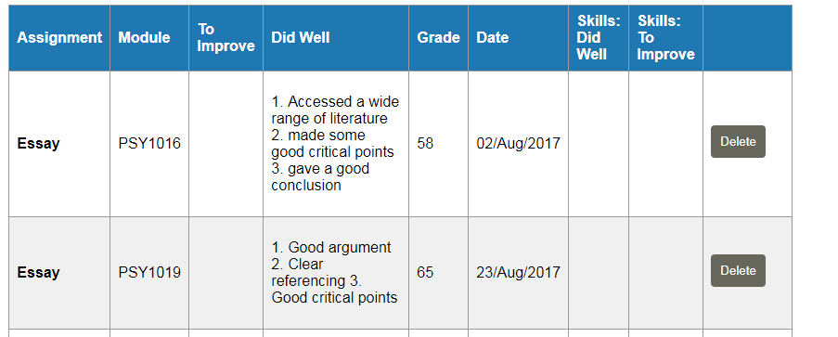
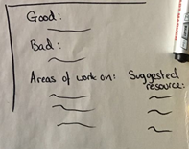
Student co-design

Slide 79


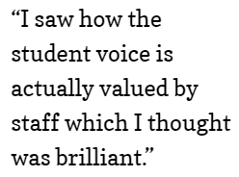

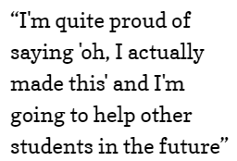
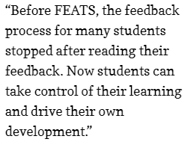
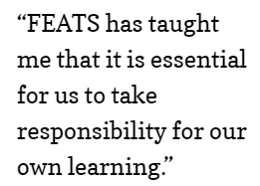

Outcomes

Slide 80
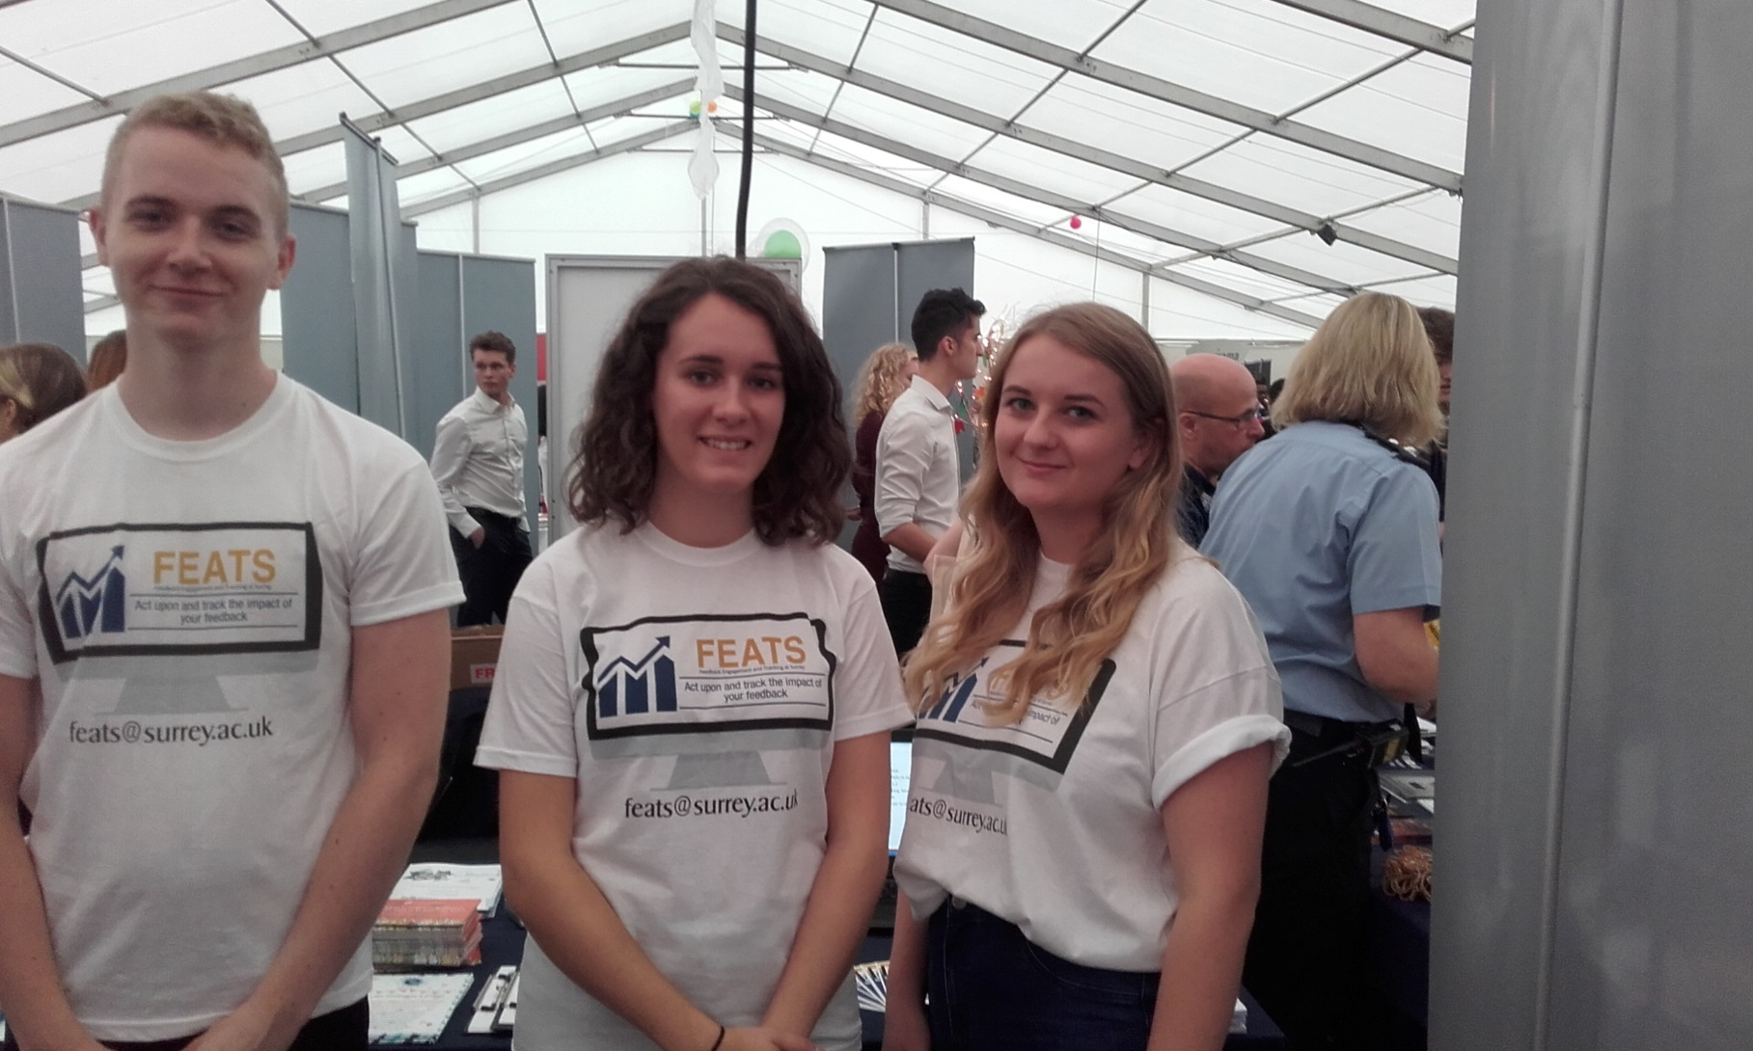
Power through Partnership

Slide 81




Acknowledgements
Collaborators:
Prof David Boud (Deakin University, Australia)
Prof David Carless (University of Hong Kong)
Dr Rob Nash (Aston University)
Dr Emma Medland (University of Surrey)
Roger Rees, Irina Niculescu, Ceri Hitchings (University of Surrey)
Research Assistants:
Mike Parker
James Rowntree
Georgina Mathlin
Emily Papps
Jessica Bourne
Joshua Best

Slide 82
Focus On: Feedback from Assessment
http://enhancementthemes.ac.uk/focus-on
#FocusOnFeedback
Notes:
Welcome Naomi
Naomi is a cognitive psychologist specialising in learning behaviour and engagement with education.
Naomi’s research focuses on the processing and implementation of feedback, educational transitions, and educational identities.
Naomi has extensive experience of academic leadership, having held the positions of Director of Undergraduate Studies and Director of Learning and Teaching in the School of Psychology at the University of Surrey, and Associate Dean (Learning and Teaching) in the Faculty of Health and Medical Sciences at the University of Surrey.
She also runs CPD events and workshops at Universities, Schools and Colleges across the UK, to support educators and students to enhance the impact of assessment and feedback on learning and development. Naomi is a Senior Fellow of the Higher Education Academy, and a National Teaching Fellow.

Slide 83
What do students think and how can we work in partnership?
QAA Scotland Focus On Feedback
Thursday 22nd March 2018
Martina Bradacova, Vice-President, SRUCSA
Simon Varwell, Development Consultant, sparqs

Slide 84
About us
SRUCSA
  Scotland’s Rural College Students’ Association
  www.srucsa.org.uk
sparqs
  Student Partnerships in Quality Scotland
  www.sparqs.ac.uk
Notes:
Usual overview

Slide 85
Outline
What are we learning from SLTA data?
Student views – SRUCSA and beyond
Your ideas

Slide 86
What are we learning from SLTA data?

Slide 87
Student-Led Teaching Awards
Operating in a number of Scottish HEIs.
Qualitative, judged process based on student comments.
Feedback from assessment often a category (appears in comments where it is not, though not as heavily).

Slide 88
What do SLTA comments praise in FfA?
Quality and quantity:
  “the lengthy essay feedback; it feels as though X really cares about our work improving, and has committed herself to giving her students every opportunity for improvement”

Slide 89
What do SLTA comments praise in FfA?
Empathy – recognising the emotional impact:
  “…is fair and honest in her feedback, while also not being overbearing or hurtful in her comments”
  “excellent at providing his feedback in a very soft and polite way, but with a deep critical insight and suggestions, which is very pleasant to read, and which encourage you to use his advice later.”

Slide 90
What do SLTA comments praise in FfA?
Developmental
  “She is especially good at telling you how you can take your work to the next level.”
  “Another example is the lengthy essay feedback; it feels as though X really cares about our work improving, and has committed herself to giving her students every opportunity for improvement.”
  “He prepared practice exam questions… and told us to submit the answers for feedback.”

Slide 91
What do SLTA comments praise in FfA?
Accessible and approachable
  “She was always willing to give extra time to explain things sometimes more slowly or in a different way if I was having difficulty…this is so important as sometimes a student can feel stupid if they do not understand and lessons need to be broken down in a different way.”
  “Making herself readily available to discuss issues or concerns, always responding to emails and requests for meetings.”

Slide 92
What do SLTA comments praise in FfA?
Personal
  “She is especially good at telling you how you can take your work to the next level.”
  “Another example is the lengthy essay feedback; it feels as though X really cares about our work improving, and has committed herself to giving her students every opportunity for improvement.”

Slide 93
What do SLTA comments praise in FfA?
Innovative
  “she sent her students an approximately three minute audio file with verbal feedback to expand on her written comments.”
  “Her feedback template allows students to see where in the grading scheme each point of assessment criteria fell (i.e. first, upper second, etc.) which helps students identify strengths and weaknesses and know how to improve their work. This feedback template is now being used by others in the Management School as a result.”

Slide 94
Other sources of data
NSS questions relating to feedback (10 & 11)
Student Partnership Agreement projects
Course and institutional surveys
Internal monitoring and review activity

Slide 95
Next steps
Analysis of SLTA data by QAA Scotland.
Summary report on SLTAs by sparqs.

Slide 96
Student views – SRUCSA and beyond

Slide 97
Your ideas

Slide 98
5 things students would like staff to do to improve the feedback process
5 things staff would like students to do to improve the feedback process
Feedback from assessment

Slide 99
5 things students would like staff to do to improve the feedback process
5 things staff would like students to do to improve the feedback process
Feedback from assessment
5 key messages for senior management on how they support feedback improvement at the institutional level
5 things that staff and students could do together to improve the feedback process

Slide 100
5 things students would like staff to do to improve the feedback process
5 things staff would like students to do to improve the feedback process
Feedback from assessment
5 key messages for senior management on how they support feedback improvement at the institutional level
5 things that staff and students could do together to improve the feedback process

Slide 101
Conclusions

Slide 102
References and resources
NSS questions
  http://www.thestudentsurvey.com/content/NSS2017_Core_Questionnaire.pdf
sparqs
  http://www.sparqs.ac.uk
SRUCSA
  http://www.srucsa.org.uk

Slide 103
Focus On: Feedback from Assessment
http://enhancementthemes.ac.uk/focus-on
#FocusOnFeedback
Notes:
Welcome Naomi
Naomi is a cognitive psychologist specialising in learning behaviour and engagement with education.
Naomi’s research focuses on the processing and implementation of feedback, educational transitions, and educational identities.
Naomi has extensive experience of academic leadership, having held the positions of Director of Undergraduate Studies and Director of Learning and Teaching in the School of Psychology at the University of Surrey, and Associate Dean (Learning and Teaching) in the Faculty of Health and Medical Sciences at the University of Surrey.
She also runs CPD events and workshops at Universities, Schools and Colleges across the UK, to support educators and students to enhance the impact of assessment and feedback on learning and development. Naomi is a Senior Fellow of the Higher Education Academy, and a National Teaching Fellow.

