Slide 1
Express Yourself:
Striking the right note with audio feedback
Sam Ellis
Senior Lecturer in Academic Development
Wendy Mazzucco
Programme Leader, BA (Hons) Accountancy
Glasgow Caledonian University

Slide 2
Some context
The staff experience
The student experience

Slide 3
Some context
The staff experience
The student experience

Slide 4
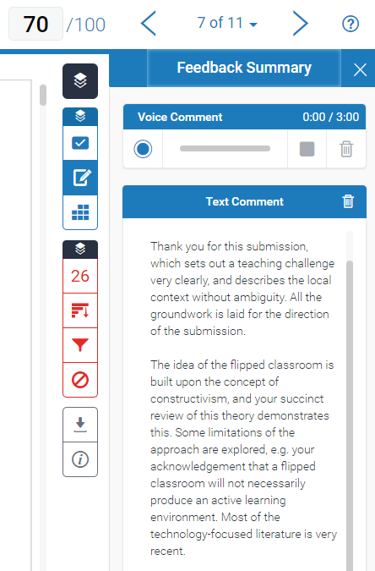

Slide 5
Some context
The staff experience
The student experience

Slide 7
Why do we like it?

Slide 8
HIGH learning pay-off
for students
25
5
16
4
HIGHLY
efficient
for staff
NOT AT ALL
efficient
for staff
5
4
3
2
1
2
4
1
1
LOW learning pay-off
for students

Slide 9
Some context
The staff experience
The student experience

Slide 10
Why do they like it?

Slide 11
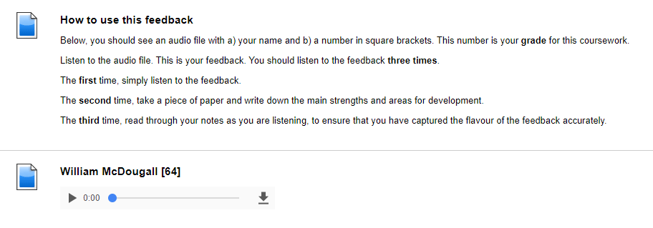

Slide 12
“This was the first time I had personally received audio feedback. I found it a very engaging way to take part in the feedback process. There is certainly a far more personal feel to hearing your voice impart this information as opposed to reading text – what was good about my blog posts, as well as points to consider for the future. I enjoyed this approach very much and will look forward to using this feedback to enhance my future work.”

Slide 13
Discussion

Slide 14
DISCUSSION QUESTION
We’ve just outlined some of the good points, and reasons for using audio feedback. What about the barriers, or the reasons not to use it?

Slide 15
AUDIENCE QUESTION
What’s your experience of audio feedback?

Slide 16
DISCUSSION QUESTION
What is the catalyst for getting started with
audio feedback?

Slide 17
AUDIENCE QUESTION
What’s stopping you from using audio feedback?

Slide 18
DISCUSSION QUESTION
How did we get our colleagues to buy into
the idea of audio feedback?

Slide 19
AUDIENCE QUESTION
What would help you to
start using audio feedback?

Slide 20
DISCUSSION QUESTION
What are the practicalities, both
technical and physical?
What could we do next?

