Slide 1
Engaging students in Institution-led Review
Thursday 19 January 2017
Simon Varwell
Development Consultant

Slide 2
About sparqs
Student Partnerships in Quality Scotland.
Funded by the Scottish Funding Council.
Works with all colleges, universities and students’ associations.
9 core staff, plus a team of part-time student trainers.
Notes:
Usual overview

Slide 3
About sparqs
4 strategic aims:
  Supporting students
  Supporting institutions
  Supporting the sector
  Developing a culture
www.sparqs.ac.uk
Notes:
Usual overview

Slide 4
Engaging students in ILR
Exploring partnership
Current work
Forthcoming challenges

Slide 5
Exploring partnership

Slide 6
Sector context
  Student engagement a key part of:
    Quality Enhancement Framework
    HE Quality Code.
    SFC quality guidance.
Notes:
6

Slide 7
SFC Guidance
  “Student engagement continues as a key principle and as a fundamental dimension of quality.”
    “We also expect, as a separate measure, that each institution-led review process should gather additional specific information from students as part of the evidence base for reviews.”
  “…student representatives should contribute directly to the review of evidence and to the deliberation of institution-led review teams.”
Notes:
7

Slide 8
Sector context
  Student engagement a key part of:
    Quality Enhancement Framework
    HE Quality Code.
    SFC quality guidance.
  Student Engagement Framework for Scotland…
Notes:
8

Slide 9


Slide 10
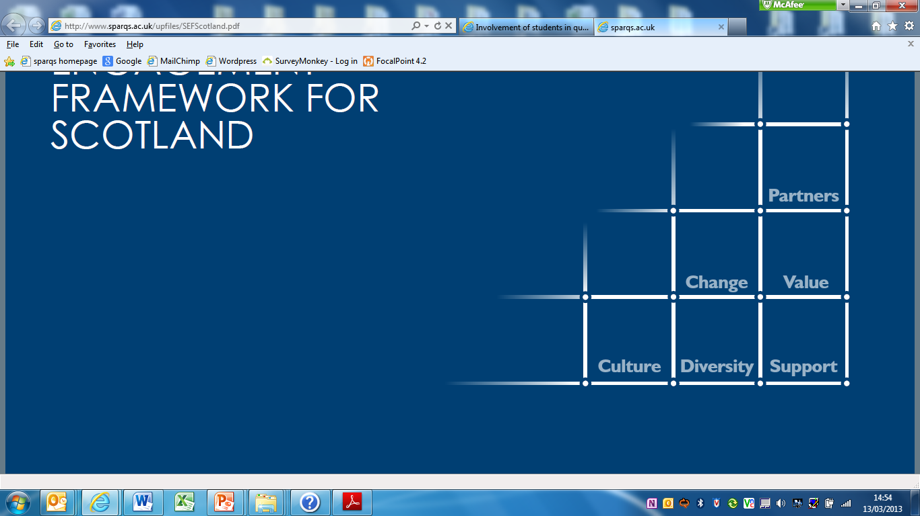

A Student Engagement Framework for Scotland
There are five key elements:
Students feeling part of a supportive institution.
Students engaging in their own learning.
Students working with their institution in shaping the direction of learning.
Formal mechanisms for quality and governance.
Influencing the student experience at national level.
The use of the term ‘learning’ throughout the framework can apply to learning, teaching and assessment.

Slide 11
A Student Engagement Framework for Scotland
There are six features of effective student engagement:
A culture of engagement.
Students as partners.
Responding to diversity.
Valuing the student contribution.
Focus on enhancement and change.
Appropriate resources and support.

Slide 12
A Ladder of Citizen Participation by Sherry R Arnstein (1969)
Citizen power
Citizen control – Citizens fully in charge of planning, policy and management.
Delegated power – Citizens in dominant or veto-wielding positions over certain matters.
Partnership – Shared planning through jointly-owned structures.
------------------------------------------
Placation – Inviting some citizens to participate in structures, but often limited in number and advisory in role.
Consultation – Asking for views, but decision are still made by those in authority.
Informing – A one-way flow of communication about what is happening or has been decided.
------------------------------------------
Therapy – Citizens are educated to cure them of their incorrect views.
Manipulation – Citizens are engineered to support or rubber-stamp existing decisions.
Tokenism
Non-participation

Slide 13
Current work

Slide 14
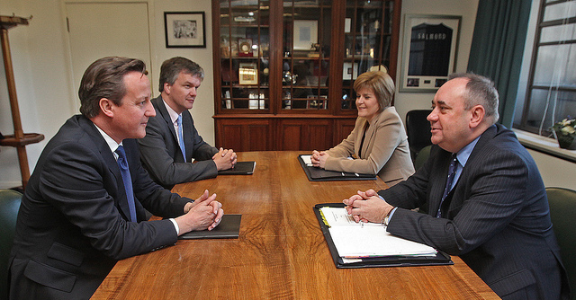
Engaging students on both sides of the table
Notes:
14

Slide 15
Engaging students on both sides of the table
Reviewer
Analyst
Expert
Investigator
Enquirer
Evaluator
Writer
Collaborator
Reviewee
Presenter
Explainer
Researcher
Representative
Service user
Lobbyist
Partner

Slide 16
Engaging students on both sides of the table
Reviewer
Training for student members of review teams (2013)
Reviewee
“Engaging Students in Institution-led Review - a Practice Guide for Universities and Students' Associations” (2016)

Slide 17
Training for student members of review teams
Day-long adaptable session. Covers:
  Explanation of ILR.
  Interpretation of documentation.
  Skills development.
  Practice review panel meeting.
  Simulation of meeting with staff.
Scope to be updated.

Slide 18
Practice Guide
Published May 2016.
Developed in conjunction with The Robert Gordon University:
  Student-Facing Review of IT resources (2015)
  Institution-led Subject Review of Gray’s School of Art (2016).
Case studies from other universities.

Slide 19
Practice Guide
Covers subject, thematic and service area reviews.
Aimed at quality teams and SAs, and those preparing for reviews.
Focuses on engaging students before, during and after…

Slide 20
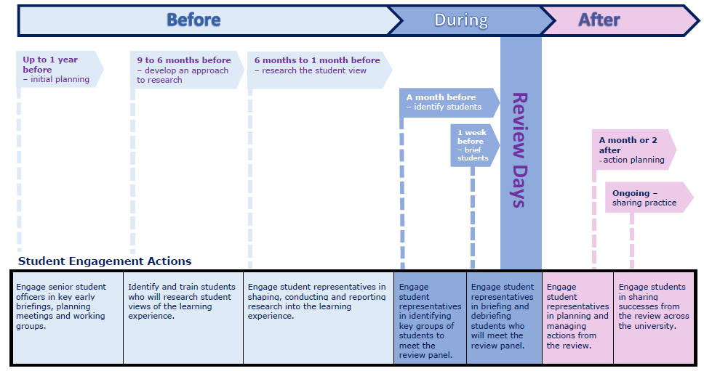
Suggested timeline

Slide 21
Practice Guide - before
Key role for SA and school reps as co-owners of the process.
Course reps and other students as researchers.
All students as reflectors on and contributors of experiences.

Slide 22
Practice Guide - before
Students as researchers:
  Fits naturally into existing rep or research roles.
  Creates autonomous space and encourages honesty.
  Frees up management!
  Practice guide contains template for briefing and training.

Slide 23
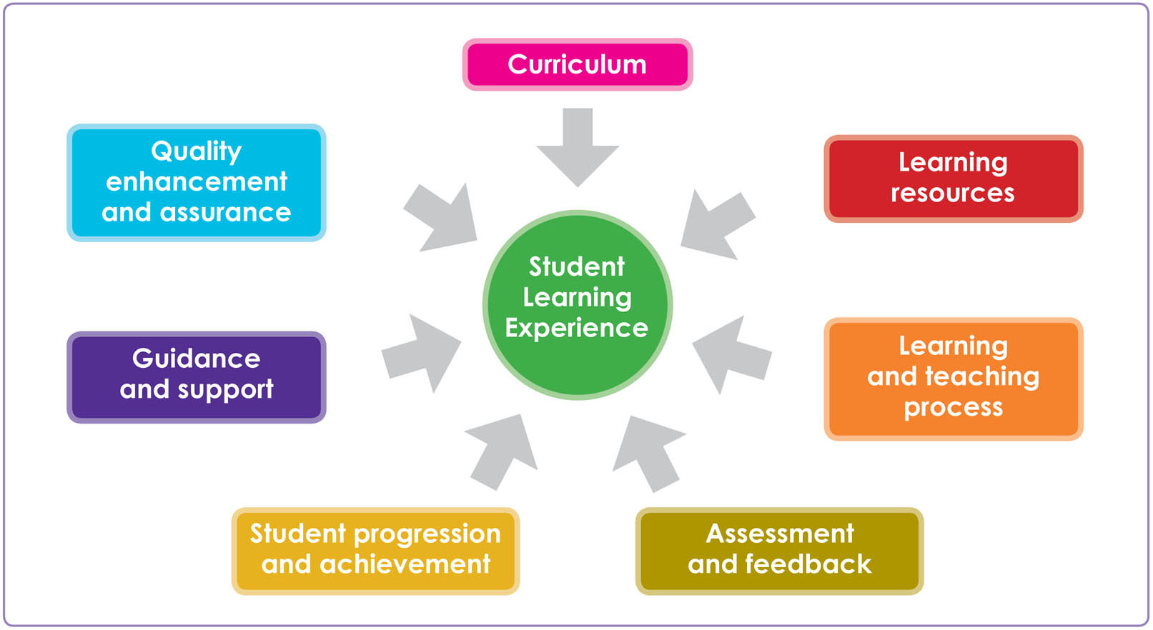
Student Learning Experience

Slide 25
Practice Guide - during
Research informs panel engagement.
Role of campaigning societies.
Engagement of distance learners.

Slide 26
Practice Guide - after
Key role for course and school reps:
  Celebrating successes.
  Responding to action points.
Key role for students’ association:
  Wider trends and policy implications.
  Sharing across the institution.

Slide 27
Forthcoming challenges

Slide 28
Forthcoming challenges
Revising our training materials and guidance:
  Your new case studies or materials.
  Your experiences of using them.
  Your requests for help or support.

Slide 29
Forthcoming challenges
Approaches to student engagement in ILR:
  Defining, recruiting and supporting student reviewers.
  SA as partners in shaping ILR process.
  Links with Student Partnership Agreements.
Support for other reviewers (especially externals).
Broader conversations about student expert networking.

Slide 30
And finally…
  “We require institutions to develop and deploy mechanisms to directly involve students in processes of institution-led quality… and to continue to build on these foundations, further embedding and extending student engagement and participation in quality.”
  SFC Guidance
Notes:
30

Slide 31
References and resources

Slide 32
References and resources
sparqs’ ILR resources, including training and guide:
http://www.sparqs.ac.uk/institute.php?page=289
SFC Guidance:
http://www.sfc.ac.uk/guidance/qualityassurance/quality_scotlands_universities.aspx
Quality Enhancement Framework:
http://www.qaa.ac.uk/about-us/scotland/development-and-enhancement
UK Quality Code:
http://www.qaa.ac.uk/assuring-standards-and-quality/the-quality-code
A Ladder of Citizen Participation, Sherry Arnstein, 1969:
http://lithgow-schmidt.dk/sherry-arnstein/ladder-of-citizen-participation.html
A Student Engagement Framework for Scotland: http://www.sparqs.ac.uk/upfiles/SEFScotland.pdf
sparqs’ Resource Library:
http://www.sparqs.ac.uk/resources.php
sparqs’ Student Learning Experience:
http://www.sparqs.ac.uk/resource-item.php?item=205
sparqs’ Student Partnership Agreement guidance: http://www.sparqs.ac.uk/institute.php?page=128
My contact details:
http://www.sparqs.ac.uk/staff.php

Slide 33
Engaging students in Institution-led Review
Thursday 19 January 2017
Simon Varwell
Development Consultant

